Slide 1
FlowTracker Bias Caused by Flow Disturbance
David S. Mueller
Office of Surface Water
U.S. Geological Survey
The use of trade or brand names does not imply endorsement by the USGS

Slide 2
Overview
FlowTracker sample volume
Potential problem
USGS tow tank tests
USGS numerical model simulations
Comparison of simulation to lab results
Effect of flow angles
Effect of hydrographer
Proposed solution
Conclusions
Best practices

Slide 3
FlowTracker – How it Works
2-D most common the field
Transmit transducer in center
Receive transducers on arms
Provides a point (small sample volume) velocity
Sample volume 0.7 cm long and 0.7 cm in diameter centered at 11.3 cm from center transducer
Attached to wading rod.
11.3 cm
Flow here must
be undisturbed.

Slide 4
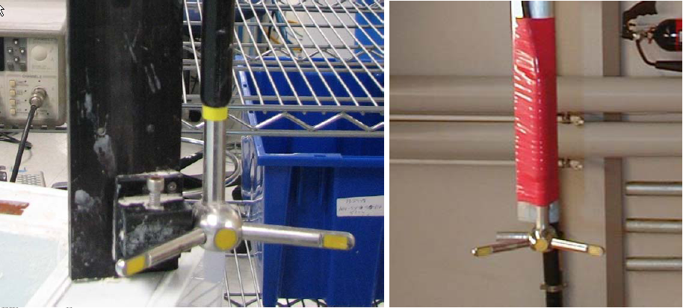
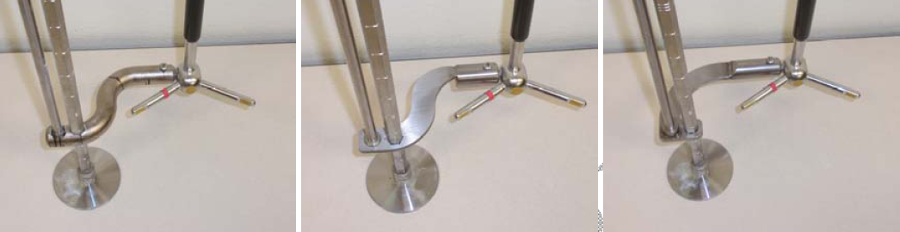
Potential Problem
Tow-tank tests in Switzerland (BAFU) and at SonTek’s facility in San Diego showed a bias caused by flow disturbance
The tow tank mounting bracket can have a significant effect on the flow in the sample volume
Using the probe only with a calibration or streamlined mount, verified SonTek’s calibration
Using a wading rod with Offset Bracket produced a negative bias

Slide 5
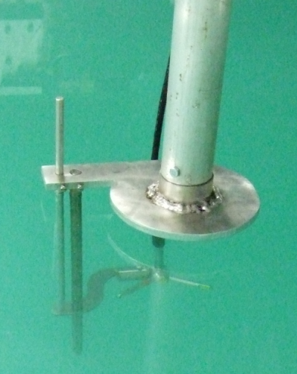
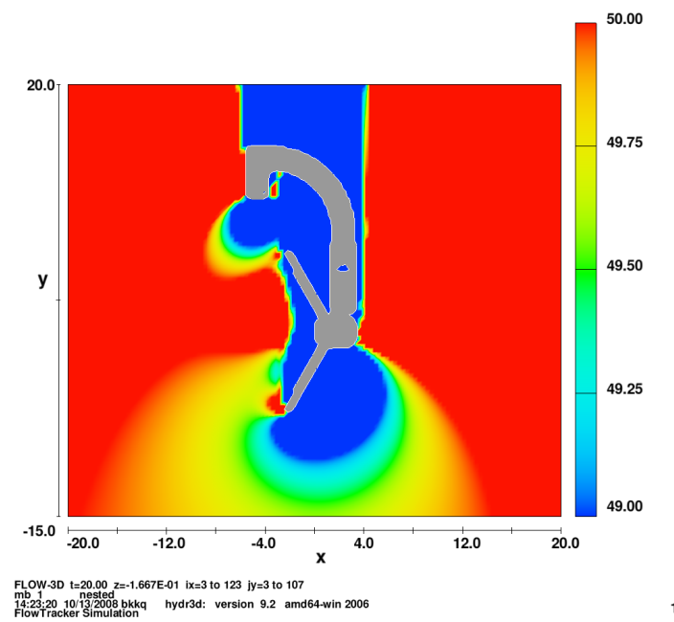
Office of Surface Water Action
Completed tests using tow tank and jet tank at HIF
  Evaluated effect of flow angle
  Evaluate bias in flowing water
Initiated simulations using Flow-3D
  Compared numerical simulations with tow-tank
  Evaluate difference between tow-tank results and flowing water

Slide 6
HIF Tow Tank – Aligned Flow
Comparison to Cart Speed
Difference from HIF Mount
*
*
HIF mount is used in the tow tank testing only and should minimize flow disturbance.
 | J-Bracket | Flat S | Round S
Mean > 0.5 fps | -1.560 | -1.596 | -1.662

Slide 7
Numerical Model
Assume:
  Uniform velocity distribution
  Infinite domain
Sensitivity simulations:
  Domain size to remove effect of boundaries
  Cell size
  Number of blocks
  Turbulence length parameter (TLEN)
Evaluation criteria
  Percent difference from ambient velocity along centerline of center transducer at 11.3 cm

Slide 8
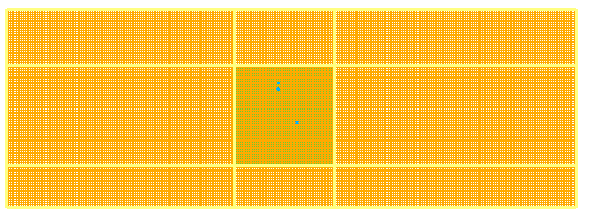
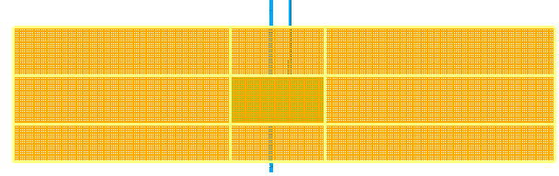
Flowing-Water Model
Two nested blocks
Inner block
  X (cross stream): -20 x 15 cm
  Y (streamwise): -15 x 20 cm
  Z (vertical): -6 x 12 cm
  Cell size: 0.25 cm
Outer block
  X (cross stream): -100 x 100 cm
  Y (streamwise): -30 x 40 cm
  Z (vertical): -20 x 30 cm
  Cell size: 1 cm
FlowTracker
  STL from manufacturer
  Center of center transducer (0, 0, 0)
Water surface
  Initial simulations with fixed surface
  Later simulations with free surface
Turbulence
  TLEN=0.2
Data extracted
  Y: +/- 0.375 cm
  Z: +/- 0.375 cm
  X: 0 to 15 cm

Slide 9
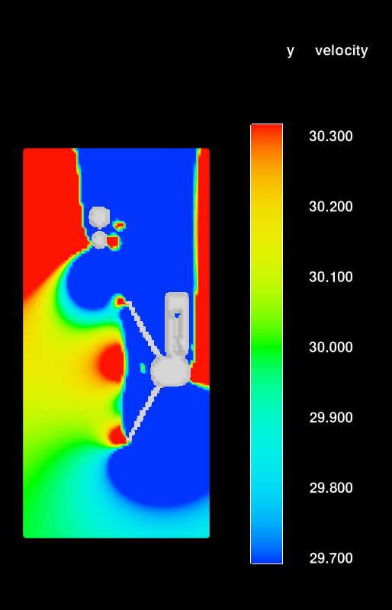
Results Didn’t Match
Tow tank tests showed a 1-1.5% negative bias
Flowing water simulations showed a positive bias of about 0.5%
If the model does match verification data ALWAYS make sure you are modeling the same conditions!!!

Slide 10
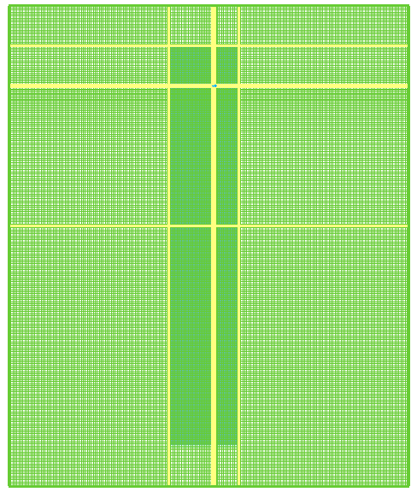
Tow Tank Model
Two nested blocks
Inner block
  X (cross stream): -20 x 15 cm
  Y (streamwise): -180 x 20 cm
  Z (vertical): -6 x 12 cm
  Cell size: 0.25 cm
Outer block
  X (cross stream): -100 x 100 cm
  Y (streamwise): -200 x 40 cm
  Z (vertical): -20 x 30 cm
  Cell size: 1 cm
FlowTracker
  STL from manufacturer
  Center of center transducer (0, 0, 0)
  GMO model used to move at fixed velocity
Water surface
  Initial simulations with fixed surface
  Later simulations with free surface
Data extracted
  Y: f(t)
  Z: +/- 0.375 cm
  X: 0 to 15 cm

Slide 11
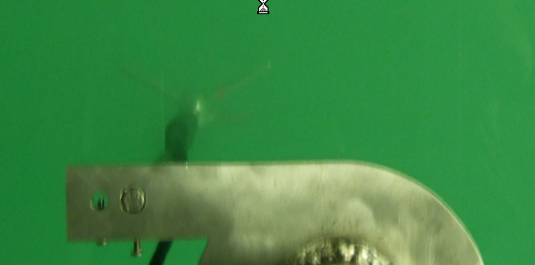
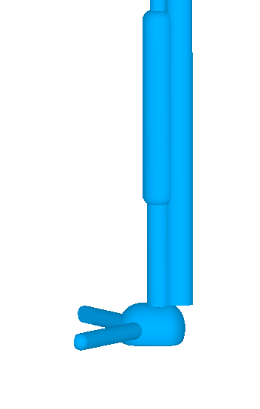
FlowTracker Calibration
Factory calibrated in small tow tank at a speed of 18 cm/s with a custom mount
Calibration for flow disturbance evaluation:
  In USGS tow tank at desired speed
  Simple mount directly to round rod
  Used to compare with wading rod and offset

Slide 12
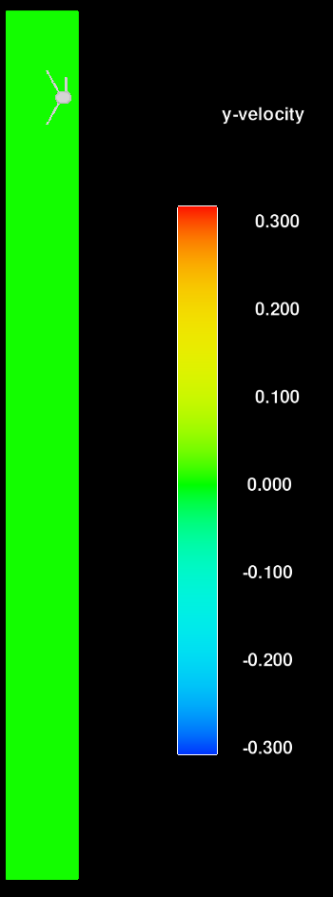
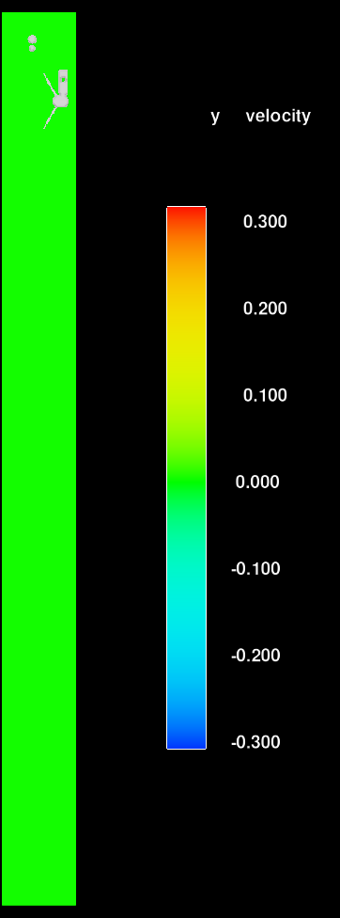
HIF Calibration Mount
Wading Rod with
J-Bracket

Slide 13
2D Probe Tow Tank Simulations
Cart Speed: 30 cm/s
Free Surface
Fixed Surface
Mount | HIF * | Free Surf. | Fixed Surf
HIF Mount | 0.08 | 1.09 | 0.76
J-Bracket | -1.30 | -0.41 | -0.48
Difference | -1.38 | -1.50 | -1.24
*FlowTracker calibrated by manufacturer

Slide 14
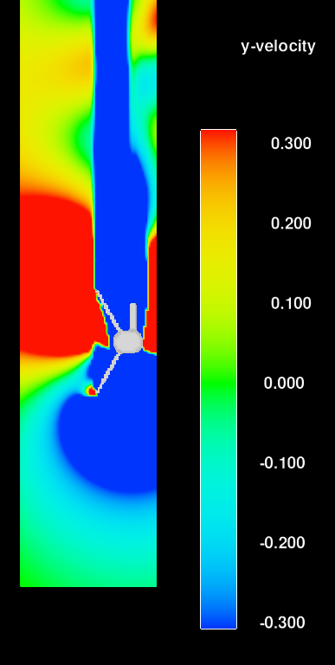
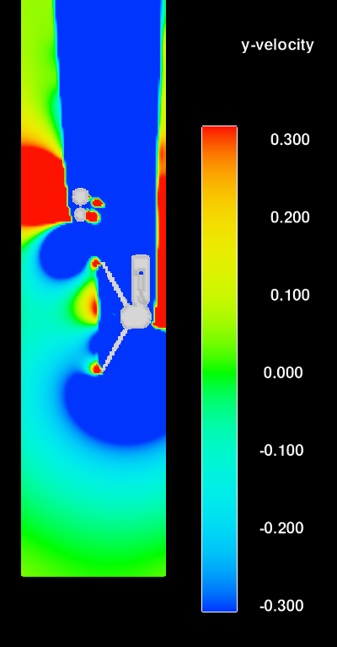
Simulation Comparisons
Tow Tank
HIF Calibration Mount
Tow Tank
Wading Rod and J-Bracket
Flowing Water with
Wading Rod and J-Bracket
%
Deviation
%
Deviation
%
Deviation
1.0
1.0
1.0
0.67
0.67
0.67
0.33
0.33
0.33
0.0
0.0
0.0
-0.33
-0.33
-0.33
-0.67
-0.67
-0.67
-1.0
-1.0
-1.0

Slide 15
Jet Tank (Aligned)
Error bars represent 2*StdDev
0.8
1.3

Slide 16
Simulated Error for 2D Probe with Flowing Water (30 cm/s)
Free Surface
Fixed Surface
Mount | HIF Jet ~ 1 ft/s | Free Surf. | Fixed Surf
HIF | -- | 1.09 | 0.76
J-Bracket | -0.75* (-0.69) | 0.47 | 0.43
Difference | -0.75 (-0.69) | -0.62 | -0.33
*Standard deviation about mean: 0.23

Slide 17
Tow Tank Effect
Still Water Moving Instrument
Mount | HIF * | Free Surf. | Fixed Surf
HIF Mount | 0.08 | 1.09 | 0.76
J-Bracket | -1.30 | -0.41 | -0.48
Difference | -1.38 | -1.50 | -1.24
*FlowTracker calibrated by manufacturer
Moving Water Still Instrument
Mount | HIF Jet ~ 1 ft/s | Free Surf. | Fixed Surf
HIF | -- | 1.09 | 0.76
J-Bracket | -0.75 (-0.69) | 0.47 | 0.43
Difference | -0.75 (-0.69) | -0.62 | -0.33

Slide 18
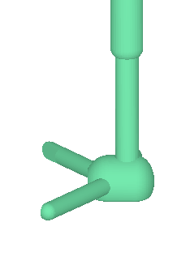
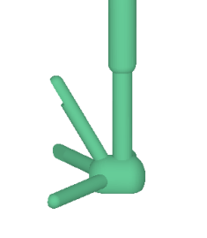
Comparison of 2D and 2D/3D Probes

Slide 19
Simulations
Aligned, Varying Velocity
Actual Water Speed (cm/s)

Slide 20
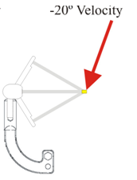
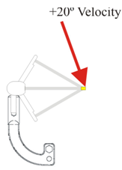
Simulations
Varying Angle, Varying Velocity
Results adjusted for 1.09% tow tank calibration

Slide 21
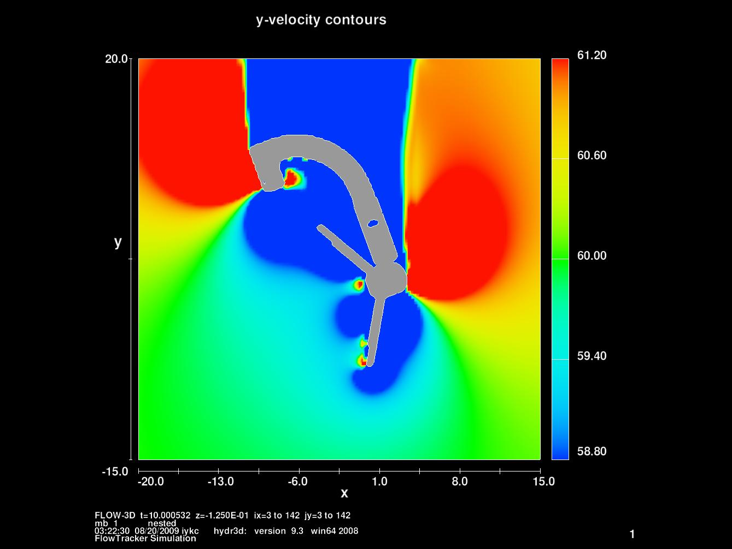
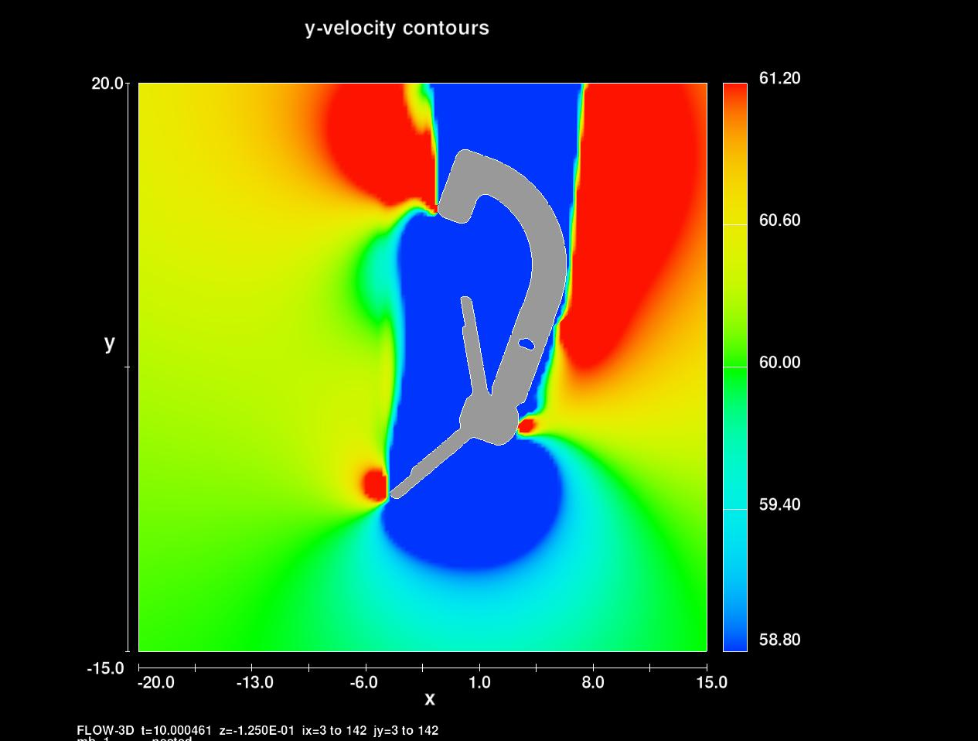
Y-Velocity Contours
-20 degrees
+20 degrees
-20.0
61.2
-20.0
61.2
60.6
60.6
Y-VELOCITY (cm/s)
Y-VELOCITY (cm/s)
60.0
60.0
59.4
59.4
-15.0
58.8
-15.0
58.8
-20.0
-13.0
-6.0
1.0
8.0
15.0
-20.0
-13.0
-6.0
1.0
8.0
15.0
Approximate Sample Volume

Slide 22
Comparison to Tow Tank

Slide 23
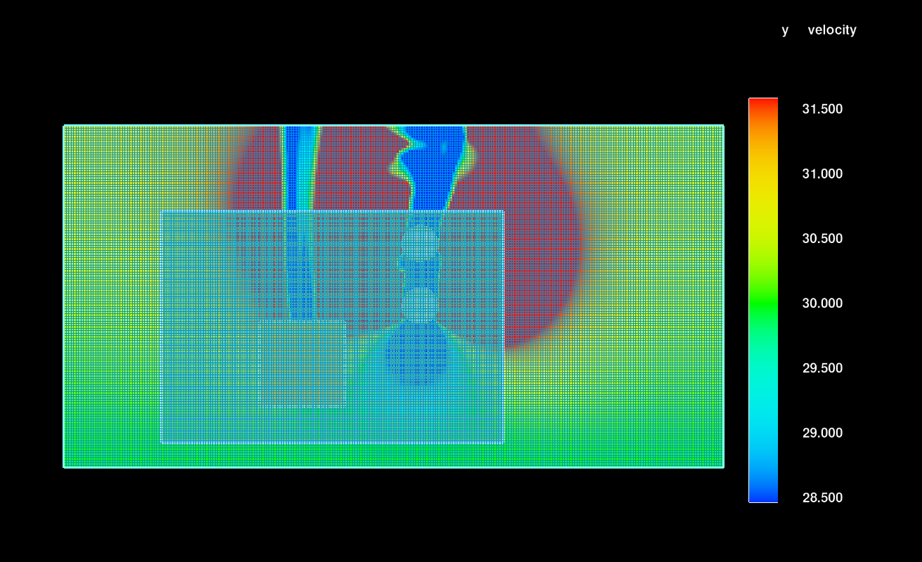
Legs Model
Three nested blocks
Inner block
  X (cross stream): -20 x 15 cm
  Y (streamwise): -15 x 20 cm
  Z (vertical): -6 x 12 cm
  Cell size: 0.25 cm
Second block
  X (cross stream): -60 x 80 cm
  Y (streamwise): -30 x 65 cm
  Z (vertical): -15 x 20 cm
  Cell size: 0.6 cm
Outer block
  X (cross stream): -100 x 170 cm
  Y (streamwise): -40 x 100 cm
  Z (vertical): -20 x 30 cm
  Cell size: 1 cm
FlowTracker
  STL from manufacturer
  Center of center transducer (0, 0, 0)
Legs
  Two 15 cm diameter cylinders
  Aligned with flow
  46 cm to side of rod
  10 cm downstream from front o rod
Water surface
  Later simulations with free surface
Data extracted
  Y: +/- 0.375 cm
  Z: +/- 0.375 cm
  X: 0 to 15 cm
Leg positions based on recommended hydrographer location from Rantz and others (1982) and Pierce (1941)

Slide 24
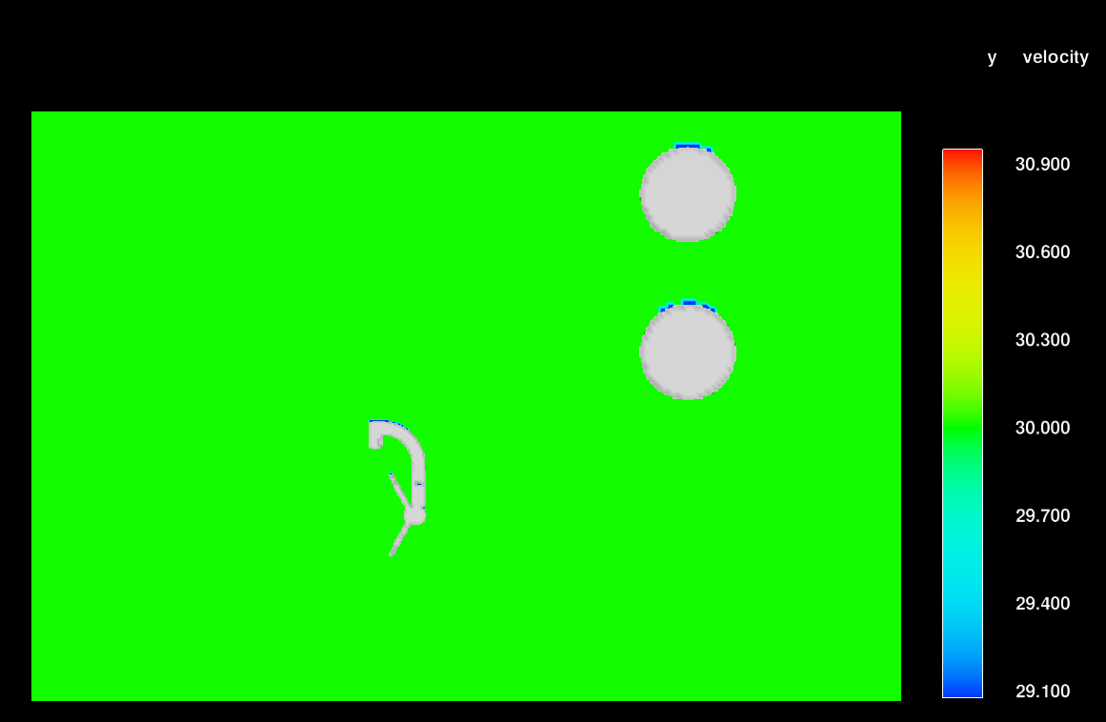
Extended Simulation Time

Slide 25
Effect of Hydrographer (30 cm/s)
Mount | % Dev | %Dev
HIF | 1.09 | 1.09
J-Bracket | 0.47
Hydrographer |  | 1.82
Difference | -0.62 | 0.73

Slide 26
Conclusions from Model Results
Flow-3D proved to be a valuable tool for investigating this problem
The FlowTracker disturbs the flow in its sample volume
The orientation, type of probe, and type of mount all affect the magnitude of the flow disturbance
Because the FlowTracker disturbs its sample volume tow tank calibrations/tests do not exactly represent turbulent flowing water conditions.
Within +/- 10 deg the results are within 1% (manufacturer spec).
The position of the hydrographer in the stream has a significant effect on the flow disturbance.

Slide 27
SonTek’s Solution
Observed bias is due to flow disturbance caused by mount and/or wading rod
Average observed bias is 1.2% for probes aligned with flow
Firmware upgrade will provide option to apply a user specified correction to measured velocities, if wading rod is selected as deployment method.
Correction can be applied or removed in both the handheld and post processing software.
Correction does not vary with flow angle.

Slide 28
Best Practices
Hydrographer should take care to position themselves to minimize flow disturbance while collecting data.
Select sections with aligned flow to minimize angles
Rehmel 2007 showed average difference of 0.1% for 55 field comparisons.
Currently no correction to the FlowTracker measurements are recommended

Slide 29
