Slide 1
Summary of GPS Testing
(GGA and VTG)
Chad Wagner and David Mueller
Office of Surface Water

Slide 2
Overview
Background – why do we need GPS?
Scope of GPS analysis
Integration of GPS and ADCPs
  GGA vs VTG
Description of data
Data analysis methods
Results
  Discharge comparisons
  Evaluation of differential correction sources
Summary

Slide 3
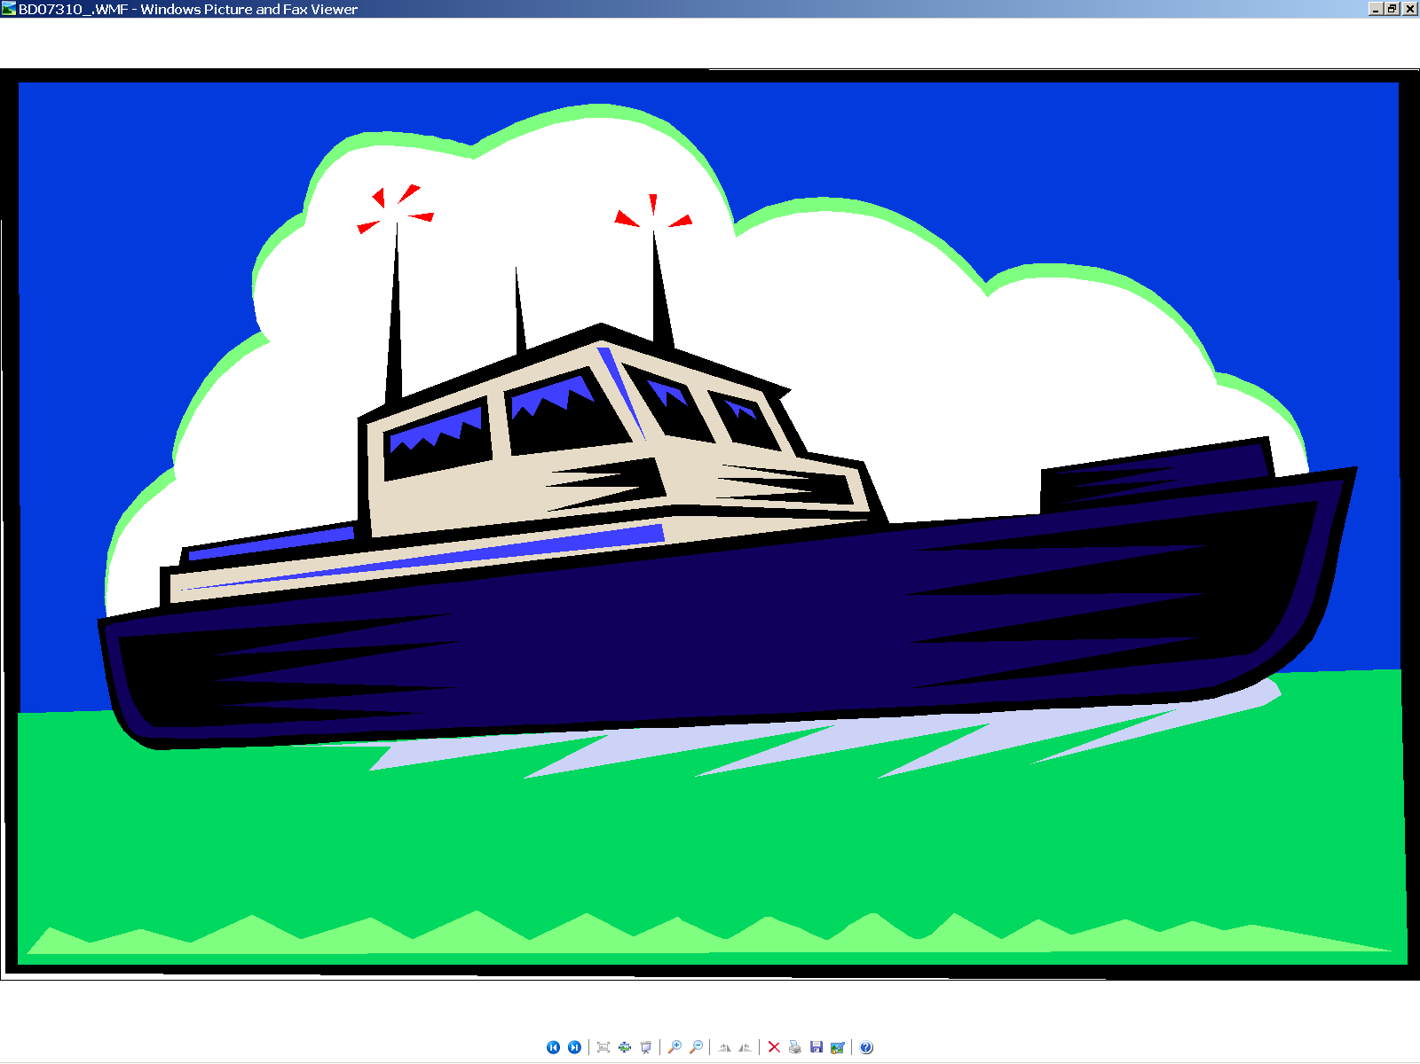
Background
ADCP Measured Velocity
The faster the boat travels,
the faster the velocity of the water relative to the ADCP.
Notes:
The water velocity measured by an ADCP deployed on a moving boat is the velocity of the water passing by the ADCP, which we will refer to as the relative water velocity (it is relative to the instrument). This relative water velocity includes the velocity of both the boat and water. Therefore, as the boat moves faster, the relative water velocity measured by the ADCP increases. Since we are interested in the actual water velocity referenced to a fixed location, the velocity of the boat must be measured and removed from the relative water velocity measured by the ADCP.

Slide 4
Background
Bottom Tracking
Boat velocity or bottom-tracking measurements are similar to the water-velocity measurements
Bottom-tracking pulses are sent separate from the water measurement pulses
Bottom tracking also measures water depths for discharge computations
Notes:
The velocity (speed and direction ) of the boat can be measured by the ADCP using a technique called bottom tracking. Bottom-tracking like water tracking is based on the Doppler-shift, except bottom-tracking measures the Doppler shift of the acoustic pulses reflected from the streambed. Assuming the streambed is not moving, the measured Doppler shift is directly related to the velocity of the boat. The measured depth to the streambed is also derived from these bottom tracking pulses.

Slide 5
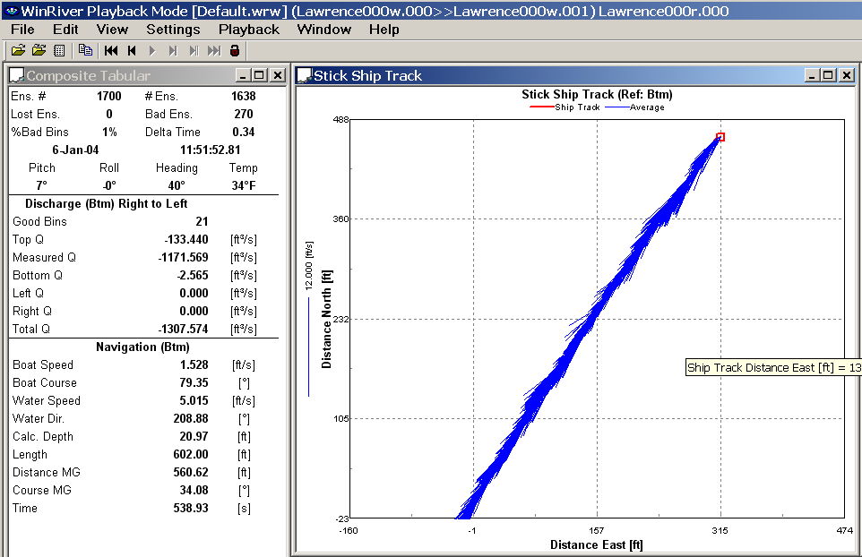
Background
Example of a Moving Bed
Notes:
The key assumption in using bottom tracking to measure the velocity of the boat, is that the streambed is stationary. However, streams transport sediment and other material both in suspension and as bed load rolling and saltating along the bottom of the stream. This transport of material can cause the bottom tracking algorithms to measure (at least partially) the velocity of the transported material, in addition to the velocity of the boat. When this happens and instrument held stationary would appear to be moving upstream.
This screen capture of the stick ship track from a TRDI ADCP illustrates the measured movement of the boat. The blue sticks represent the water velocity vectors and the small red square represents the boat. The boat was held in a stationary position, but because the bottom tracking was affected by transport of material along or near the streambed, the ADCP perceives an upstream movement of the boat which is reflected in the ship track. This conditions is referred to as a moving bed.

Slide 6
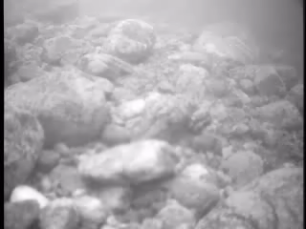
Background
Cause of a Moving Bed
Transport of material (sediment or other organic material) along the streambed usually by rolling or saltation.
Notes:
One possible cause of a moving bed is the transport of material (sediment or other organic material) along the streambed. This is often referred to as bed load. Material transported in this manner typically rolls or saltates along the streambed as illustrated in the video.

Slide 7
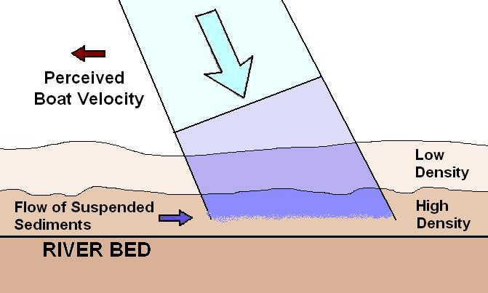

Background
What Causes the Moving Bed Bias
Environment Canada
Notes:
Sediment and other organic material can also be transported in suspension with limited contact with the streambed. Typically the concentration of suspended material increases from the water-surface to the streambed. The suspended material near the streambed and within the acoustic pulse of the bottom tracking [CLICK] will generate a Doppler-shift in addition to the Doppler-shift generated from the streambed. If the acoustic signal with the resulting Doppler shift reflected from the suspended material within the bottom tracking acoustic pulses is strong enough, the bottom tracking measurements will be affected and the measured boat velocity will be biased in the opposite direction of the velocity of the suspended material, resulting in a moving bed. This cause for a moving bed is called a water bias. Theoretically a moving bed could be caused by water bias in a concrete lined channel if there were sufficient suspended material being transported.
Water bias may affect both measured boat velocity and depth.
The higher the concentration of suspended material the more dense the water-material mixture. The more dense the water-material mixture the greater the amplitude of the reflected acoustic energy. If the density is great enough, the reflected acoustic energy from the suspended material may become strong enough to be confused with the reflected acoustic energy from the streambed causing the depth to be measured to this dense layer of suspended material rather than to the stable streambed. Therefore, the measured depth is less than it should be.
Under these conditions, alternatives should be used to properly reference the data. We will discuss several methods in this course for dealing with the bias in the boat and water velocity. For the depth, the use of a lower-frequency depth sounder is the only good option and this option will require the use of a GPS to measure the boat and instrument velocity.

Slide 8
Background
Why do we need GPS?
Discharges measured using vessel-mounted ADCPs may be biased by bedload transport; this bias is referred to as a moving-bed error.
The moving bed bias introduces an apparent upstream boat velocity, which reduces the calculated downstream water velocity and the corresponding discharge will be biased low.
The integration of a GPS to measure the velocity of the ADCP has been shown to alleviate the systematic errors associated with a moving bed.

Slide 9
Overview
Background – why do we need GPS?
Scope of GPS analysis
Integration of GPS and ADCPs
  GGA vs VTG
Description of data
Data analysis methods
Results
  Discharge comparisons
  Evaluation of differential correction sources
Summary

Slide 10
Scope of Analysis
The purpose of the analysis is to quantify the bias and random noise associated with GPS-based ADCP discharge measurements relative to bottom-track based discharge measurements;
Sites that did not have a moving-bed condition at the time of measurement were used in the analysis.
The GPS equipment utilized in the analysis was limited to GPS receivers with the capability of providing sub-meter positional accuracy, and does not include Real-time Kinematic (RTK) GPS units.
The analysis is based on 63 bottom-track and GPS-referenced discharge measurements comprised of 579 individual discharge measurement transects collected at 42 different sites across the US, Canada and New Zealand between 2002 and 2007.

Slide 11
Overview
Background – why do we need GPS?
Scope of GPS analysis
Integration of GPS and ADCPs
  GGA vs VTG
Description of data
Data analysis methods
Results
  Discharge comparisons
  Evaluation of differential correction sources
Summary

Slide 12

Computation of Discharge
To compute the discharge, only the angle between the water-velocity and the boat velocity vectors is needed.
where
  Q is the total discharge;
  T is the total time for which data were collected;
  D is the total depth;
  V_{f} is the mean water-velocity vector;
  V_{b} is the mean boat-velocity vector;
  θ is the angle between the water-velocity vector
  and the boat-tracking vector;
  dz is the vertical differential depth; and
  dt is differential time.
True
North
Magnetic
North
Orientation
of Instrument
Bottom-Tracking
Vector
Water-Velocity
Vector
Water-Tracking
Vector
Notes:
This is the basic equation for computing measured discharge (exclusive of unmeasured areas) by use of an ADCP mounted onto a moving boat.
To compute the discharge, only the angle between the water-velocity vector and bottom-tracking vector is needed.
When bottom tracking is used, computing the theta angle is a simple exercise because the water-tracking vector and bottom-tracking vector are both referenced to the instrument.
However, when using a GPS as the boat velocity reference, determining theta is a more complex problem.

Slide 13
Why is the compass important?
True
North
Magnetic
North
True
North
Magnetic
North
Orientation
of Instrument
Orientation
of Instrument
Boat Vector
from bottom track
Boat Vector
From DGPS
ADCP Vector
ADCP Vector
Bottom Tracking
DGPS
Notes:
As we mentioned in the last slide, when bottom tracking is used, the direction of the relative water-velocity vector (WT) and the boat velocity vector (BT) are referenced to the instrument.
When GPS is used to determine the boat-velocity vector, the boat velocity vector is referenced to true north by use of the GPS, while the water-tracking vector is still referenced to the instrument. The orientation of the instrument relative to true north must be determined to put the boat-velocity vector and the relative water-velocity vector in the same orientation reference system.
The compass is used to determine the orientation of the instrument referenced to magnetic north (θ_{Inst}) and then the magnetic variation (θ_{Mag} ) is required to transfer the instrument orientation to a True North reference.

Slide 14
Two Compass Concerns
True
North
Magnetic
North
Orientation
of Instrument
Magnetic variation
Boat Vector
From DGPS
Actual compass reading
ADCP Vector
DGPS
Notes:
When bottom track is used for the boat velocity reference compass errors will cause a rotational error in the measured water velocity, but the magnitude of the velocity is unaffected and therefore the compass has no effect on discharge measured using bottom track as the boat velocity reference. However, when an external boat velocity reference such as GPS is used, the effect of the compass is significant. Compass errors (which impact the the measurement of the instrument orientation referenced to magnetic north) and the magnetic variation ( θ_{Mag} ) must be accounted for when using GPS as the boat velocity reference.
The errors associated with the compass measurements, horizontal accelerations and environmental conditions near the instrument, both need to be accounted for when measuring velocity and/or discharge using GPS as the boat velocity reference. It is also important to note that compass errors can cause errors in the measured discharge that are proportional to the speed of the boat.
The magnetic variation or declination at any point on the Earth is the angle between the local magnetic field – which is the direction the north end of a compass points -- and true north. The declination is positive when the magnetic north is east of true north and negative when magnetic north is west of true north. Magnetic declination varies both from place to place, and with the passage of time. The magnetic declination in a given area will change slowly over time, possibly as much as 2-25 degrees every 100 years or so, depending upon how far from the magnetic poles it is.
Therefore, proper setup and calibration of the ADCP’s internal compass, a slow boat speed, and determination of the local magnetic variation are critical to discharge measurements made using GPS as the boat-velocity reference.

Slide 15
Integration of GPS and ADCP
Differences between bottom track and GPS referenced discharges can be attributed to either the quality of the GPS data or the accuracy of the ADCP heading measurement as referenced to true north (compass calibration and magnetic variation).
The impact of compass errors on the GPS accuracy was not specifically evaluated in this analysis.

Slide 16
GGA
Provides position information but no velocity information
Velocity is computed in WinRiver or RiverSurveyor from two consecutive GGA sentences by computing the distance traveled and dividing by the time between the sentences
Requires differential correction for acceptable accuracy
Affected by multipath errors
Notes:
The GGA sentence provides geographic position information determined by the Global Positioning System. The position data includes the time, latitude, longitude, and information about the satellite constellation used to reach the position solution. Velocity is computed in WinRiver and RiverSurveyor from two consecutive positional solutions by dividing distance traveled by time. To achieve the accuracy required for use with an ADCP, a differential correction must be applied when using the GGA data string. Multipath errors are a major concern when using the GGA sentence and can limit the applicability of GPS as a boat reference at locations near bridges and/or buildings, with dense tree cover or in canyons.

Slide 17
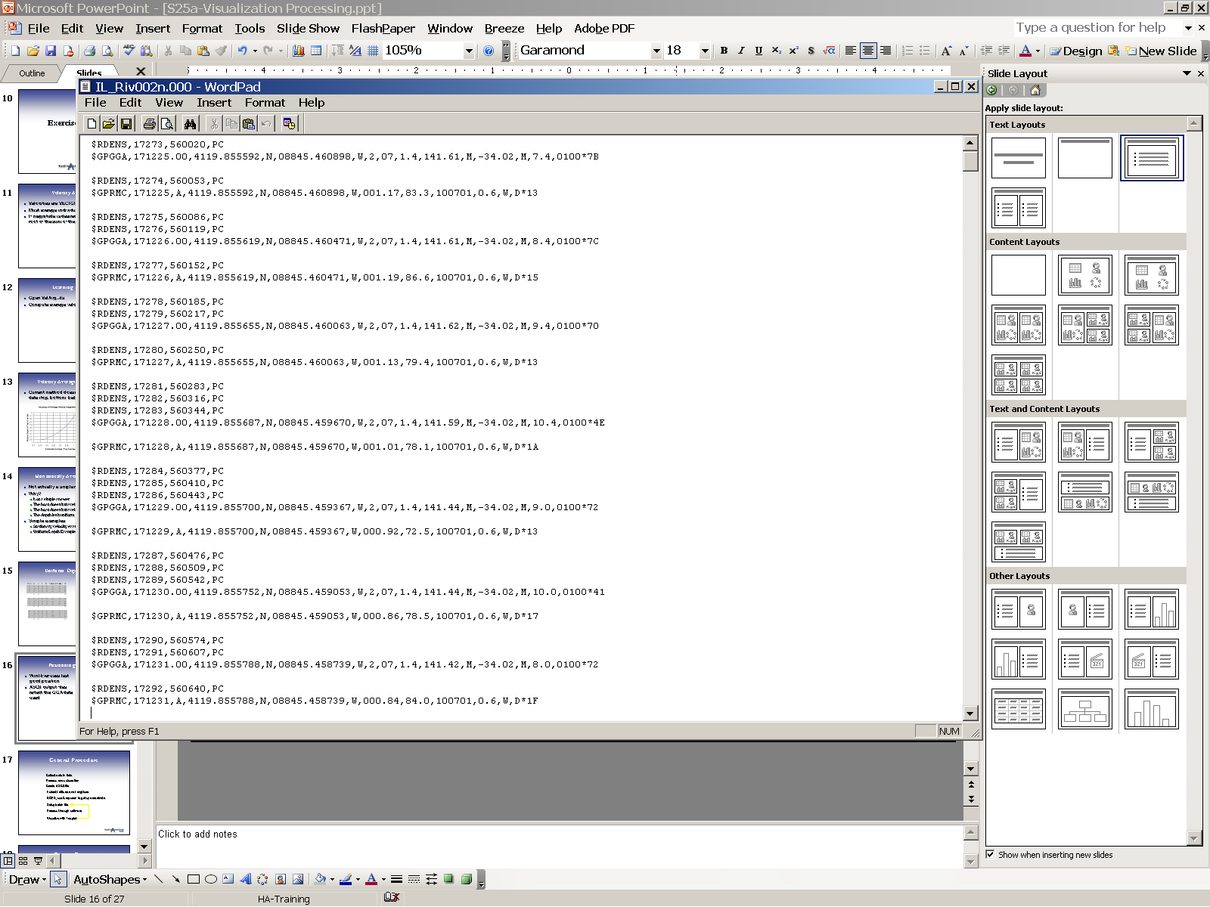
GGA Sentence
GPS Quality Indicator
0 – invalid fix
1 – nondifferential fix
2 – differential fix
See receiver manual for other codes
Age of differential correction
Latitude
DDMM.MMMMMM
Geoidal Separation
Check Sum
Latitude
Direction
MSL Reference
Longitude
Direction
HDOP
Meters
Meters
Sentence ID
Base Station ID
UTC Time
HHMMSS.SS
Longitude
DDMM.MMMMMM
Number of Satellites
Notes:
Here is a detailed summary of the data contained in the GGA sentences

Slide 18
VTG
Provides velocity only, not position
Based on Doppler-shift from the satellite signals to the receiver (typically)
Not affected by multipath errors
Does not require differential correction
Beware of how the receiver handles low velocities
Beware of how the receiver handles loss of satellite coverage
Notes:
The VTG sentence directly provides velocity relative to the ground which includes data on direction and speed, but not position. The VTG velocity is determined by measuring the Doppler shift in the satellite carrier phase frequencies. The great advantage of the VTG alternative is that it is minimally impacted by multi-path and satellite changes due to the short sampling time required. In addition, any delay in the signal such as when it bounces off objects or ionoshperic/atmospheric distortions does not affect the precision of the measurement. As a result, the Doppler measurement of velocity can be produced without the need for any differential correction.
VTG is a good alternative, however the user must beware of how the receiver handles low velocities and loss of satellite coverage.

Slide 19
VTG Sentence
Course (degrees)
Check Sum
Speed
Speed
$GPVTG,62.2,T,,,000.99,N,001.83,K,D*79
Course Reference True North
Speed Reference knots
Speed Reference kilometers/hour
Sentence ID
Notes:
Here is a detailed summary of the data contained in the VTG sentences.

Slide 20
Summary of VTG and GGA
NMEA Sentences
GGA - Geographic position information determined by reference to the Global Positioning System. The position data includes the time, latitude, longitude, and information about the satellite constellation used to reach the position solution.
VTG - Velocity relative to the ground by measurement of the Doppler shift in the satellite carrier phase frequencies, which includes data on direction and speed.
Not all GPS receivers have the capability to provide the VTG string.
Notes:
We briefly touched on the VTG and GGA sentences in lesson 4, but because of their importance in the scheme of integrating a GPS with an ADCP, we will revisit them in more detail here.
The GGA sentence provides geographic position information, referenced to true north, determined by reference to the GPS. The position data includes the time, latitude, longitude, and information about the satellite constellation used to reach the position solution. Velocity is computed between two positional solutions by dividing distance traveled by time. To achieve the accuracy required for use with an ADCP, a differential correction must be applied when using the GGA sentence to determine the boat velocity.
The VTG sentence provides velocity relative to the ground directly, which includes data on direction (reference to true north) and speed. The VTG velocity is determined by measuring the Doppler shift in the satellite carrier phase frequencies. The quality of the VTG solution is also influenced by the number of satellites and the shape of the constellation (PDOP) during the observation. The great advantage of the VTG alternative is that it is minimally impacted by multi-path and satellite changes due to the short sampling time required. In addition, any delay in the signal such as when it bounces off objects or ionospheric/atmospheric distortions does not affect the precision of the measurement. As a result, the Doppler measurement of velocity can be produced without the need for differential correction.
Not all GPS receivers have the capability to output the VTG string, so when purchasing a unit, be sure to check the output specifications for VTG capability.

Slide 21
Comparison of VTG and GGA
GPS Characteristic | VTG | GGA
Requires at least 4 satellites | x | x
Data quality influenced by PDOP | x | x
Significantly impacted by multi-path and satellite changes |  | x
Impacted by signal delay bouncing off objects or atmospheric distortion |  | x
Requires differential correction for use w/ ADCP |  | x
Always record both VTG and GGA data strings, with ALL FILTERS OFF!
Notes:
Here is a table that provides a comparison of the VTG and GGA GPS sentences.
Both the VTG and GGA sentences require at least 4 satellites to provide accurate information and are influenced by the geometry of the satellites (PDOP).
The VTG sentence is not impacted by multi-path errors or satellite changes, nor is it impacted by signal delay bouncing off objects or atmospheric distortion.
Unlike GGA, VTG does not require differential correction for use with an ADCP.
Finally, it is important that both VTG and GGA data strings are both recorded during data collection making sure that all filters on the GPS receivers are turned off.

Slide 22
Overview
Background – why do we need GPS?
Scope of GPS analysis
Integration of GPS and ADCPs
  GGA vs VTG
Description of data
Data analysis methods
Results
  Discharge comparisons
  Evaluation of differential correction sources
Summary

Slide 23
Data
Discharges were measured using both bottom-track and GPS-referenced boat velocities for 63 measurements collected at 42 different sites by a variety of agencies, users and instruments.
Each of the 579 measured transects was processed individually and inspected for data quality issues.
The information provided in the discharge summary from WinRiver II software (version 2.03), general comments related to each transect, the GPS positional precision, type of GPS and differential correction source used, update rate for ADCP and GPS data, and the level and location of multipath or boat speed spikes were documented during data processing.
Transects with erroneous data resulting from GPS communication and reception issues were eliminated from the analysis.

Slide 24
Data
The final dataset used for the analysis consisted of:
  59 measurements (39 have GGA data, 49 have VTG data, and 30 measurements have both GGA and VTG data); and
  535 transects (451 transects have GGA data, 421 transects have VTG data, and 337 transects have both VTG and GGA data); from
  39 different sites
Stream widths ranged from 50 to 2,490 ft and average depths ranged from 4.9 to 26 ft.
Average velocities varied from less than 0.3 ft/s to 6.5 ft/s.
Total discharges varied from 71 ft³/s to 240,100 ft³/s.

Slide 25
Overview
Background – why do we need GPS?
Scope of GPS analysis
Integration of GPS and ADCPs
  GGA vs VTG
Description of data
Data analysis methods
Results
  Discharge comparisons
  Evaluation of differential correction sources
Summary

Slide 26
Data Analysis Methods
All data were compiled and inspected visually as well as statistically
Problems were easier to identify in GGA data because of the large spikes in boat velocity, but VTG errors were more subtle.
The percent differences (errors) between the GGA and bottom track (BT) referenced discharges, and the VTG and BT referenced discharges were calculated for each individual transect and the mean discharge of all transects at each of the measurement sites.

Slide 27
Data Analysis Methods
A Wilcoxon Signed-Rank hypothesis test was used to determine if the mean percent differences (errors) between GGA and BT referenced discharges and VTG and BT referenced discharges are statistically different from zero (biased).

Slide 28
Overview
Background – why do we need GPS?
Scope of GPS analysis
Integration of GPS and ADCPs
  GGA vs VTG
Description of data
Data analysis methods
Results
  Discharge comparisons
  Evaluation of differential correction sources
Summary

Slide 29
Results – Discharge Comparisons
Data comparisons between GPS and Bottom track-based discharges were based only on the data where both GGA and VTG data were collected.
This approach eliminates any difference in site conditions that could affect the results of the analysis.
Discharges were compared using all individual transects and mean discharge at each measurement site.

Slide 30
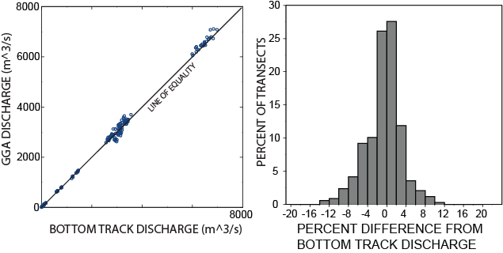
Results – Discharge Comparisons Using Individual Transects
    Comparison of the discharges computed using bottom track and GGA as the boat velocity reference

Slide 31
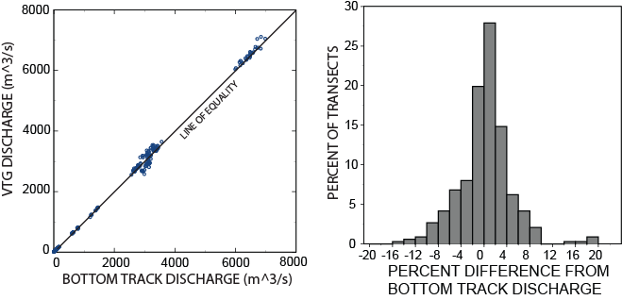
Results – Discharge Comparisons Using Individual Transects
    Comparison of the discharges computed using bottom track and VTG as the boat velocity reference

Slide 32
Results – Discharge Comparisons Using Individual Transects
Graphically it would appear that there is little difference between the BT and GGA or VTG based discharges.
The Wilcoxon Signed-Rank test indicates that:
  The mean difference between GGA and BT-based discharges was not biased at the 95% significance level (p=0.072) ;
  The mean difference between VTG and BT-based discharges is biased at the 95% significance level (p=0.015).

Slide 33
Results – Discharge Comparisons Using Individual Transects
Even though the Signed-Rank test indicates the VTG data is biased, the mean differences for both data sources are small (0.39% for VTG and -0.52% for GGA).

Slide 34
Results – Discharge Comparisons Using Individual Transects
Variation in percent difference for transects based on mean water velocities and stream width
Notes:
A more detailed examination of the data shows that large deviations in the VTG data occur at sites with low mean velocities (< 0.20 m/s or 0.65 ft/s) and/or narrow widths (< 25 m or 82 ft). Filtering the data to evaluate only 1) only the data with velocities greater than 0.20 m/s or .65 ft/s and 2) only data with stream widths > 25 m or 82 ft.

Slide 35
Results – Discharge Comparisons Using Individual Transects
Filtering the data to evaluate only the data with velocities greater than 0.20 m/s(0.65 ft/s) results in a dataset with a minimum mean velocity of 1.1 ft/s and a minimum width of 48 ft.
For this condition, the hypothesis test again shows that the mean percent difference for the GGA data is not significantly different from zero (p=0.122) but the VTG data are biased (p=0.032) at the 95% significance level.

Slide 36
Results – Discharge Comparisons Using Individual Transects
If, however, the data are filtered to evaluate only data with stream widths > 25 m (82 ft), the resulting data have a minimum mean velocity of 0.07 m/s (.23 ft/s) but a minimum width of 56 m (183 ft).
The hypothesis test on these data shows that the mean percent difference from BT for both the GGA (p=0.337) and the VTG (p=0.129) data are not significantly different from zero at the 95% significance level.

Slide 37
Results – Discharge Comparisons Using Individual Transects
On the basis of these data and the hypothesis tests:
  The discharges measured using GGA as the boat velocity reference can be considered to have no bias relative to discharges measured using bottom track as the boat velocity reference.
  The hypothesis test on the VTG data indicate that there is no bias in discharge for streams greater than 56 m (183 ft) wide, but a bias of 2.65% for streams with widths < 25 m (82 ft).

Slide 38
Results – Discharge Comparisons Using Mean Discharge Measurements
The discharge comparisons based on individual transects more heavily weights the effects of conditions at sites where a larger number of transects were collected.
To eliminate this potential problem the mean discharge at each measurement site was computed using each reference, which resulted in 30 measurements for each boat reference
Notes:
The mean percent difference from the BT discharges was -0.52 for GGA and 0.41 for VTG.

Slide 39
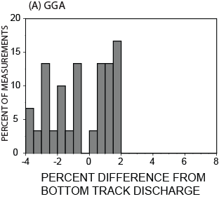
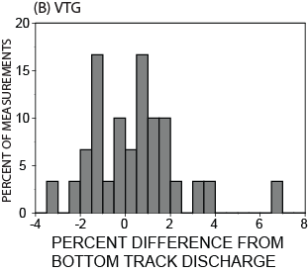
Results – Discharge Comparisons Using Mean Discharge Measurements
The hypothesis tests on mean discharge measurements indicate that the mean percent difference from bottom tracking for both the GGA (p=0.175) and the VTG (p=0.416) data are not significantly different from zero at the 95% significance level.

Slide 40
Results – Evaluation of Differential Correction Sources
Measured discharges were evaluated using differentially corrected GGA as the navigation reference for three wide-area satellite-based differential correction sources commonly used in North America:
  WAAS
  OmniSTAR
  CDGPS
Notes:
The Wide Area Augmentation System (WAAS) is a free correction service provided by the Federal Aviation Association and can provide submeter accuracy depending on the GPS receiver being used.
OmniSTAR VBS (www.omnistar.com) is a fee for service correction source that also provides submeter level differential corrections.
CDGPS (www.cdgps.com) is a wide-area differential correction source initially developed for the Canadian positioning market. The CDGPS signal can be acquired throughout Canada and northern areas of the United States.
WAAS and OmniSTAR correction services were evaluated using Trimble AgGPS 132 receivers and CDGPS was evaluated using data collected in Canada with Novatel receivers. This evaluation is complicated by the fact that discharges based on multiple correction sources were not collected at any sites, which would have resulted in direct comparisons of the accuracy of the correction sources.

Slide 41
Results – Evaluation of Differential Correction Sources
Notes:
The source of the differential correction is likely only one of the reasons for the percent differences between GPS and BT-referenced discharges shown in this Table. Both the maximum depth and mean velocity of the streams represented in the CDGPS data are much larger than those represented in the other data.
In addition, the standard deviation of stream width is considerably higher for the OmniSTAR data. Typically the variability in discharges measured with an ADCP on large streams is less than that measured on small streams. The lower variability on larger streams is due to 1) the additional data collected, which averages both turbulence and acoustic noise and 2) because the unmeasured portions of the cross section that must be estimated using the measured data are a smaller percentage of the overall discharge than for smaller streams. Considering the limitations of the data it appears that the free WAAS correction source performs as well as the OmniSTAR.
The advantage of VTG data over GGA data for bottom tracking is that VTG data do not depend on differential corrections. This table also summarizes VTG data collected in Canada with Novatel receivers, in New Zealand with Novatel V1 Smart Antennas, and in the United States using Trimble AgGPS 132 receivers. The average percent differences observed in the VTG data are comparable to the differentially-corrected GGA data. Both VTG and GGA data from the Novatel receivers exhibit differences relative to BT data that are smaller than data from Trimble receivers.
Additional controlled testing to allow better comparisons is needed to quantitatively compare the receivers and differential correction sources

Slide 42
Summary
The data and analysis indicate that discharge referenced to GGA or VTG data are, on average, within about +/- 0.5% of that measured using bottom tracking.
There were considerably more random errors and outliers in the percent differences between GPS and bottom track referenced discharges for sites with mean velocities less than 0.20 m/s (0.65 ft/s) and/or stream widths less than 25 m (82 ft).

Slide 43
Summary
WAAS appears to be an adequate differential correction source for ADCP discharge measurements, if errors less than 2 % are acceptable.
The data also indicate that VTG provides similar discharges to those based on GGA data and could be a valuable alternative where differential corrections may be difficult or impossible to obtain.

Slide 44
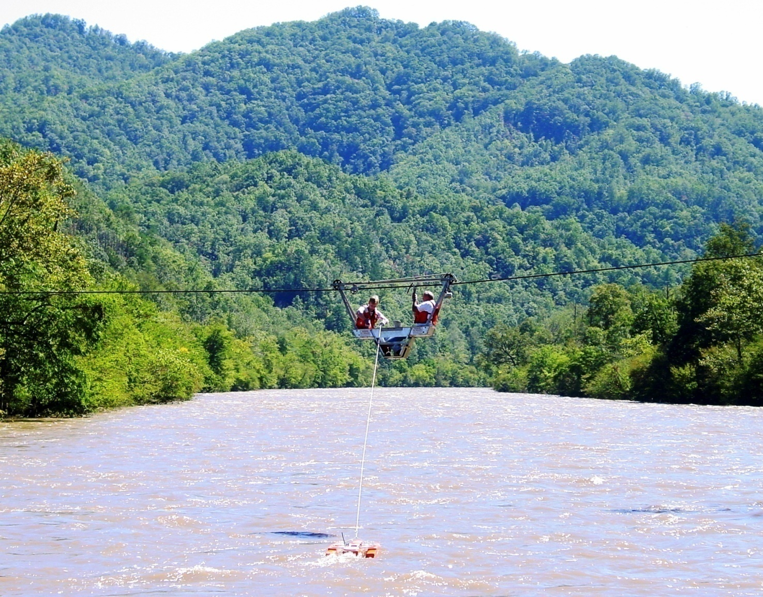
Questions?

