Slide 1
Use of Sontek RS Live for Data Collection and Review
David S. Mueller
Office of Surface Water
July 2011

Slide 2
Agenda
Hardware (briefly)
Measurement procedures
Working with the software
Data review
Mobile software (briefly)

Slide 3
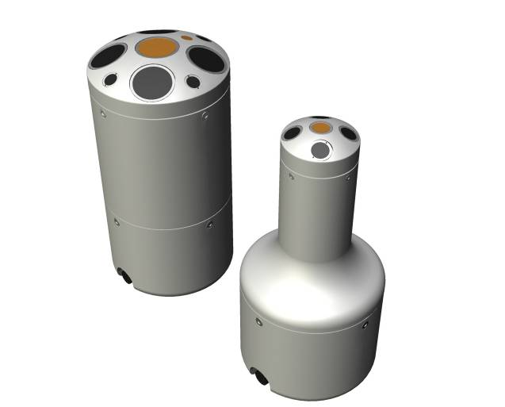
SonTek RiverSurveyor
M9 - 9-beam 3-frequency profiler
  4 beams at 1 Mhz, 4 beams at 3 Mhz
  1 beam @ 500 kHz (depth)
  Velocity profiling range: 1-130 ft (BT)
S5 – 5-beam 2-frequency profiler
  4 beams at 3 Mhz
  1 beam @ 1 MHz (depth)
  Velocity profiling range: 1-17 ft (BT)
Uses RiverSurveyor Live for PC or Mobile for data collection and processing
S5
M9

Slide 4
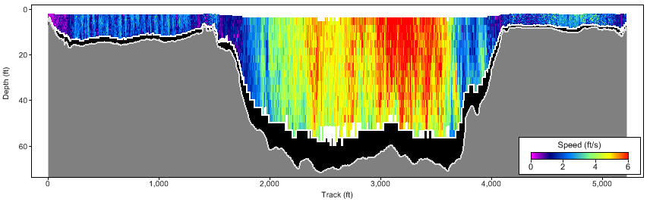
Multi-Frequency Multi-Ping
Automatic frequency, ping type (mode), and cell size switching.
Ping types include:
  pulse coherent shallow-water profiling
  pulse incoherent water profiling and bottom-track
  SmartPulseHD – uses pulse-coherent, broadband, and incoherent for precise measurements
  vertical beam depth

Slide 5
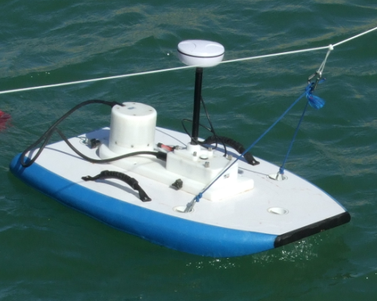
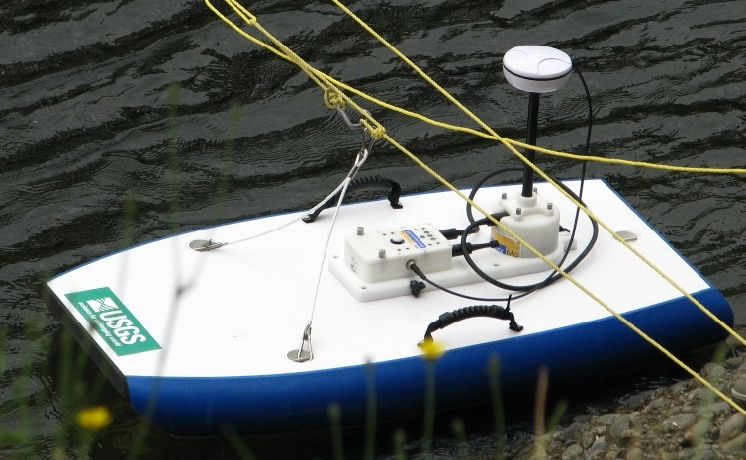
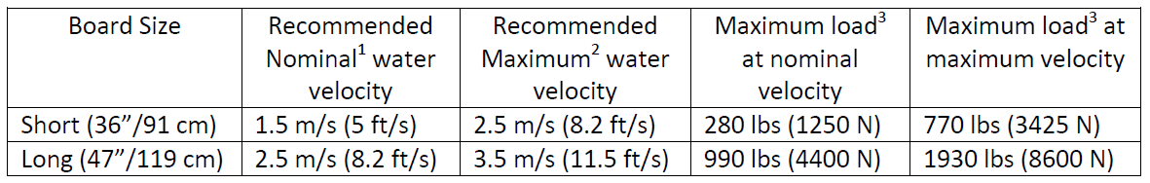
Hydroboard Options
Short (without white
line recalled)
Long (all recalled)

Slide 6
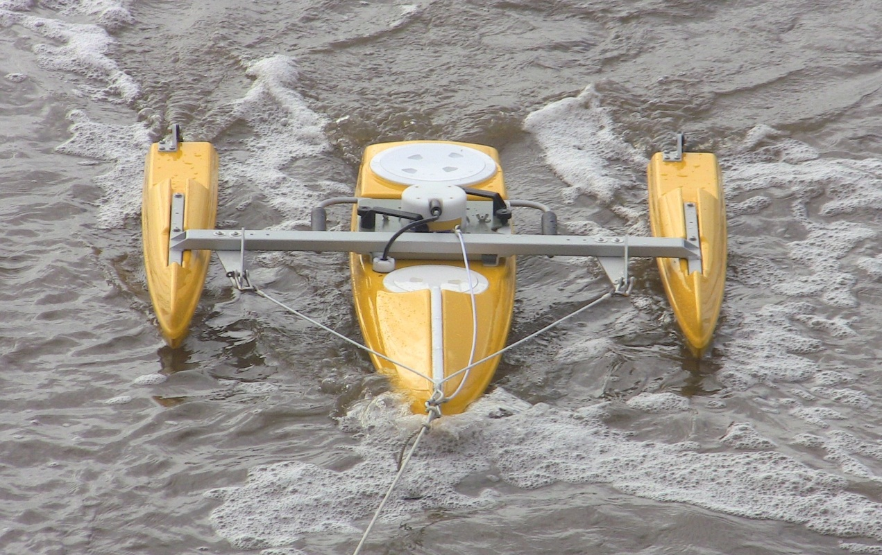
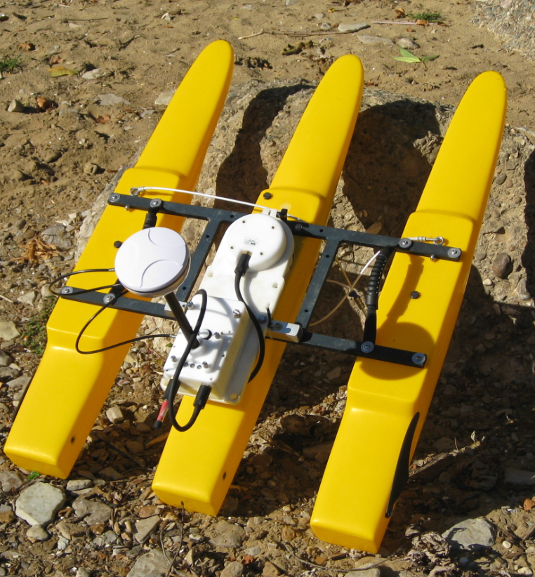
OceanScience
Better in high velocities, but also bigger and heavier
Larger boat above has worked well in > 15 ft/sec

Slide 7
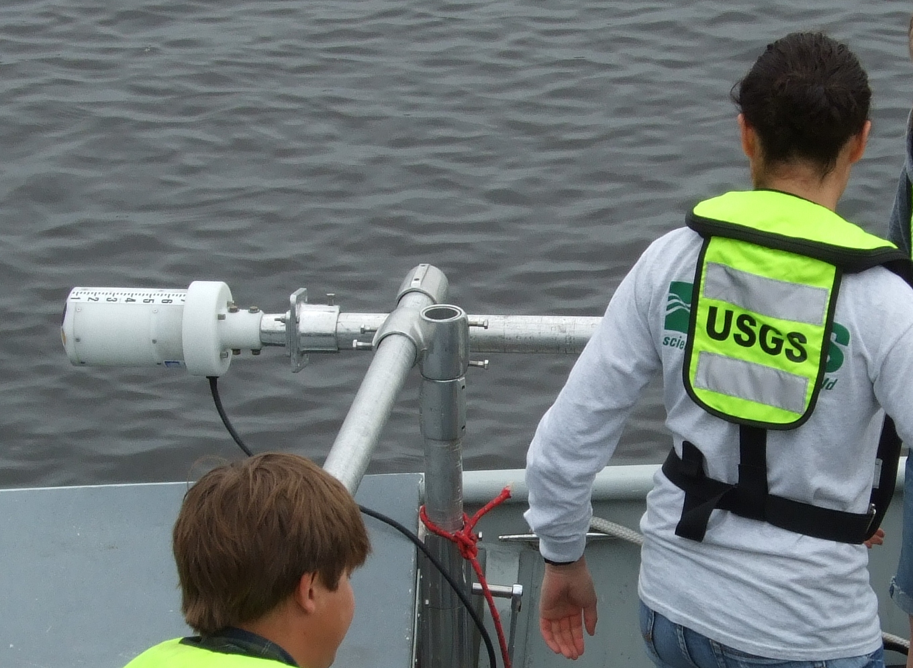
SonTek Boat Mount Adapter

Slide 8
Measurement Procedure
Ports / Comm.
Units
GPS Option
Site Information
Date / Time
System Test
Compass Cal.
Magnetic Variation
Transducer Depth
Track Reference
Depth Reference
Salinity
Moving-Bed Test
Start System
Start Edge
Start Moving
End Edge
End Transect
Repeat 15-18

Slide 9
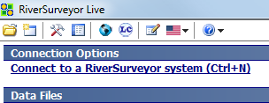
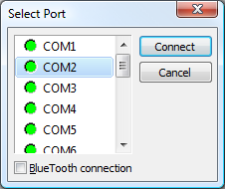
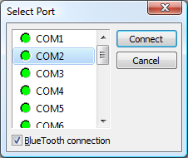
1. Ports / Comm.
Direct, Radio or integrated laptop BlueTooth
Supplied BlueTooth connection
Connects at 57600 baud

Slide 10
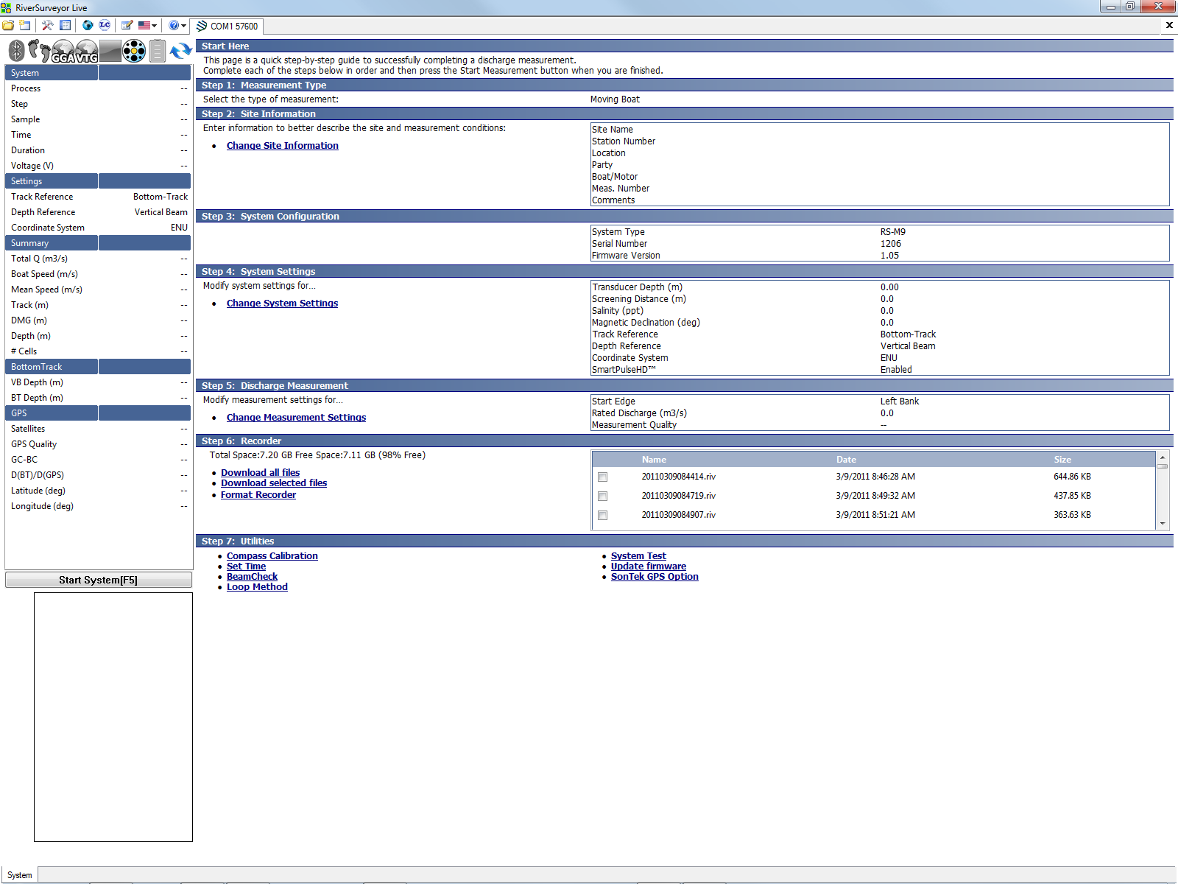
Connected to the System

Slide 11
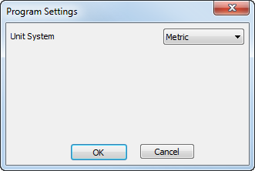
2. Units

Slide 12
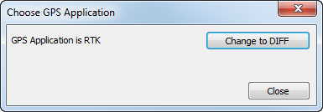
3. GPS Option

Slide 13
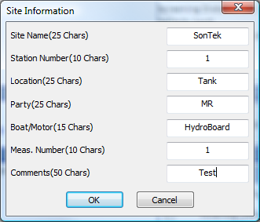
4. Site Information

Slide 14
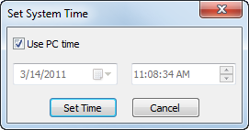
5. Date / Time

Slide 15
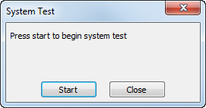
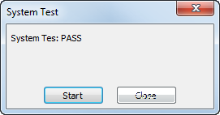
6. System Test

Slide 16
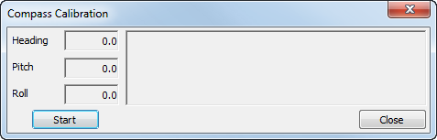
7. Compass Calibration

Slide 17
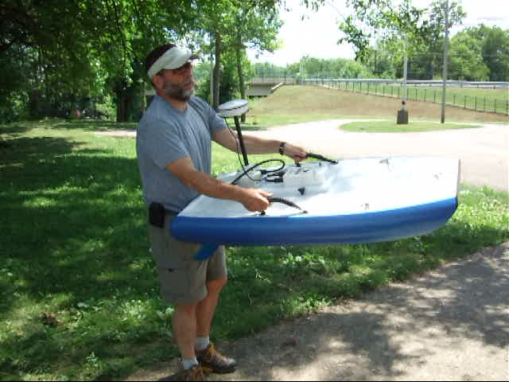
Compass Calibration
Requires two complete circles while pitching and rolling the ADCP and boat significantly.
A calibration with minimal pitch and roll is acceptable if only minimal pitch and roll is experienced during the measurement, such as on a manned boat.
Make sure you are away
from any source of
magnetic interference
(Iron bridge, cell phone,
watch, belt buckle, etc)
Notes:
RiverSurveyor
The RiverSurveyor compass calibration is a multi-tilt calibration that requires two complete circles while the pitching and rolling the ADCP and the boat significantly.
A calibration with minimal pitch and roll may be acceptable if only minimal pitch and roll is experienced during the measurement, such as on a manned boat. However, even in this situation pitching and rolling the boat as much as possible will improve the calibration.
Click Start and rotate ADCP through two complete circles, slowly, while varying the roll and pitch angles as much as possible.

Slide 18
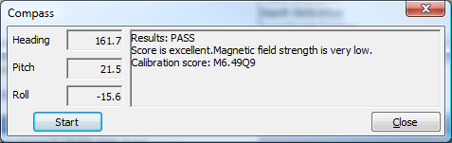
Compass Calibration
The calibration score has two parts
  M is magnetic distortion which should be very low (less than 10), again this may not be the case if there is minimal pitch and roll
  Q is a calibration score which should be very high (scale 1-10)
Calibration file is saved in the following location:
  Documents\SonTek Data\YYYY_MM_DD\CompassCal
Notes:
Compass Calibration
After completing two complete rotations press the Stop button.
The calibration routines will calculate a calibration score and provide brief comments on the results of the calibration.
Generally the results should say “Pass”, but the Score is often less than excellent if the pitch and roll were minimal.
The calibration score has two parts:
M is the magnetic distortion which should be very low (less than 10)
Q is a calibration score which should be very high on a scale of 1-10

Slide 19
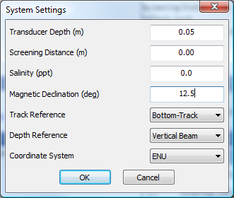
System Settings

Slide 20
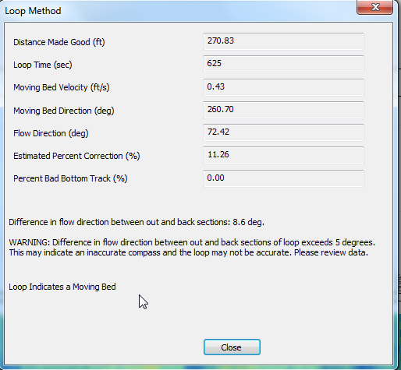
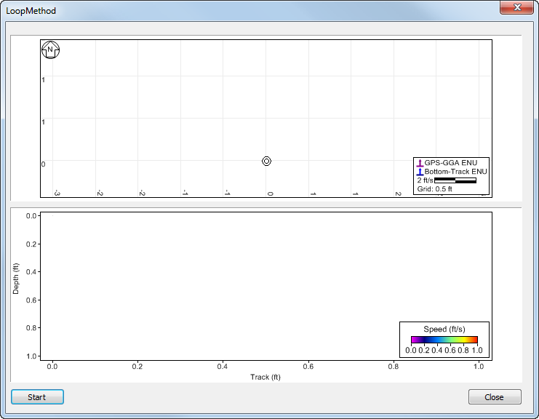
13. Moving-Bed Test
Flow
D_{UP}

Slide 21
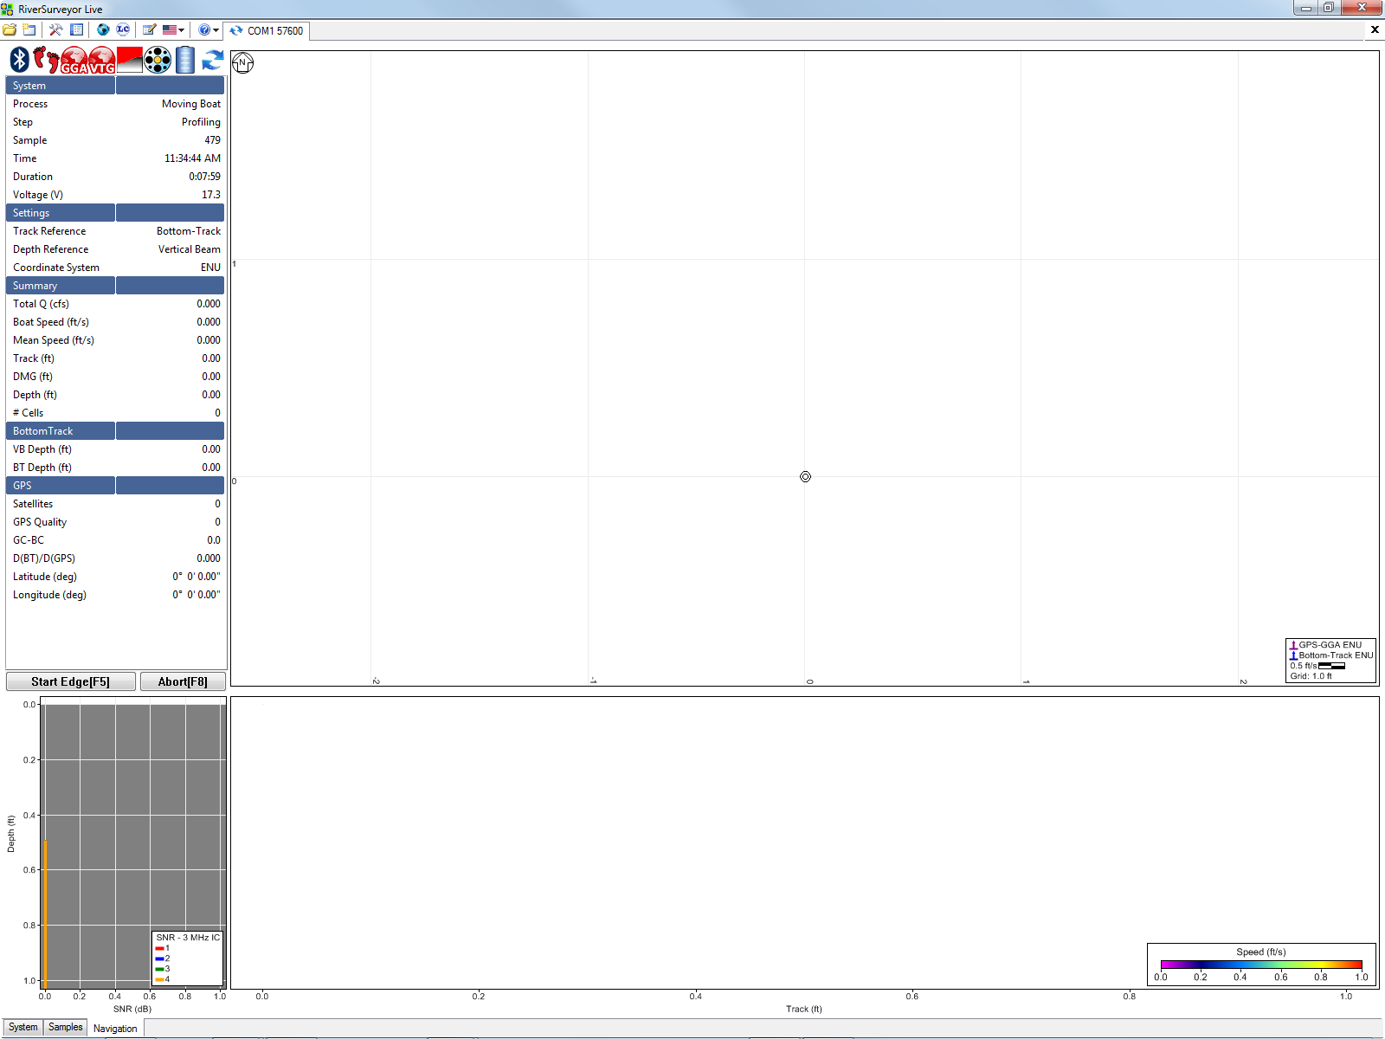
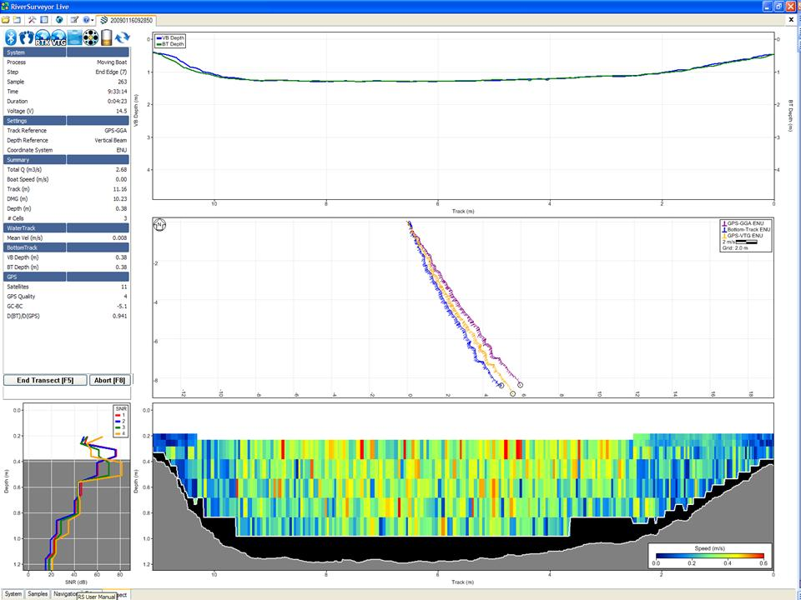
Making a Measurement

Slide 22
Collecting a Transect
Collect start edge profiles at left/right bank
Start moving and collect transect data
Collect end edge profiles at the opposite bank
Repeat to make additional transects
F5
F5
F5
F5
Start Edge/
End Edge
Transect
End Edge/
Start Edge
Left Bank
Right Bank

Slide 23
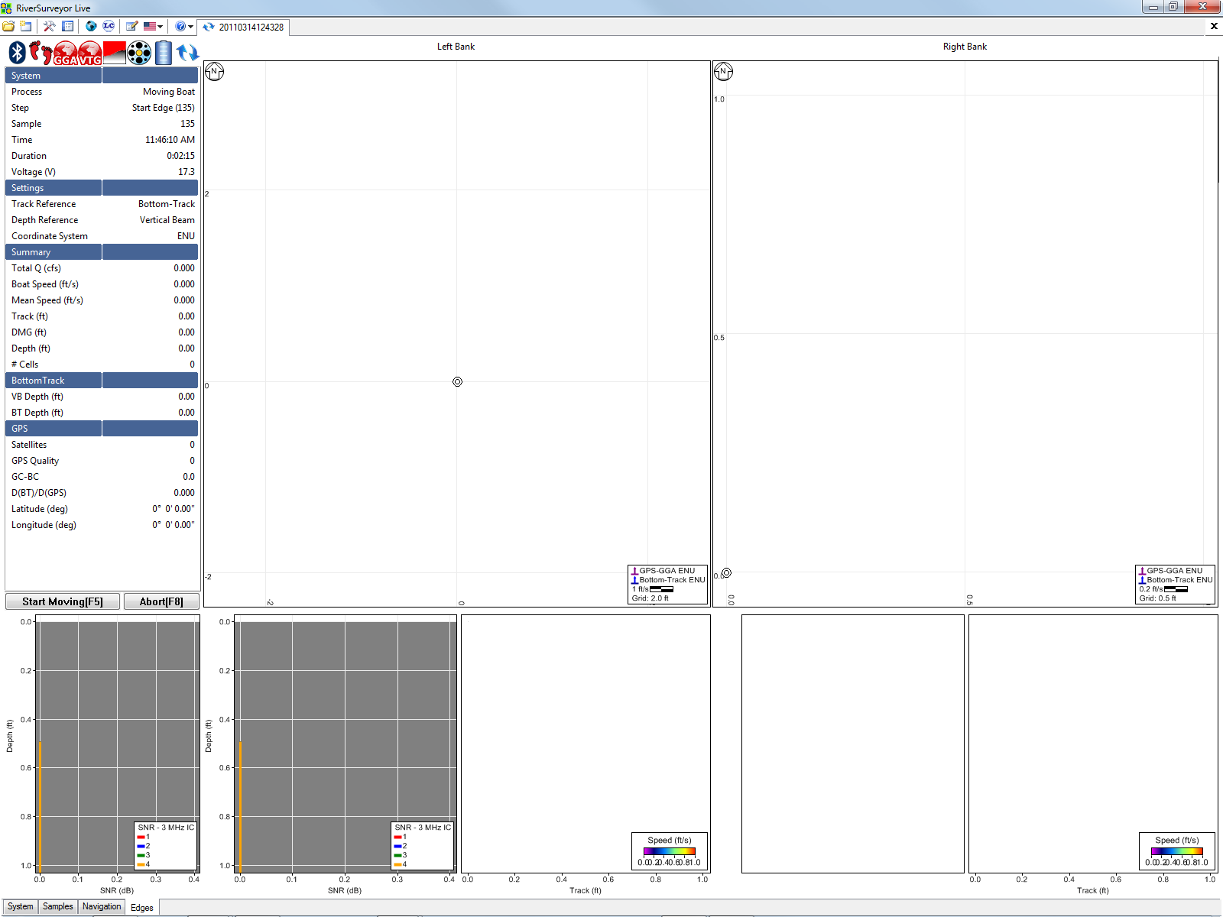
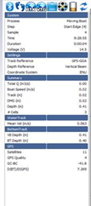

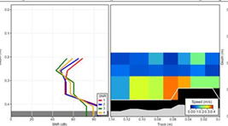
Collecting a Transect

Slide 24
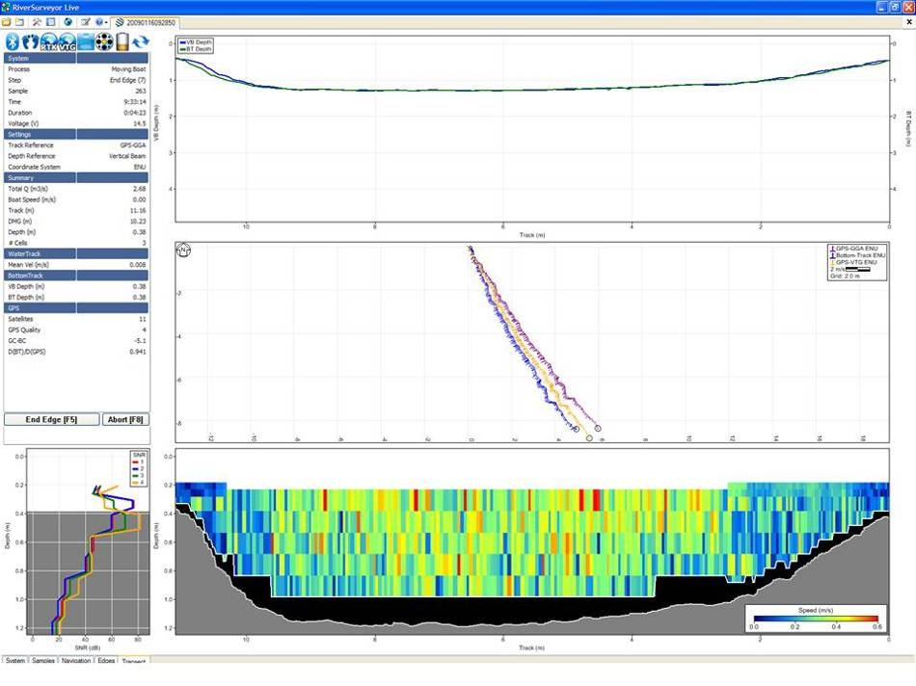
Collecting a Transect
Start Moving/Transect
Select Start Moving(F5) or press F5 and it switches to the Transect tab
Stays on the Transect tab during data collection

Slide 25
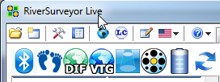
Watch Status Icons
Displays current status information
Blue is generally best
Yellow – caution – (Note Yellow Feet = bad bottom track and will use previous boat speed for 9 samples)
Red – Bad – when feet turn red = bad BT and depth

Slide 26
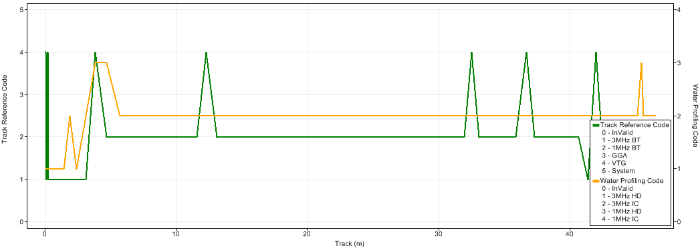
Review Track Reference Time Series
VTG
VTG
VTG
VTG
VTG
1 MHz BT
1 MHz BT
3 MHz BT
View if/when track references are being substituted
Area for any samples with track reference
“0-Invalid” > 9 times in a row will not have a measured discharge (uses previous good up to 9 times)

Slide 27
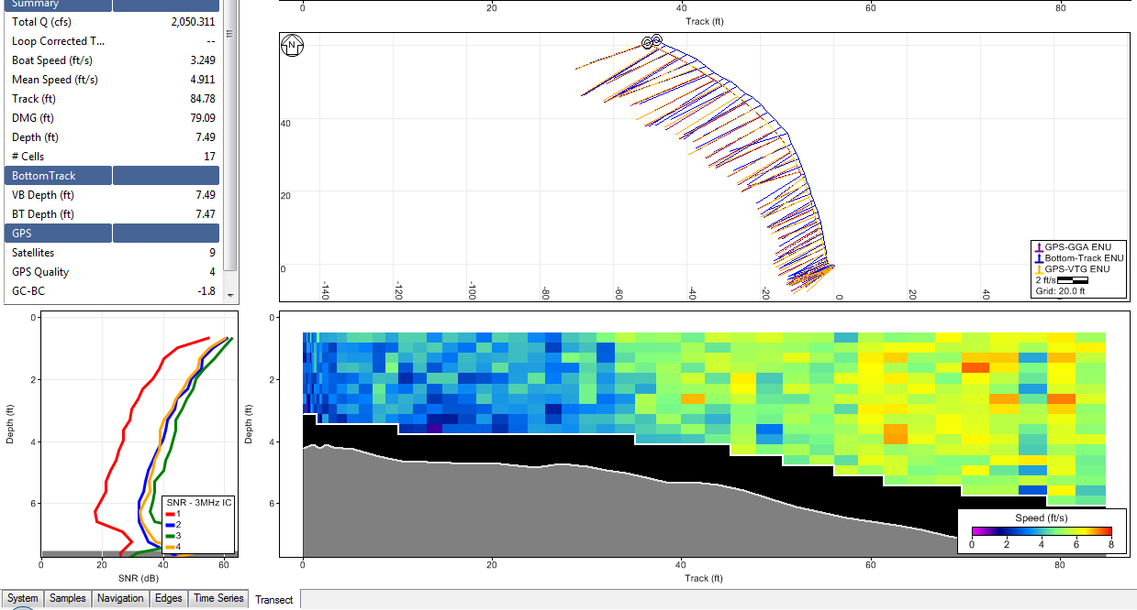
Watch SNR Profiles
If beams separate, lower transducer

Slide 28
Ending a Measurement
Ending a Measurement:
On completion of the data collection process, click Abort(F8) or press F8
To abort the measurement at any time,
click Abort(F8) or press F8

Slide 29
Where are the data?
System Test – Always on PC or Handheld
Compass Cal. – Always on PC or Handheld
GPS Data – integrated in transect data
Transect Data
  Always on ADCP memory card
  Version 2.5 or later also on PC or Handheld
  Automatically checked for communications errors
  *r.rivr are files logged on PC or Handheld
  *.riv are files logged on ADCP
  Currently references cannot be changed during data collection (Must reprocess transects to change reference)

Slide 30
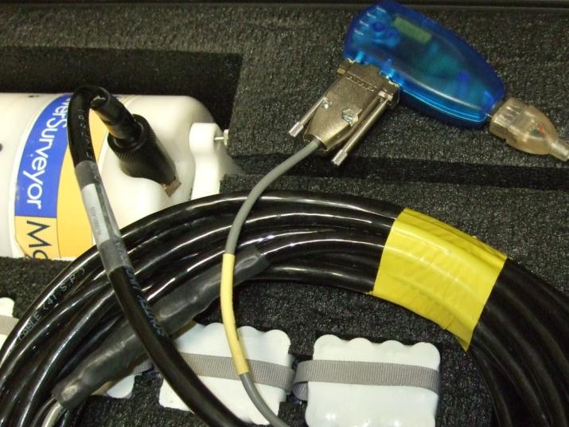
Downloading Data
Software warns during data collection of missing samples and download needed
Downloading data
is quickest when
directly connected
to ADCP and using
USB-Serial adapter.
Format ADCP
routinely after any
needed data is
downloaded and archived

Slide 31
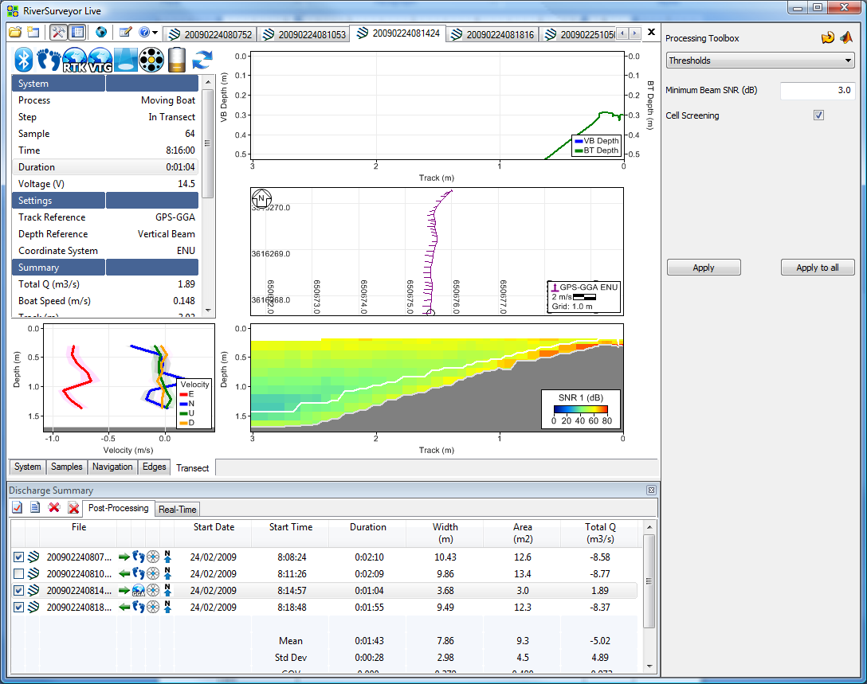
RiverSurveyor Live
Main Toolbar
Tabs to select data file
Tab Window
Display
Sidebar
Processing
Toolbox
Tab Window
selection
Discharge
Measurement
Summary

Slide 32
Main Toolbar
“Open File” and “Connect to System”
Each file (transect) or system connection gets its own tab
Swap between tabs by clicking or pressing
Ctrl+Tab or Ctrl+Shift+Tab
Tabs may be closed by pressing Ctrl+F4 or clicking the small X in the right corner (in line with tabs – not the Close Program icon)

Slide 33
Main Toolbar
“Show/Hide Processing Toolbox” and
“Show/Hide Discharge Summary”
Hotkeys
Processing Toolbox (Ctrl+T)
Discharge Summary (Ctrl+S)

Slide 34
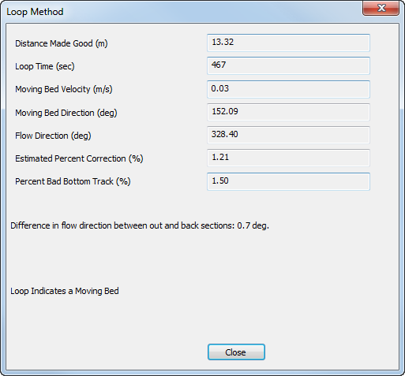
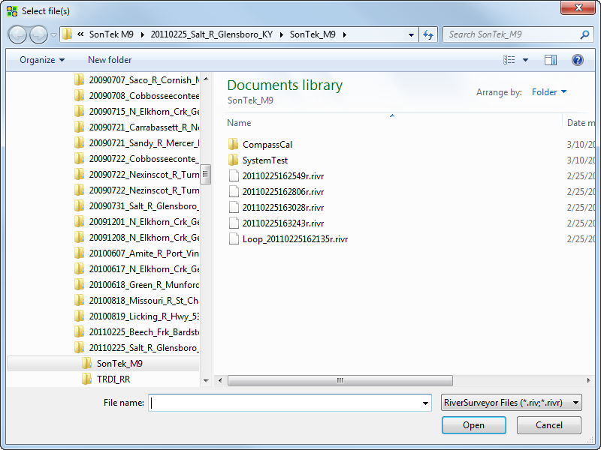
Main Toolbar
Load a loop test (NEW)
Same warning messages as LC

Slide 35
Tab Windows
Tab Windows show different views of the data
Changing tabs changes all open files
The Sidebar is common to all Tab Windows
Swap tabs by clicking or pressing PageUp and PageDown

Slide 36
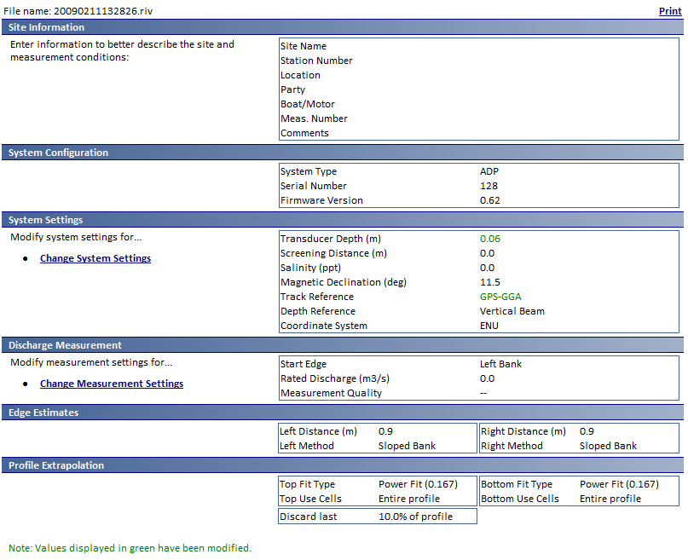

Tab Windows - System
System Tab
A summary all the key
settings
Used for real-time setup
Can be printed
Items in green have been changed since the field data collection.

Slide 37
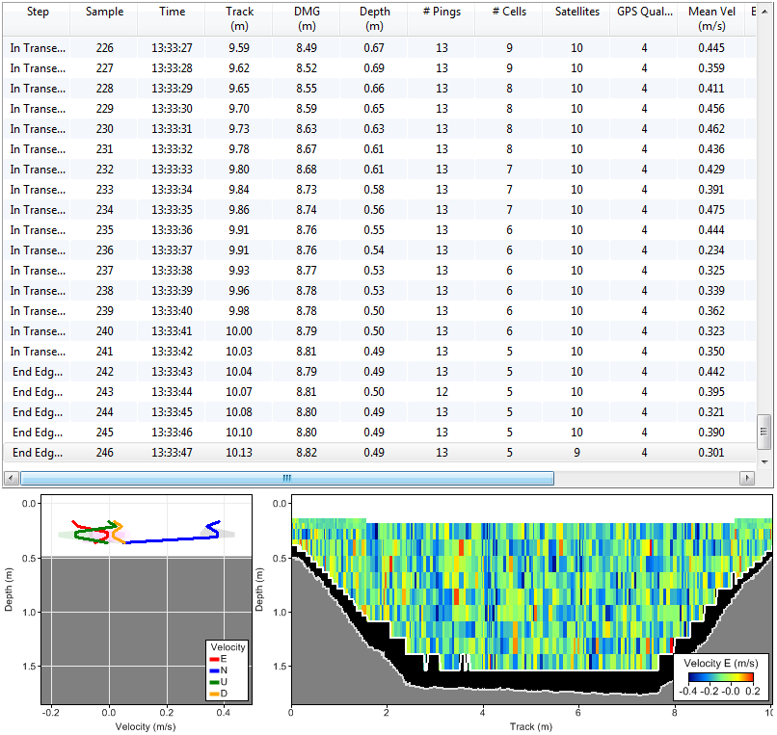

Tab Windows - Samples
Samples Tab
Tabular display for all
samples
Contour and additional
profile graph
Tabular can be
customized
Use arrows to scroll up or down and left and right arrows to jump to top (beginning) or bottom (end) of data
Edges are displayed in the tabular data

Slide 38
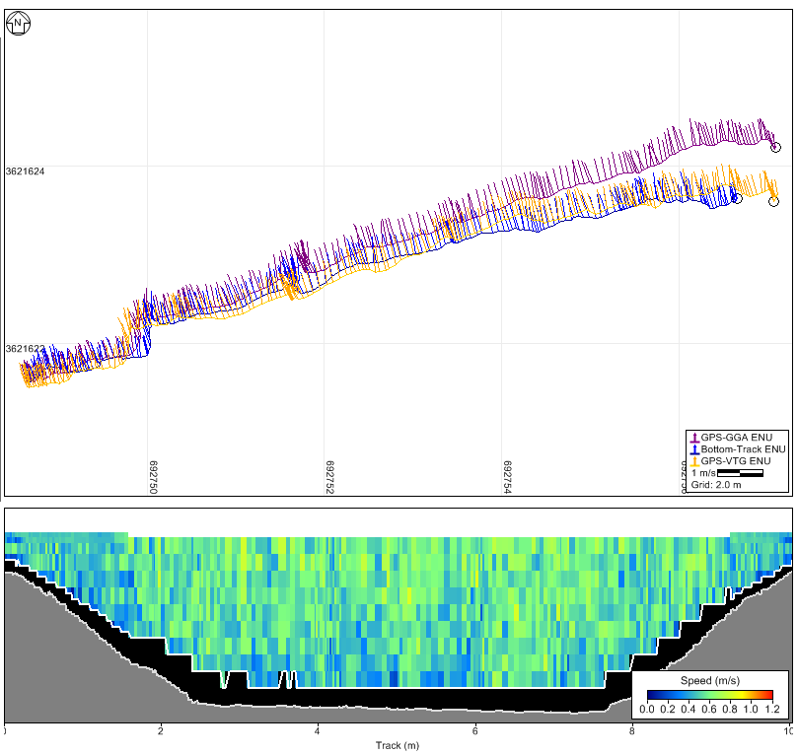

Tab Windows - Navigation
Navigation Tab
Good all purpose
Track and Contour
Edges are not displayed here

Slide 39
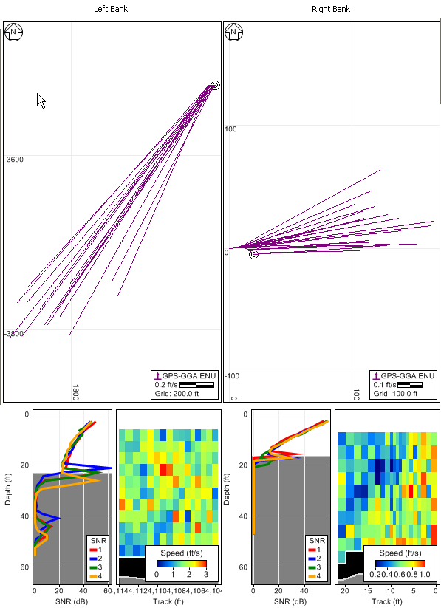

Tab Windows - Edges
Edges Tab
Track, Profile and
Contour for each edge
Good tool to evaluate:
Variation in positions
Variation in depth
Relative position
between references
Only Edges are displayed
in this tab

Slide 40
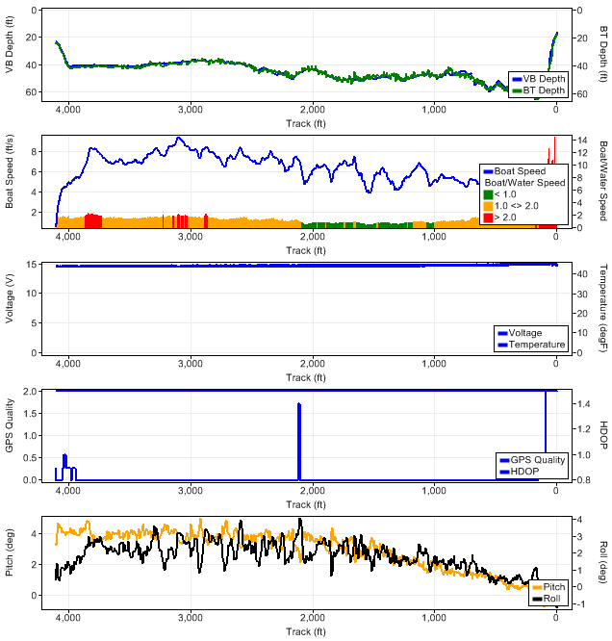

Tab Windows – Time Series
Time Series Tab
Multiple time
series graphs
at once
Edges are not displayed here

Slide 41
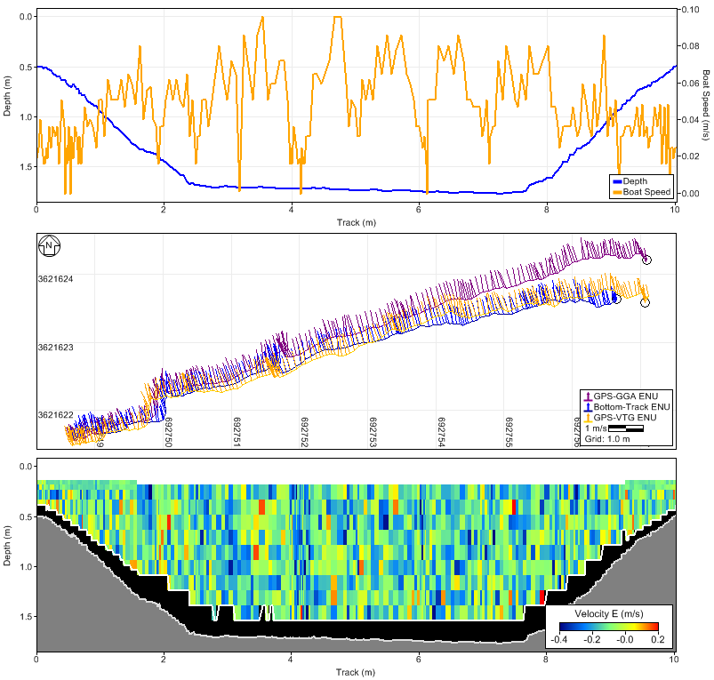

Tab Windows - Transect
Transect Tab
Good for comparisons
of parameters over
the length of the
transect
Time Series, Track, Contour
Edges are not displayed here

Slide 42
Graphs
Right click on graph to change what is displayed.

Slide 43
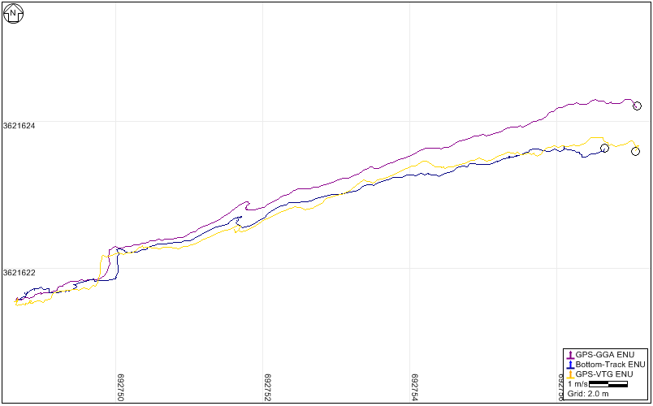
Graphs – Track
Show Velocity Vectors
Hides vectors to make it
easier to see the tracks
Controlling the Track
Left click and drag to move the graph around
Use mouse scroll wheel to zoom in or out
or use Z and Shift+Z keys
Change vector length using Ctrl++ or Ctrl+-
(AutoScale must be off)

Slide 44
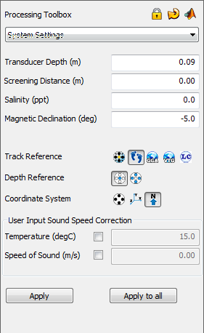
Processing Toolbox
All processing controls are here
Only available during post-processing
Some parameters
(System and Measurement settings)
can be modified on the System tab
Show/Hide Processing Toolbox using
icon in main toolbar
Tool Sets selected using combo box
Updates with each file selected
Lock transect
Reset to Field icon

Slide 45
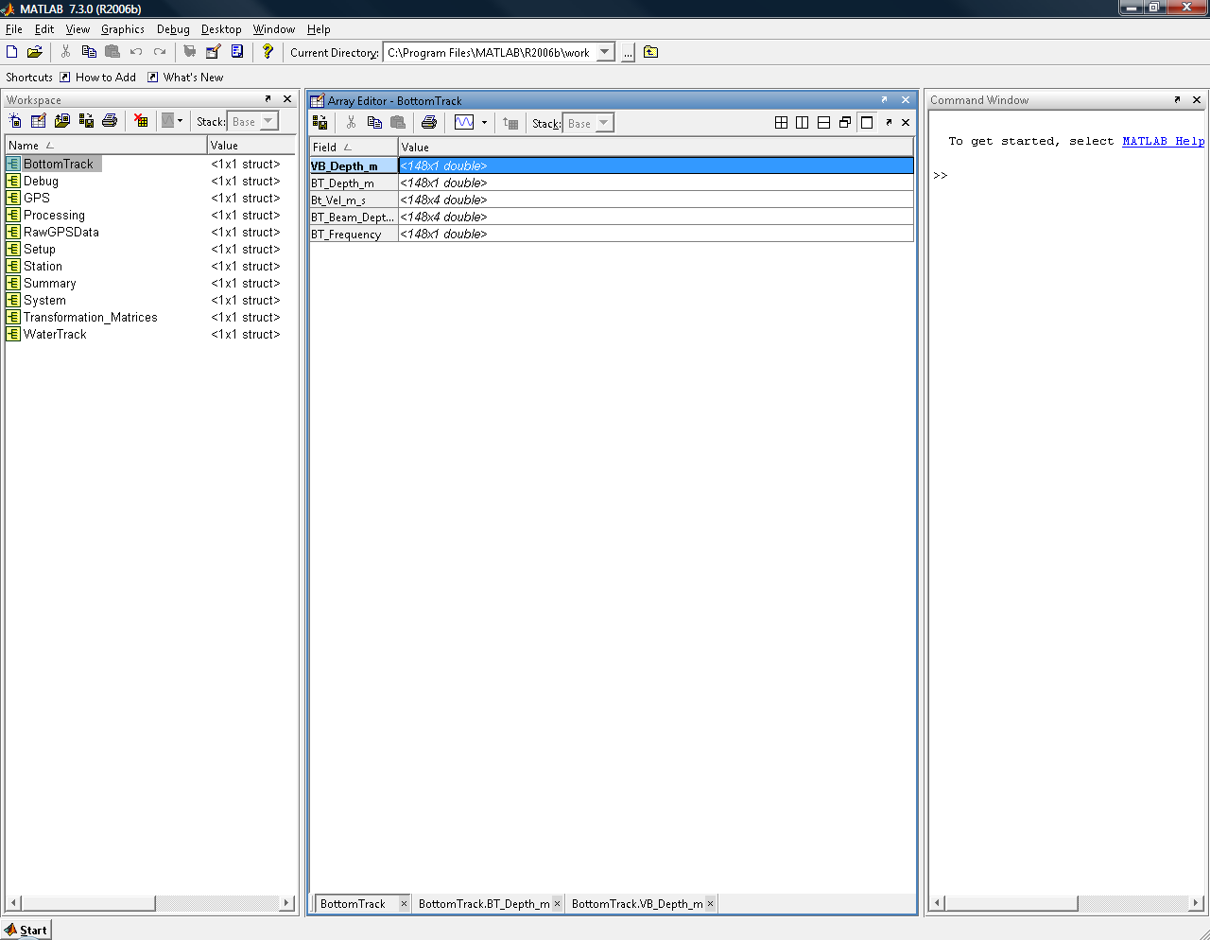
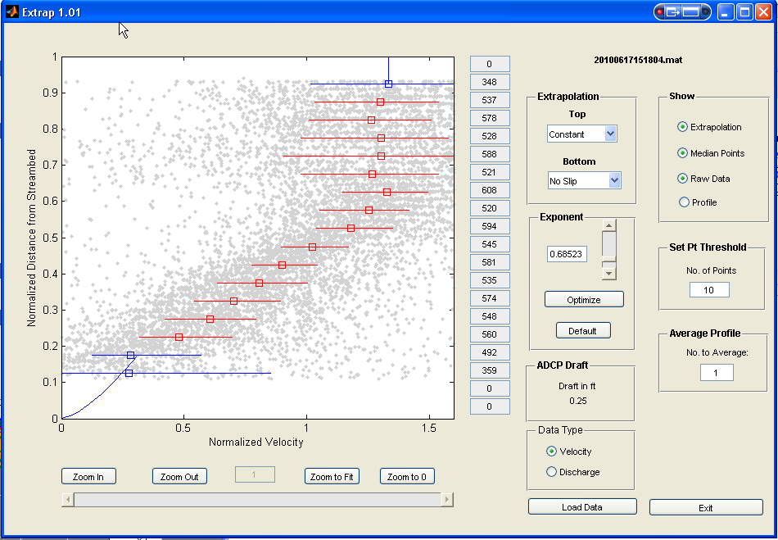
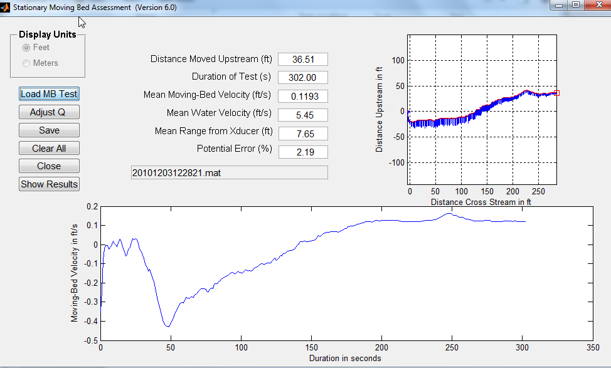
Processing Toolbox
Matlab Export
Used to create files that are
for importing into USGS
programs (LC, SMBA, extrap,
EDI)
Contains all data and settings
Parameters are grouped
Velocities are in the reference
and coordinate system at the time of export

Slide 46
Processing Toolbox – System Settings
Adjust field settings as necessary
Screening distance – distance below transducer for valid data. (Normally set to zero, use default blanking distance)
Combinations of references and
coordinates must be logical
i.e. GPS in beam coordinates does not make a lot of sense

Slide 47
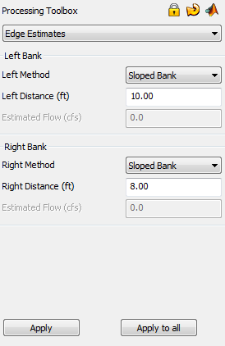
Edge Estimates
Sloped Bank
Vertical Bank
User Input (estimated Q)
  Must document method used to
  estimate Q
    AA measured depths and velocities
    Visual estimate of depths and vel.
    Estimated Q between software
    calculated Q from sloped and vertical
    Other...
Use “Apply to all” for multiple
transects from the same
measurement

Slide 48
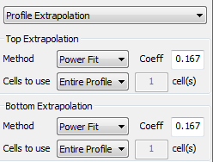


Setting Extrapolations
Power / Power
  Default
  Change exponent
    Must change for both top and bottom
Constant / Power
  Set top “Method” to constant
  Set top “Cells to use” to “Only Use”
  Set top “cells” to 1
Constant / No Slip
  Set top “Method” to constant
  Set top “Cells to use” to “Only Use”
  Set top “cells” to 1
  Set bottom “Cells to use” to “Only Use”
  Set bottom “cells” to 2 or 1
  (generally recommend 2)

Slide 49

Processing Toolbox – Thresholds
Heading correction – allows manual compensation for poor compass calibration
Minimum SNR – used for data screening (recommend not changing)
Cell Screening – turns of screening of data below sidelobe cutoff.
Composite Tracks – turns on and off automatic substitution of GPS and BT.

Slide 50


Discharge Measurement Summary
Toolbar Buttons
Summary Report
ASCII Export
Delete Selected (highlighted) Records
Delete All Records
Highlight outside 5%

Slide 51

Discharge Measurement Summary
Full color report
Based on past
report structure
Site Information is
drawn from data files
Settings that are not
common are
highlighted with an
asterisk
Unchecked records are not displayed

Slide 52


Discharge Summary NEW
Prompt for compass calibration
Prompt for system test file
Compass calibration, system test, and loop test included in output

Slide 53



Review Track Reference
Determine best track reference
Look at ship track plot for any irregularities
  Uncheck composite tracks to verify reference not substituted
  Typically check composite tracks for final Q

Slide 54


Significant Bad Bottom Track
Ref: BT
Composite Track Off
No Q or width Computed when Track Ref Invalid (Boat speed = 0)
Ref: BT
Composite Track On
VTG used when BT invalid
Shiptrack has VTG data plotted with Bottom-Track (Blue)
This measurement had moving bed and good GPS data, so VTG or GGA should be used for track reference

Slide 55


Determine Best Depth Reference
Look at VB depth and BT Beam Depth on a time series plot… make sure they are plotted at the same scale
Will substitute with alternate reference if selected reference not available (not an option)

Slide 56







RS Live Mobile
Loop Method
NEW
Almost everything in PC software is also in mobile Software
Must have Bluetooth PCM
Some reported issues of locking up after loop

Slide 57
Use of SonTek S5/M9
Make comparison measurements for the range of conditions you intend to use the instrument
  Water velocities
  Streambed type
  Flow depths
  Turbulence
  Sediment concentration
You can then use the instrument if there are no significant deviations from the comparison measurements
  Consistent biases are of particular concern
If a check measurement is indicated, use a different instrument
Document and submit comparisons to OSW to assist in finalizing the evaluation of these instruments. https://collaboration.usgs.gov/wg/oswha/Testing/default.aspx

Slide 58

Questions?

