Slide 1
Review and Rating of Moving-Boat ADCP Q Measurements
David S. Mueller
Office of Surface Water
September 2012
Notes:
Welcome to the 2012 edition of review and rating of moving-boat ADCP discharge measurements. I gave a similar webinar in 2010 but due to technical difficulties we weren’t able to record it. I have had numerous requests for this topic and we have begun to include this topic in our basic ADCP training classes. While this presentation will be similar to the original presentation in 2010 it has been updated to reflect changes in knowledge, software, and policies. We will record this and make it available through the hydroacoustic web page for anyone wishing to view this information at a later time.

Slide 2
Overview
Considerations in Rating a Measurement
Six Review Steps
Gather information for rating as you review
Three Examples
Notes:
I will begin by discussing the things that should be considered in rating a measurement and where and how you would obtain and treat this information. Next a simple six step process for reviewing data will be presented that will allow you to gather the information important to rating your measurement as you review your data. Finally, I will work through three examples with different issues and describe the logic I would use in rating those measurements.

Slide 3
Rating Considerations
Variability of transect discharges
Pattern in transect discharges
Accuracy and % of unmeasured areas
top and bottom extrapolation
edge extrapolation
Quantity and distribution of missing/invalid data
Quality of boat navigation reference
Bias or noise in bottom track
Noise in GPS data
Notes:
Things to consider when rating an ADCP discharge measurement. First quantify the variability in discharge among the transects. Look for patterns in the transect discharges that do not appear random. Consider the accuracy and percentage of discharge represented by the unmeasured areas at the top, bottom, and edges and any locations in the cross section where invalid data were collected. Also evaluate the quality of the navigation reference. Is bottom track noisy or biased by sediment transport? Does the GPS data look reasonable or does it contain unrealistic jumps in the ship track or boat speed?
Let’s look in more detail at how to treat each of these considerations in achieving a final rating for the measured discharge.

Slide 4
Variability in Transect Discharges
A coefficient of variation (COV) is computed by the software (Std./|Avg.|)
The COV represents the sampled random error in the discharge measurement.
Using COV to estimate a 95% uncertainty associated with random errors as measured
4 passes: COV * 1.6
6 passes: COV * 1.0
8 passes: COV * 0.8
10 passes: COV * 0.7
12 or more passes: COV * 0.6
Add 0.5% for systematic errors
This is probably an optimistic estimate
Notes:
The manufacturer’s software, both WinRiver 2 and RiverSurveyor Live, compute the coefficient of variation or the standard deviation divided by the average for the transects the comprise the measurement. This coefficient of variation represents the sampled random error in the discharge measurement. Generally uncertainty is reported to the 95% coverage level. To obtain the 95% uncertainty associated with the mean discharge we can multiply the coefficient of variation by the appropriate coverage factor from a student’s t distribution and divide by the square root of the number of transects in the mean. For simplicity in application we have computed the these values for commonly collected numbers of transects. If your measurement had 4 transects the 95% uncertainty based on the variability in discharge among the transects would be 1.6 times the coefficient of variation. For 8 passes 0.8 times the coefficient of variation and so on. The resulting value represents only random errors and does not account for biases. On the basis of information provided by one of the manufacturers we can account for systematic uncertainty by adding about 0.5% to the 95% random uncertainty. At this point, this is likely an optimistic estimate of the uncertainty in your measurement because we have not considered the potential biases associated with the unmeasured areas or with any problems in the overall measurement. However, the value we have computed will be our base uncertainty to which we may add based other considerations.

Slide 5
Example of Random Error
COV
Systematic bias
95% Uncertainty (Random Error) = 5 *0.8 + 0.5= 4.5%
8 Transects
Base
Uncertainty
Notes:
As an example of computing the base uncertainty, let’s look at this data. The coefficient of variation is 0.05 or 5%. There are 8 transects. So we multiply 5% time 0.8 and add 0.5% systematic uncertainty to achieve a base uncertainty of 4.5%.

Slide 6
Using COV with Two Transects
Convert COV to % (0.012 = 1.2%)
Round to the nearest whole % (1.2% = 1%)
If rounding = 0% use an uncertainty of 3%
If rounding > 0% - multiply % by 3.3
Add 0.5% for systematic errors
Examples: COV = 0.00, Uncertainty = 3.5% COV = 0.01, Uncertainty = 3.8% COV = 0.02, Uncertainty = 7.1% COV = 0.03, Uncertainty =10.4%
Notes:
The approach I just describe works well as long as you have at least 4 transects. However, with our new policy of accepting two transect measurements provided the duration of the data collection is at least 720 seconds creates a problem. Having only two samples does not provide us with a very good estimate of the uncertainty and using the student’s t distribution results in a huge multiplier. In addition, RiverSurveyor Live reports the coefficient of variation to three decimal places and WinRiver 2 to only two decimal places. That isn’t a problem for small multipliers but it is for large ones. The approach I am proposing results in a similar distribution of results as if the purely theoretical approach was applied, but provides a simple application.
Obtain the coefficient of variation from the manufacturers software or SWAMI and convert it to percent and then round to the nearest whole number. If the value rounds to zero we will assume a random uncertainty of 3%. I don’t believe any two transect discharge measurement should be rated excellent. It may be excellent but the data are simply not available to support that rating. If the rounded value is greater than 0, multiply by 3.3 and add 0.5% for systematic errors. It may be just as easy to use the examples computations presented here. A two transect measurement with a coefficient of variation of 0.00 or 0.01 could be rated good depending on the other consideration. A two transect measurement with a coefficient of variation of 0.02 could be rated fair provided other considerations are not significant, but a coefficient of variation of 0.03 or greater will result in a rating of poor.

Slide 7
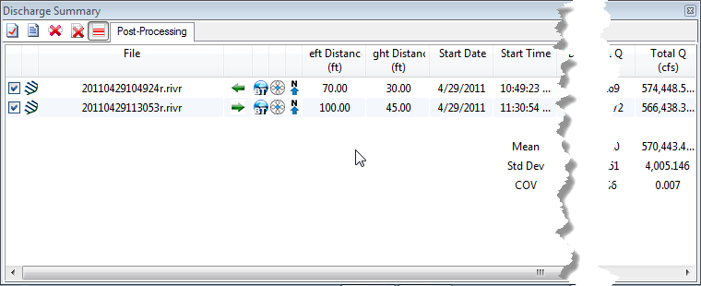
2 Transects in RiverSurveyor Live
0.007 converts to 0.7% and rounds to 1%
1 * 3.3 = 3.3%
Add 0.5% systematic bias
0.5 + 3.3 = 3.8%
Notes:
Here is an example of a two transect measurement in RiverSurveyor Live. The coefficient of variation is 0.007 which converts to 0.7 % and rounds to 1%. The 1% is multiplied by 3.3 to get 3.3% and then the estimate for systematic bias is added to achieve a base uncertainty of 3.8%.

Slide 8
2 Transects in WinRiver 2
0.02 converts to 2%
2 * 3.3 = 6.6%
Add 0.5% systematic bias
0.5 + 6.6 = 7.1%
Notes:
For WinRiver 2 the coefficient of variation is labeled Std./Avg and is this example is 0.02, which converts to 2%. 2% is multiplied by 3.3 and the estimate for systematic bias is added for a base uncertainty of 7.1%.

Slide 9
Uncertainty is not Error
A measurement with a large uncertainty may be
accurate, but we don’t know that, so it has a large uncertainty. A large uncertainty doesn’t mean the discharge is in error say 8% only that we believe the measurement is within 8% of the true value, which is unknown.
The proposed approach although using computations is not intended to be quantitative but provide a quantitative basis for making a qualitative rating of the measurement as Excellent, Good, Fair, or Poor.
Notes:
Before we continue, lets make sure we understand what we are computing. A measurement with a large uncertainty may be
accurate, but we don’t know that, so it has a large uncertainty. A large uncertainty doesn’t mean the discharge is in error say 8% only that we believe the measurement is within 8% of the true value, which is unknown.
Also to clarify, the proposed approach although using computations is not intended to be quantitative but provide a quantitative basis for making a qualitative rating of the measurement as Excellent, Good, Fair, or Poor.

Slide 10
Summing Uncertainty
Summing uncertainty from different sources should be the square root of the sum of the squares
For simplicity you may simply sum the values.
This will result in a larger uncertainty, particularly if the uncertainties are large.
If simply summing, estimate low and tend to round down.
If using sum of squares, use realistic values.
Notes:
Combining uncertainties from various sources is accomplished by computing the square root of the sum of the squares. However, for simplicity a simple summation can be used, although this will result in a larger uncertainty than using the square root of the sum of the squares. So if using the simple sum estimate your uncertainties low and round values down. If you use the square root of the sum of the squares you can use realistic values of the uncertainties.
For example for uncertainties of 5, 3, and 1 percent the final uncertainty is 5.9 percent but when using the simple sum you would get 9%. Thus, estimating low and round down we might get 5 +2 +0 = 7% which is a more reasonable estimate.

Slide 11
Patterns in Transects
Random errors should not display a pattern
A pattern in flow may indicate the need to adjust measurement procedures
Rising or falling – fewer transects
Periodic – more transects
COV may be larger than actual error
Notes:
Ok. On to other considerations. Look for patterns in the transect discharges. Random errors should not form a pattern. If a pattern is identified it could indicate that the flow is unsteady and there may be a need to adjust the measurement procedures to achieve the goal of the discharge measurement. For rising or falling situations, using fewer transects in each average could allow multiple discharge measurements and may help in rating development. However, if the goal is to simply get a mean and the fluctuations are periodic more transects may be required to properly sample and average over the period of the fluctuation.
A pattern caused by flow unsteadiness but represented in the transects used to obtain a mean discharge will result in a greater coefficient of variation than is actually caused by random error and the uncertainty may be overestimated.

Slide 12
Extrapolation
Evaluate discharge profile (use extrap)
Check field notes for wind effects
Use extrap’s discharge sensitivity analysis to determine the potential percent uncertainty associated with extrapolations.
Subjective judgment
Does the measured data represent the unmeasured areas?
Do the available fit options provide reasonable values for the unmeasured areas?
Notes:
Evaluation of the discharge profile to determine the appropriate top and bottom fit can be very important to the final discharge. Previously we had suggested methods for evaluating the profile using the manufacturers software, but there were limitations associated with that approach. The Office of Surface Water has developed and released a standalone software called extrap which should make this process more accurate and more efficient. Field notes on the direction and speed of the wind can be very helpful in determining the appropriate top extrapolation method. During surface water reviews my personal experience is this information is not consistently recorded in a manner that helps determine the top extrapolation. When recording this information in the field, do so with the intent of providing information to justify the top extrapolation method.
Extrap version 3.1 includes a discharge sensitivity analysis that can be used to estimate the percent uncertainty associate with extrapolations.
Finally, your judgment is important. Extrap can only use the data measured by the ADCP. You have to decide based on your knowledge of the site and field notes: Does the measured data represent the unmeasured areas? Do the available fit options provide reasonable values for the unmeasured areas?

Slide 13
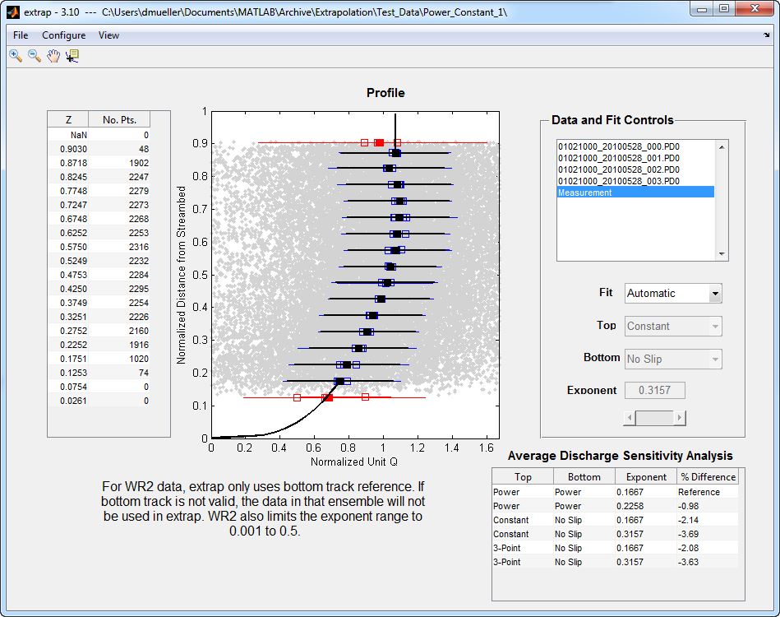
Using extrap
For a 30 minute training video on using extrap
go to the hydroacoustics web page at hydroacoustics.usgs.gov and click On Demand and then Introduction to extrap 3.x
To go directly to video use the following url:
http://hydroacoustics.usgs.gov/training/podcasts/
extrap3/player.html
Notes:
This is the new user interface for extrap 3.1. This version includes some new and important features:
You can load multiple transects. For TRDI simply load the mmt files and all check transects are loaded.
The transects are composited to form a profile for the whole measurement.
The program uses and automatic algorithm to evaluated the data and suggest a fit, but the user can manually change the fit. It is still your responsibility to evaluate the fit and change it if necessary.
Finally there is the discharge sensitivity analysis, which we will discuss in more detail.
For a complete tutorial on using extrap please see the 30 minute training video available from the USGS hydroacoustics web site.

Slide 14
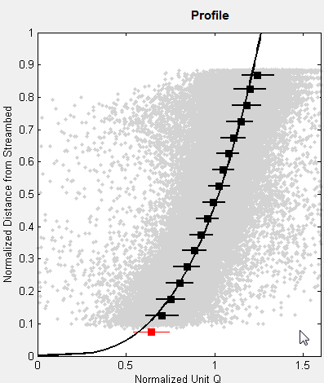
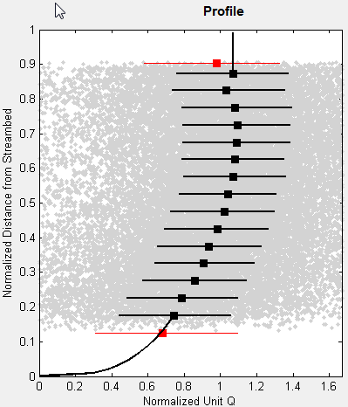
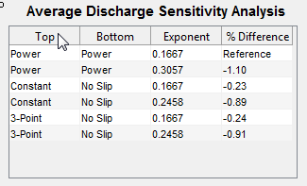
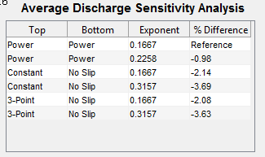
Discharge Sensitivity Analysis
Uses only the composite measurement fit methods and exponent
Reference: Power / Power / 0.1667
Evaluate sensitivity / uncertainty associated with extrapolation
Notes:
The discharge sensitivity analysis is new to extrap 3 and can be a useful tool for determining both how important the extrapolation method is and what the potential error due to the unmeasured top and bottom may be in the rating of the measurement. The table assumes that the power fit with a 1/6th exponent is the reference and then computes the difference from this reference for other fit options. For this example we can see that there is a bend back near the surface and that a constant fit at the top and no slip at the bottom is appropriate. Looking at the table we can see that if the default were retained in our measurement we would have an error of about 3.7% from the automatically selected fit of constant/no slip with an optimized exponent. This difference is not huge but certainly significant. If we agree that power at the top is not appropriate then our decision is between constant and 3-pt at the top and no slip with the default or a least squares fit exponent at the bottom. The maximum difference among these options is about 1.5%. The automatic logic selected Constant / No Slip with an exponent of 0.3157, which would need to be entered in to the manufacturers software to compute the final discharge. In the rating of this measurement, we could assume a maximum uncertainty associated with the unmeasured areas at the top and bottom of about 1.5%.
For this next example, the automatic mode selected power / power with an exponent of 0.3057. However, evaluating the sensitivity of this measurement to the extrapolation methods we see that all methods are within about 1%. Generally changes in discharge greater than 1% should be addressed so the new exponent should be entered in the manufacturers software. In the rating of this measurement, we could assume a maximum uncertainty associated with the unmeasured areas at the top and bottom of less than 1%.

Slide 15
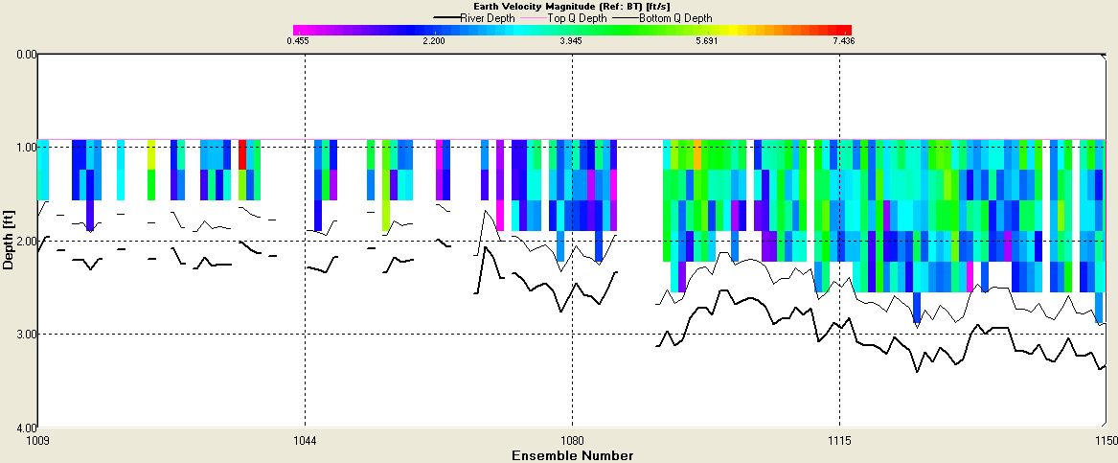
Other Bottom Considerations
Smaller bed material (clay, slit, sand, gravel)
Accurate extrapolation likely
Rough bottom
Extrapolation uncertain
Notes:
The roughness of the bottom can also contribute to uncertainty in the bottom extrapolation. The extrapolation is likely accurate if the both is composed of clay, silt, sand, or gravel. However, for cobbles, boulders, or fractured bed rock the bottom may be extremely rough and the flow through the bottom roughness and even the depth measured by the ADCP difficult to assess. In such circumstances one may need to increase the uncertainty for the extrapolation; however, remember the uncertainty is a percent of total discharge and the discharge through those roughness elements is likely a small percentage of the total.

Slide 16
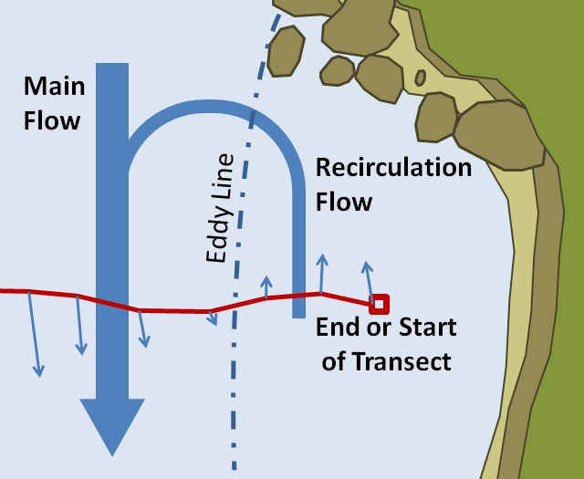
Edge Estimates
What percentage of flow is in the edges?
May be small enough to disregard accuracy
Recommend no more than 5% in each edge
Eddy at edge
Is the effect of the eddy captured?
Any field notes about the edge?
Does the measured start or end velocity represent the velocity in the edge?
Large edge
Large edge estimates should have supporting documentation
Irregular edge shapes
Subjective judgment
Notes:
Edge estimates. Hopefully the edge discharge is small enough that even significant errors are a small percentage of the total discharge. Edge estimates should be less than 5% in each edge or addition documentation supporting the estimate should be provided (OSW Technical Memorandum 2012.01).
If there is an eddy or recirculation zone at the edge, the first option is to select a better cross section. If that is not possible then it is necessary to properly measure the eddy by making sure the negative flow is captured in the data. Field notes should document flow reversals along the edges.
Often during floods with flow in the flood plain it is difficult if not impossible to measure in the flood plain due to vegetation. When this occurs measurements by alternative techniques and/or documentation supporting the estimate should be provided.
The manufacturers software provide two standard edge shapes: triangular and square. If your edge does not resemble either of those shapes or the velocity distribution does not attenuate smoothly to zero at the bank, you may need to adjust the edge coefficient in WinRiver 2 or manually compute and enter and edge discharge in RiverSurveyor Live.
Finally, you need to consider the uncertainty in your edge estimate. This is completely dependent on your observations and judgment.

Slide 17
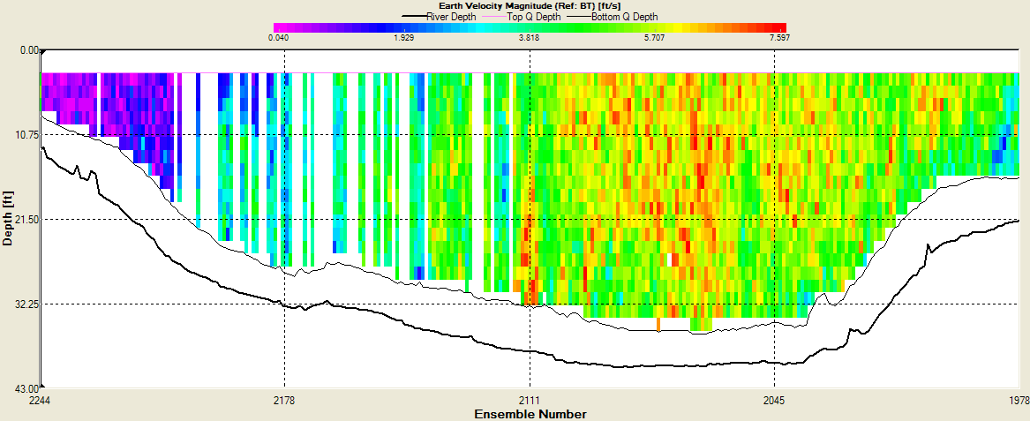
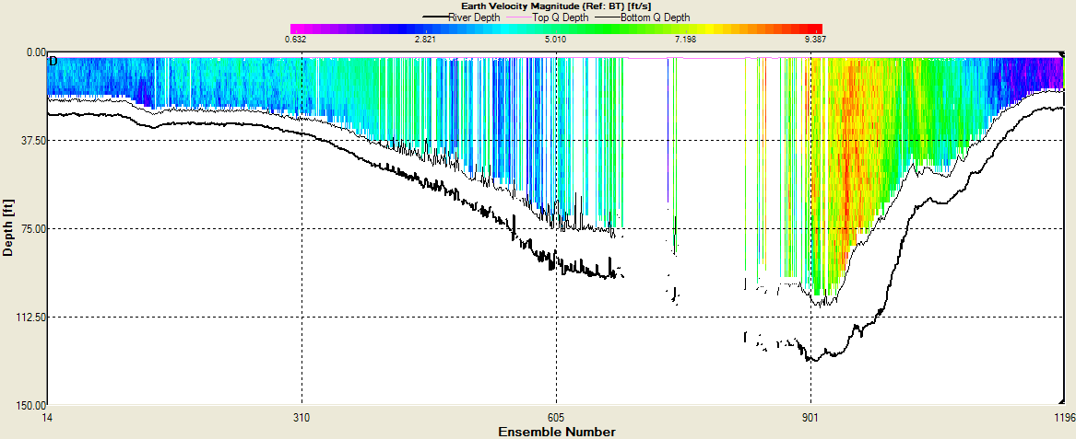
Consider Invalid Data
Percent of invalid data
Distribution of invalid data
How well is that portion of the flow estimated
Notes:
I am often asked how much invalid data is allowed. My answer is always, it depends. You could lose 50% of your data but if it is every other ensemble the chances are your measurement is still accurate because the valid ensembles represent the flow well and will be used to fill in the invalid areas. So, the important consideration is not how much invalid data, but how it is distributed. If the valid data surrounding the invalid data are representative of the invalid data as in the top two contour plots the uncertainty in discharge is not large. However, if the invalid data are not well represented or occur in a key location as in the lower contour plot the effect can be significant.
This description is accurate for data processed with WinRiver 2. For RiverSurveyor Live the situation is a little different. RiverSurveyor Live does not compute the discharge for areas where the data are invalid. If the selected navigation reference is lost and there is no alternative navigation reference, RiverSurveyor will hold the last valid boat velocity for 9 seconds after that the data are marked invalid and no discharge is computed for the invalid data. Thus, the discharge computed with RiverSurveyor Live that has invalid ensembles is always biased low.
The amount of uncertainty you assign based on invalid data is a subjective judgment based on your observations of the flow.

Slide 18
Summary of Rating Approach
Consider the data
Consider the hydraulics
Consider site conditions
Use statistics if possible
Use your judgment
Pay attention to potential errors (as a percentage) as you review the data
Notes:
In summary, the proposed approach to rating your measurement is to:
Consider the data
Consider the hydraulics
Consider the site conditions
Where possible use statistics or computations to estimate the uncertainty
And use your judgment
You should be able to do this as you review your data. Just remember the percent uncertainty is of the total discharge. So a 50% potential error in an edge that is on 2% of the flow is only a 1% uncertainty on the final discharge.

Slide 19
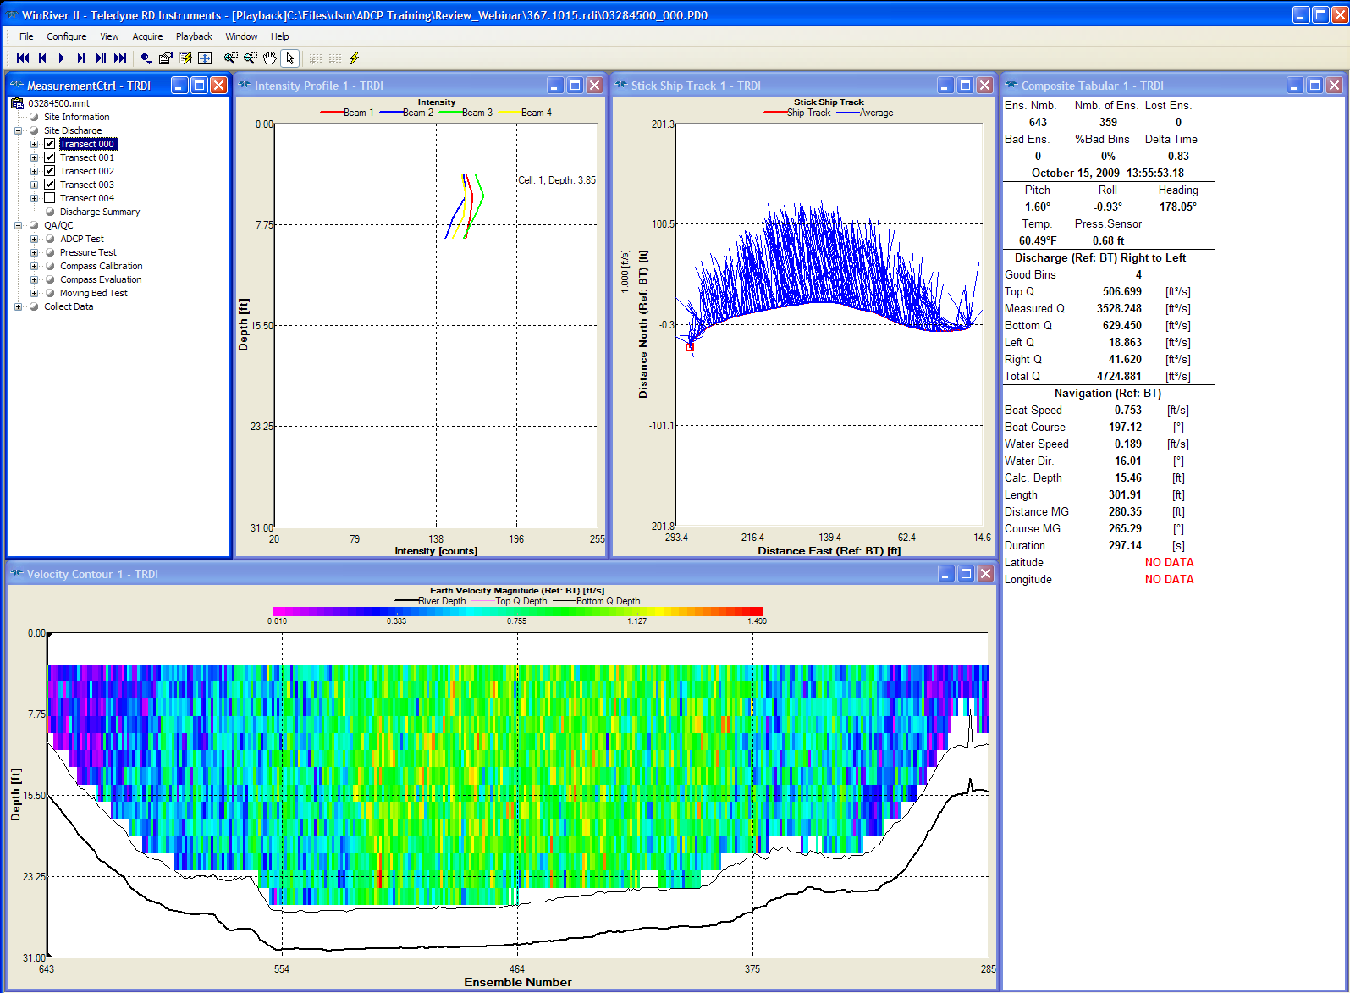
Steps of Review
QA/QC
Composite tabular
Stick Ship Track
Velocity contour
Extrapolation
Discharge summary
For simplicity the review examples are from WinRiver II but the same principals apply to RiverSurveyor Live
Notes:
Althoug I am using WinRiver 2 as the example here each of these areas are in RiverSurveyor Live.
Look at QA/QC, composite tabular data, the stick ship track plot, the velocity contour plot, use extrap to evaluation the extrapolation methods, and finally look at the discharge summary. Using these steps you should be able to identify any major issues with your measurement and assign an appropriate rating to your measurement. If these steps reveal something unusual about your data additional steps may be needed to determine the cause of the problem, however, that is beyond the scope of this webinar.

Slide 20
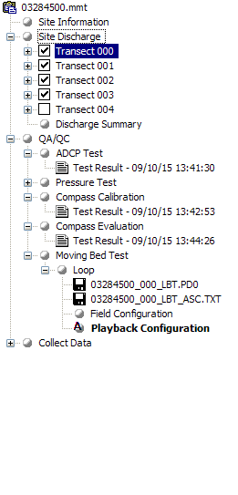
QA/QC
ADCP Test Error Free?
Compass Calibration (Required for GPS or Loop)
Calibration and evaluation completed
< 1 degree error
Moving-Bed Test
Loop
Requires compass calibration
Use LC to evaluate
Stationary
Duration and Deployment
SMBA required to evaluate StreamPro
Multiple may be needed?
Notes:
Is the ADCP test free from errors?
Is there a compass calibration and evaluation? A compass calibration is required for use of GPS or the Loop method)
Is the calibration or evaluation acceptable?
Is there a moving-bed test? If the loop method is used there should be an accurate compass calibration and/or evaluation.
Is there a stationary moving-bed test? Is it of the appropriate duration.
Review the data in the manufacturers software and evaluate using LC or SMBA.

Slide 21
Composite Tabular
Number of Ensembles
> 150
Lost Ensembles
Communications error
Bad Ensembles
Distribution more important than percentage
Distribution evaluated in velocity contour plot
Reasonable temperature
Notes:
Composite Tabular
Is the number of ensemble appropriate? Should be greater than 150.
Are there lost ensembles caused by communications errors?
Here we can look at the percent of invalid or bad ensembles, but as we discussed earlier the distribution is more important than the number.
Is the temperature reasonable? How does it compare to the independent temperature recorded in the field notes?

Slide 22
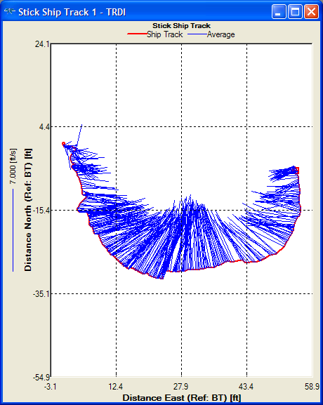
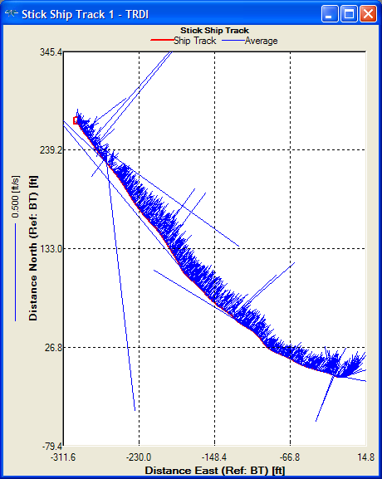
Stick Ship Track
Check with appropriate reference (BT, GGA, VTG)
Track and sticks in correct direction
Magnetic variation
Compass time series
Sticks representative of flow
WT thresholds
Irregular ship track?
BT thresholds
BT 4-beam solutions
Compass errors that vary as you complete a transect can not be calibrated out and may not be reflected in the evaluation error
Notes:
Stick Ship Track
Check the stick ship track with the reference that will be used for computing the final discharge.
Are the track and sticks in the correct direction? If not, is the magnetic variation entered? You may need to evaluate the compass time series to look for serious compass errors?
Compass errors that vary as you complete a transect, as shown in the top figure, can not be calibrated out and may not be reflected in the evaluation error but can cause strange looking ship tracks.
Do the sticks represent the flow properly? Large discrepancies, often caused by ambiguity errors and in the lower figure, can often be filtered out using the threshold settings in WinRiver 2.
Is the ship track smooth or irregular? If irregular, did the instrument have a compass? Often StreamPro’s without compasses will show an irregular ship track due to uncompensated rotation but this does not constitute and error. If the ship track has jumps in it the threshold settings in WinRiver 2 may help filter out the erroneous data.

Slide 23
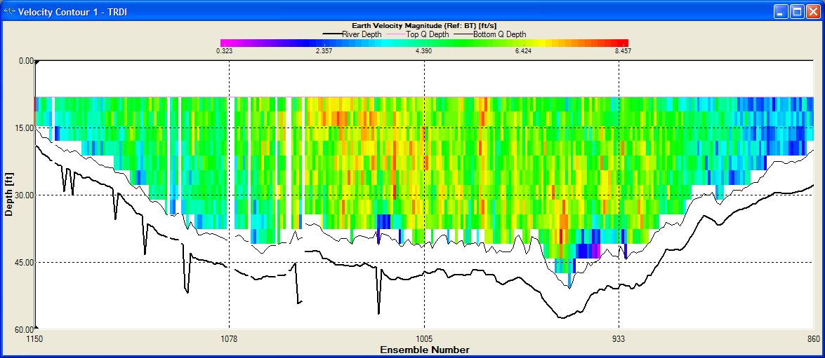
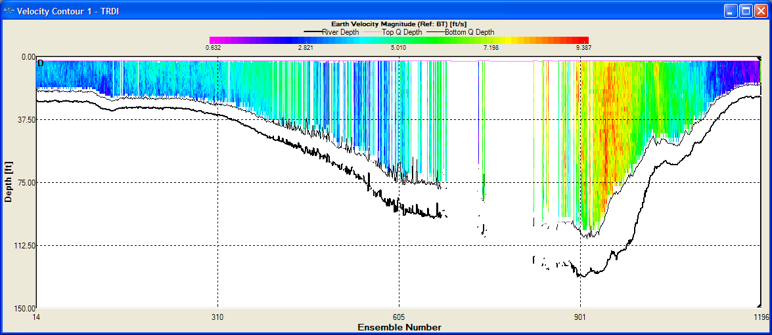
Velocity Contour
Unusual or unnatural patterns in velocity distribution
WT Thresholds
Spikes in bottom profile
Turn on Screen Depth
Distribution of invalid and unmeasured areas
Qualitative assessment of uncertainty
Notes:
In the velocity contour, look for unusual or unnatural pattern in the velocity distribution. If these are observed, the threshold settings in WinRiver 2 can be used to filter that data. Look for spikes in the bottom profile. If these are observed as in the top figure, turn on screen depth in the process settings in WinRiver 2 to filter these data out. What is the distribution of invalid data and unmeasured areas. Here you must make a qualitative assessment of the uncertainty associated with the invalid data.

Slide 24
Velocity Extrapolation
Use extrap
Select one fit for entire measurement unless conditions change during the measurement
Notes:
Use extrap to select one fit for the entire measurement. The only time the fit should vary between transects is if conditions have changed during the measurement. A significant change in wind speed or direction, which should be documented in the field notes.

Slide 25
Discharge Summary
Transects: duration > 720 seconds
Directional bias
GPS used
Magvar correction
Consistency
Discharges (top, meas., bottom, left, right)
Width, Area
Boat speed, Flow Speed, Flow Dir.
Notes:
Finally look at the discharge summary.
If the duration greater than 720 seconds?
Is there a directional bias? This is common for GPS based measurements if there is compass error or incorrect magnetic variation.
Look for consistency in the discharges (top, measured, bottom, left, and right), the boat speed, width, area, and flow speed and direction.
Any unexpected and unexplained inconsistencies could add to the uncertainty of the final discharge.

Slide 26
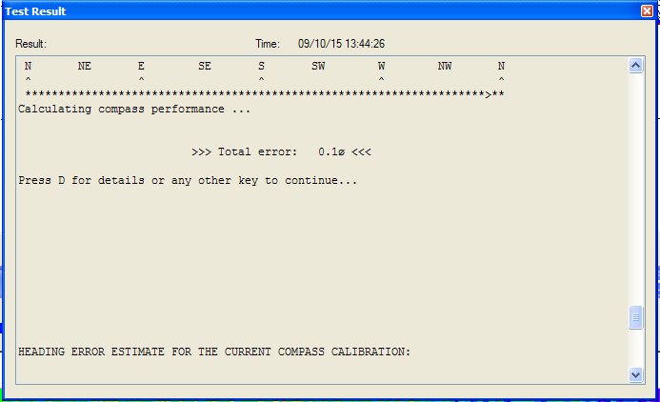
Example 1 – Compass Cal.
Compass Evaluation is Good!
Notes:
Now that we have discussed what to look for and the steps of processing a measurement lets look at three examples.
Example 1.
Looking at the QA/QC we see the compass evaluation is good.

Slide 27
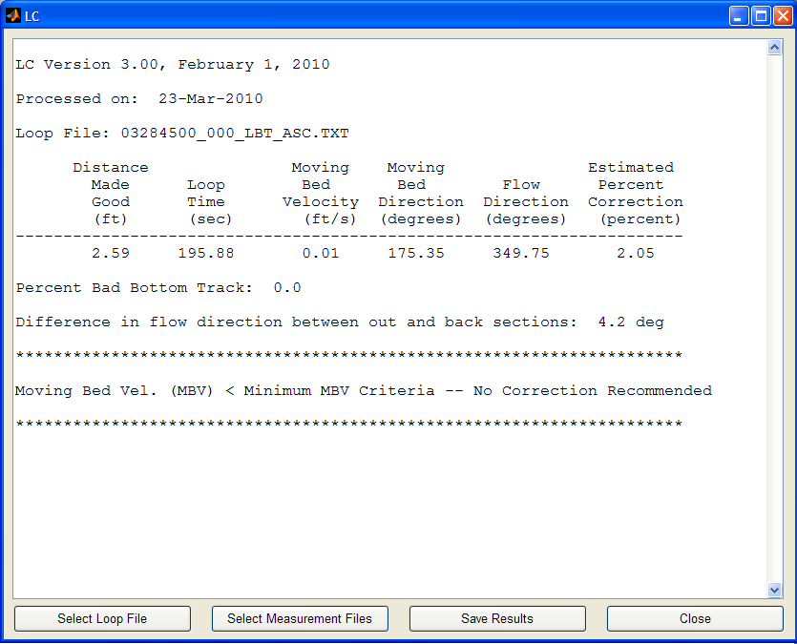
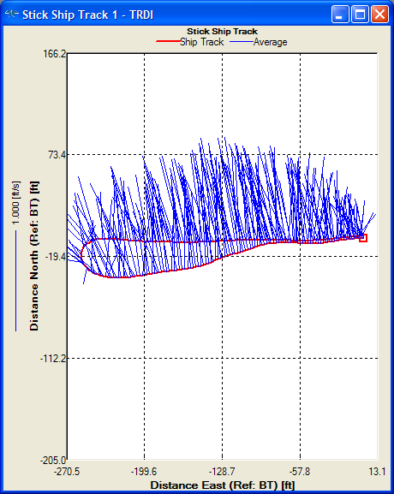
Example 1 – Moving-Bed Test
Loop looks good
LC finds no problems with loop
Lost BT
Compass Error
No moving-bed correction required
Notes:
A loop moving-bed test was completed. There was no lost bottom track, the potential compass error is low, and no moving-bed was detected.

Slide 28
Example 1 – Composite Tabular
> 300 ensembles
No lost ensembles
0-1 bad ensembles
Temperature reasonable
Notes:
Looking at the composite tabular data.
There are over 300 ensembles in each transect.
No lost ensembles.
Zero and 1 bad ensembles.
And the temperature appears reasonable.

Slide 29
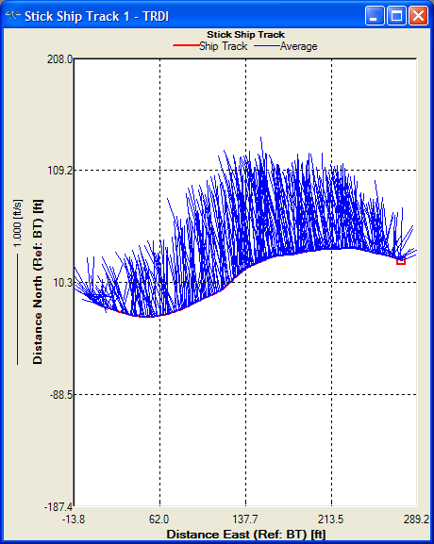
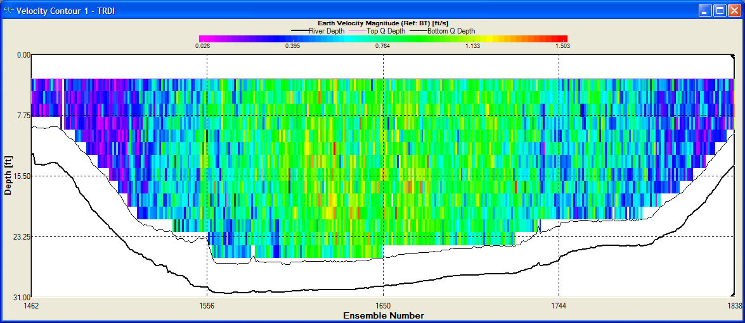
Example 1 – Ship Track / Contour
Ship track consistent
No spikes in contour plot
No unnatural patterns
Unmeasured areas reasonable in size
Notes:
Ship track looks consistent.
No spikes or unusual patterns in the contour plot.
The size of the unmeasured areas a the top and bottom appear reasonable.

Slide 30
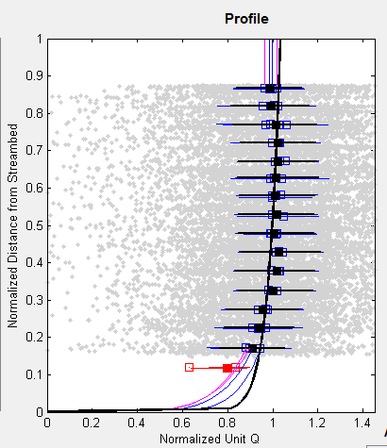
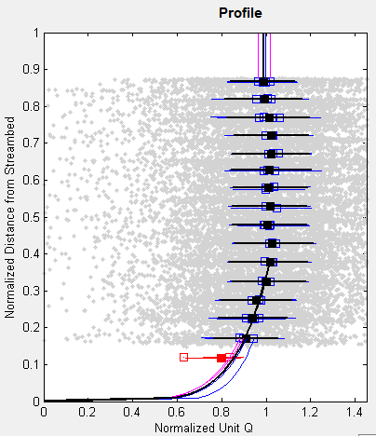
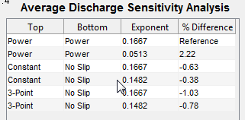
Example 1 - Extrapolation
Automatic
Manual
Overestimates data
Better fit
Uncertainty Est. = 1%
Notes:
Using extrap to evaluate the extrapolation methods yields to potential fits. The automatic method selected a power/power fit with and exponent of 0.05. However, reviewing the fit shows that it appears to overestimate the data at both the top and bottom. A manual fit of constant / no slip with an exponent of 0.15 seems to provide a better fit. The difference in discharge between the two is about 2.5%, but the power/power fit shows that it overestimates. I would estimate the uncertainty due to the fit to be about 1%.

Slide 31
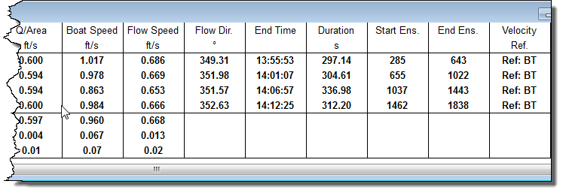
Example 1 – Discharge Summary
Duration > 720 seconds
1 negative Q in left edge
Everything else very consistent
Notes:
From the discharge summary we see that the duration is greater than 720 seconds. There is one negative discharge in the left edge, but the edges represent about 1% of the total discharge. Everything else is very consistent.

Slide 32
Example 1 - Rating
Random uncertainty
1.6*1%= 1.6 %
Systematic bias
1.6 + 0.5 = 2.1 %
Invalid Data
None
Extrapolation
About 1% uncertainty in extrapolation
Edges
About 1% of total Q and appeared reasonable
Final assessment
2.1 +1 = 3.1 %
Rate this measurement “GOOD”
Notes:
So how would I rate this measurement. The coefficient of variation was 0.01 and there were 4 transects so we multiply 1.6 times 1 percent to get 1.6% random uncertainty. Add 0.5% for systematic bias to get a base uncertainty of 2.1%. There was no invalid data. We estimated the extrapolation uncertainty to be about 1% and the edges were only about 1% of the total discharge and looked reasonable. Final assessment is an uncertainty of about 3.1%, so rate this measurement “Good”.

Slide 33
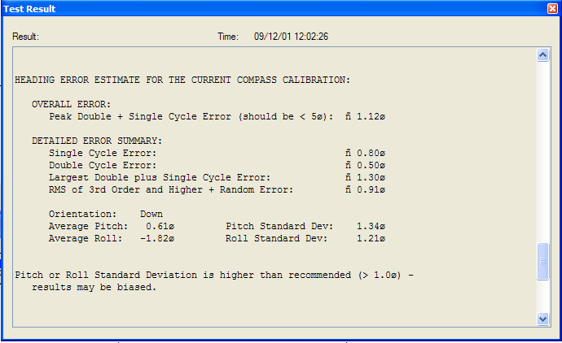
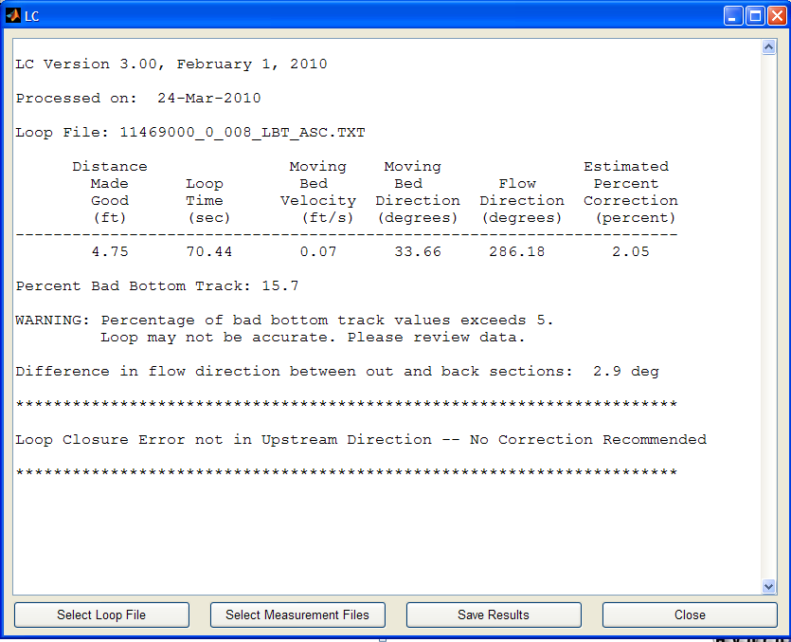
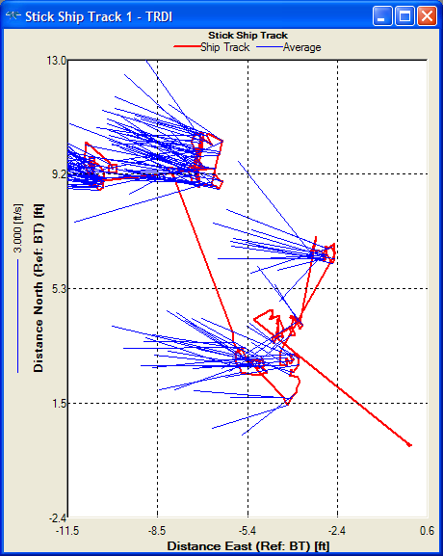
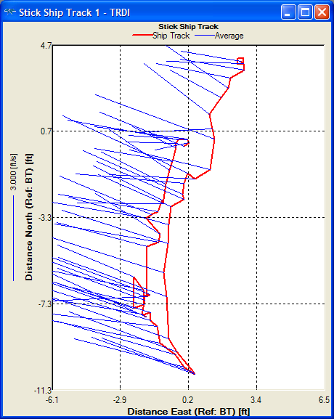
Example 2 – QA/QC
No test errors
Compass Cal
High pitch and roll
Moving-bed tests
Bottom track problems
Notes:
Example 2.
No test errors.
The compass calibration had a high pitch and roll.
The loop moving bed test had bottom track problems, losing bottom track about 16% of the time. Given the poor compass calibration and poor loop test, if these had to be used to correct the discharge or determine if there really was a moving bed the discharge would be more uncertain.

Slide 34
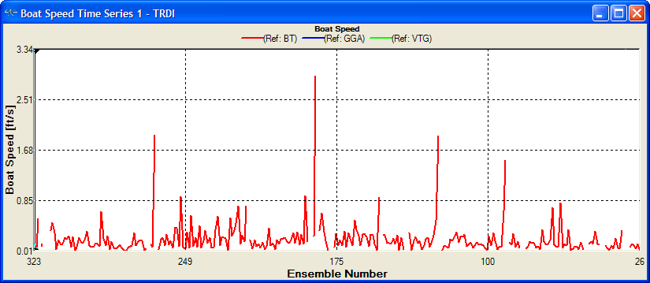
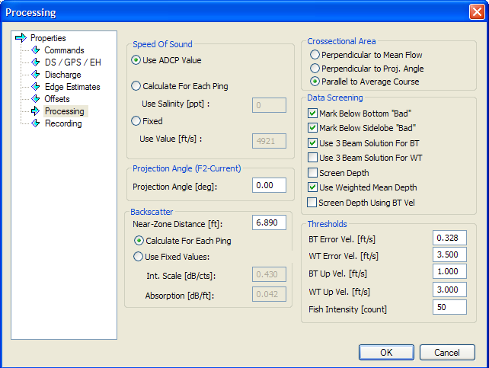
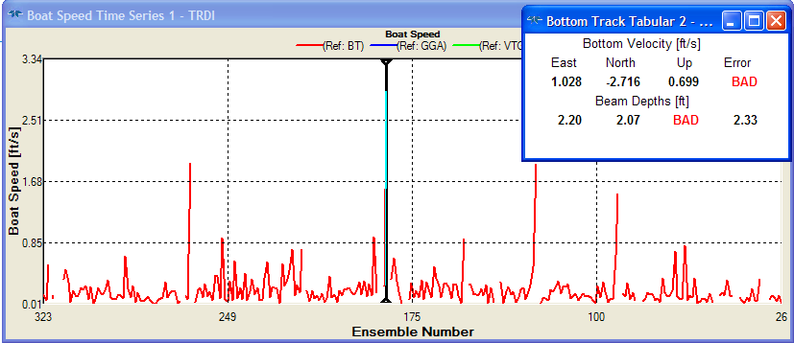
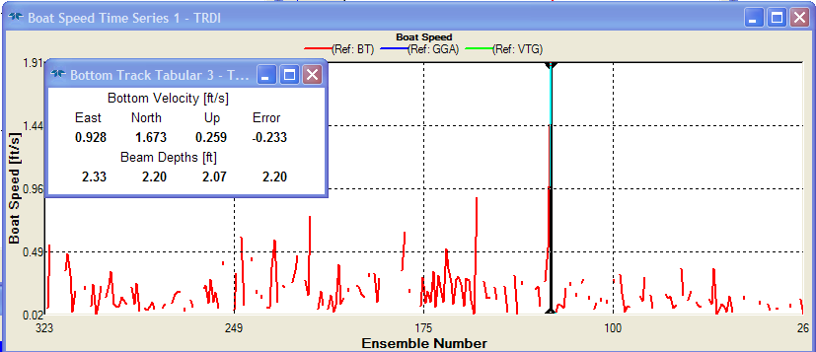
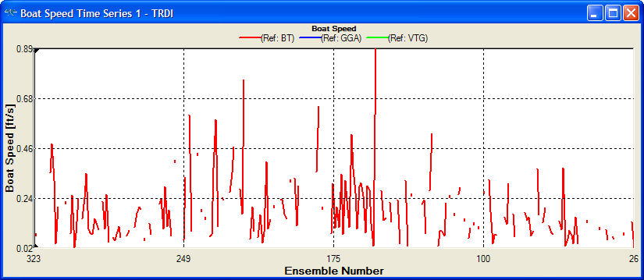
Example 2 – Bottom Track Issue
Time series plots show spikes
3-beam solution
High vertical velocity
Notes:
Looking in more detail at the bottom track issues shows that there were a lot of 3-beam solutions and the bottom track had unexpected high vertical velocities. This can be identified by placing the slider over a peak. In the center figure the error velocity is bad, indicating a 3-beam solution. Turning off 3-beam solutions still results in spikes remaining. In the bottom figure you can see the up velocity in the bottom track is 0.259, which seems high. Setting a threshold for bottom track vertical velocity removes the spike but the result is a lot of invalid data as shown in the lower left figure.

Slide 35
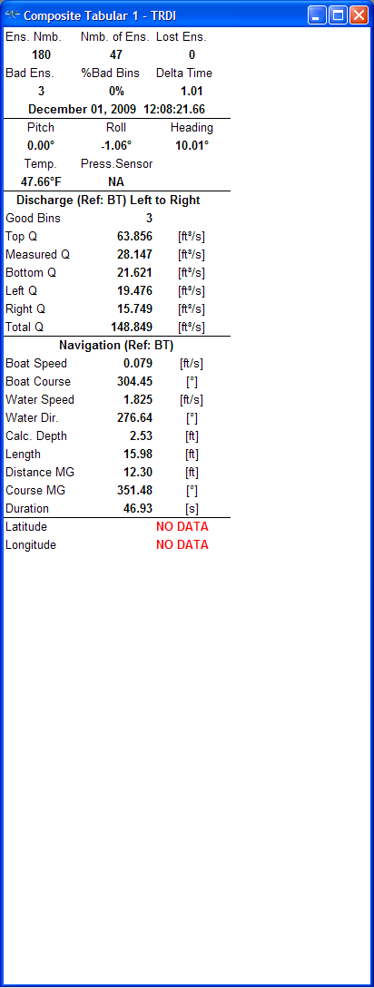
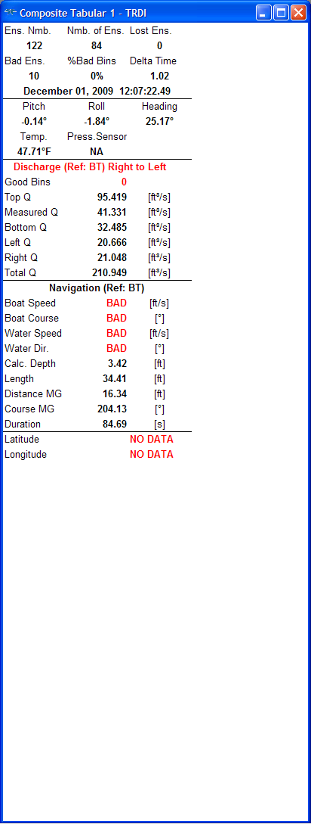
Example 2 – Composite Tabular
Too few ensembles
Short duration < 500 seconds
Bad bins
Notes:
The number of ensembles in each transect is low with 84 being the maximum and 43 the minimum. The sum of the durations of 8 transects is still less than 500 seconds. Although the number of bad bins isn’t high, they represent about 10% of the data, so their distribution may be important.

Slide 36
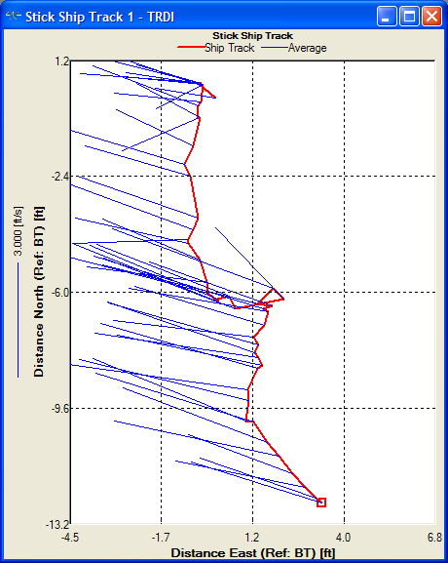
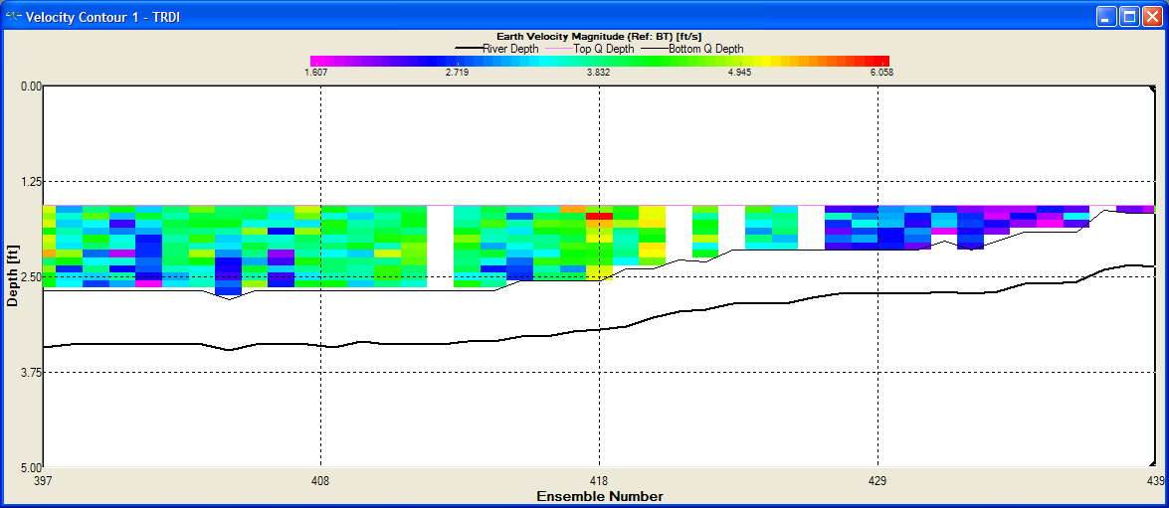
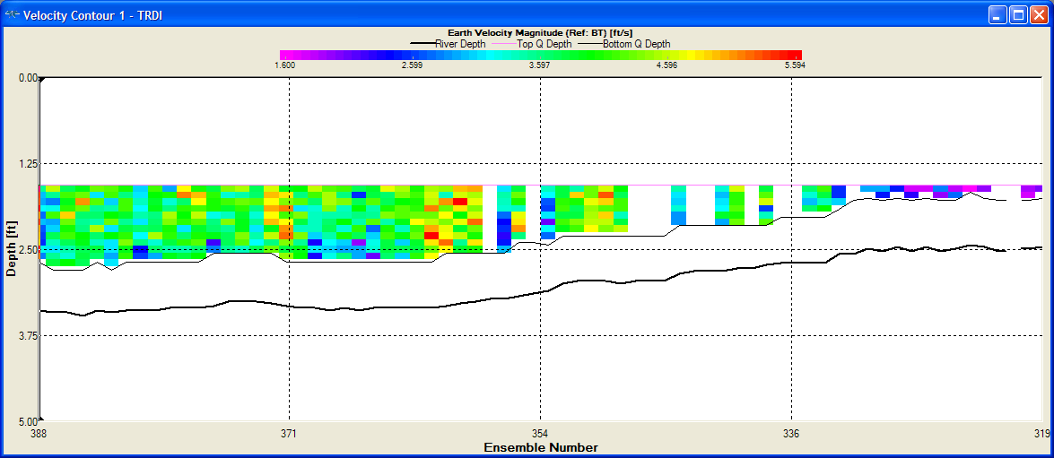
Example 2 – Ship Track / Contour
Irregular ship track
RG 1200
Thresholds didn’t help
No bottom spikes
Invalid data
Not many
High percentage because of so few ensembles
Estimates probable reasonable
Large unmeasured areas
Notes:
The data were collected with a 1200 kHz Rio Grande. The ship track is very irregular indicating problems with bottom tracking and applying the thresholds discussed earlier didn’t improve the situation much. The contour plot shows no bottom spikes and it appears that the invalid data are probably represented reasonably well by the neighboring valid data. However, the unmeasured top portion appears rather large and could result in a the final discharge being very sensitive to the top extrapolation method.

Slide 37
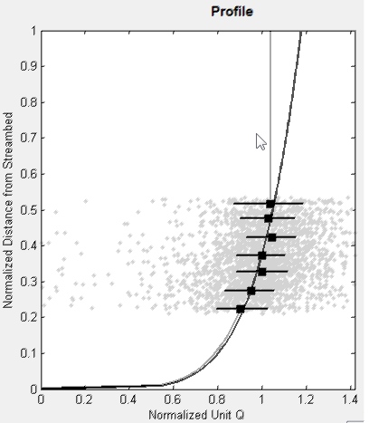
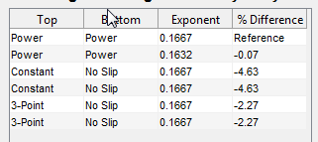
Example 2 - Extrapolation
Large unmeasured top
Field notes
Wind (u/s, d/s)
Surface observation
Uncertainty
5% ???
Notes:
Using extrap to evaluate the discharge profile validates our assumption that the top extrapolation is going to be difficult to evaluate due to lack of data and that the size of the top unmeasured area will result in significant changes in discharge based on the selected extrapolation. Both the power/power with 1/6th exponent and the constant / no slip with 1/6th exponent provide reasonable fits to the data, but the difference in final discharge is 4.6%. This is where field notes are important. If there was a documented strong upstream wind, I would be inclined to use constant / no slip. However, in absence of any documentation or site conditions that would result in a bend back at the top of the profile I would stay with the power/power fit with a 1/6th exponent. Thus, the uncertainty due to extrapolation methods is about 5%.

Slide 38
Example 2 – Discharge Summary
Duration < 500 seconds
Consistent edges
Inconsistent width and area
Bottom track problems
High Q COV
Notes:
From the discharge summary we find:
The duration is less than 500 seconds.
The edges are consistent but the width and areas are not, owing to the identified problems with bottom track.
The discharges have a high coefficient of variation of 0.14 or 14%.

Slide 39
Example 2 - Rating
Random uncertainty
14* 0.8 = 10%
Systematic bias
10 + 0.5 = 10.5%
Invalid data
Some but not significant
TOO FEW ENSEMBLES
Bottom track problems
Large unmeasured areas
Extrapolation
Large unmeasrued top ~ 5% uncertainty
Edges
Reasonable
Final Assessment
10.5 + ? + 5 = 15.5+ %
Rate this measurement “POOR”
Notes:
So, what does the final rating look like.
The random uncertainty is the coefficient of variation of 14% multiplied by 0.8 because there were 8 transects. Adding the systematic bias the bas uncertainty is 10.5%. The invalid data did not appear to be a huge problem, but the large unmeasured top portion resulted in about a 5% uncertainty in the extrapolation method. The edges were reasonable, so the final assessment is an uncertainty of about 15% and I would rate this measurement “Poor”.

Slide 40
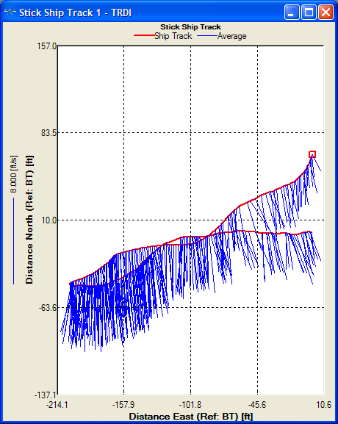
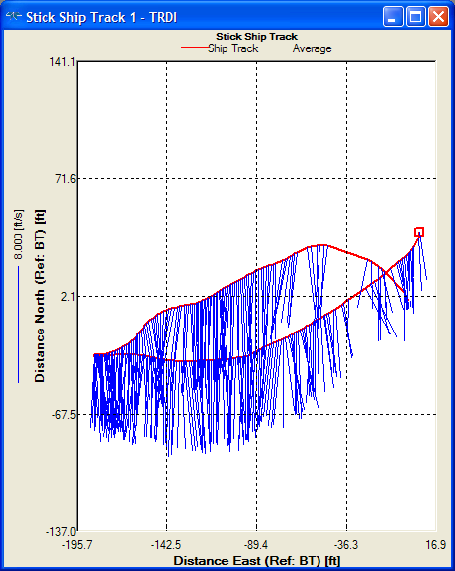
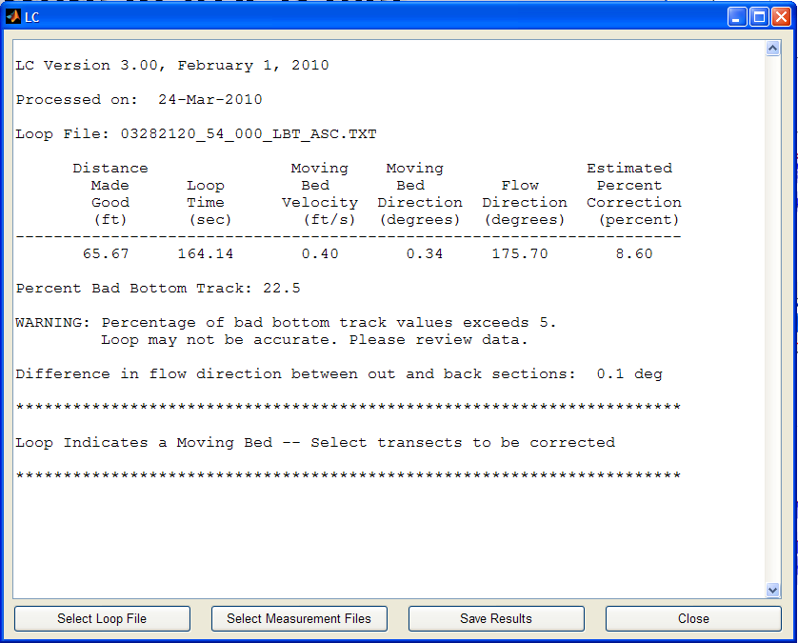
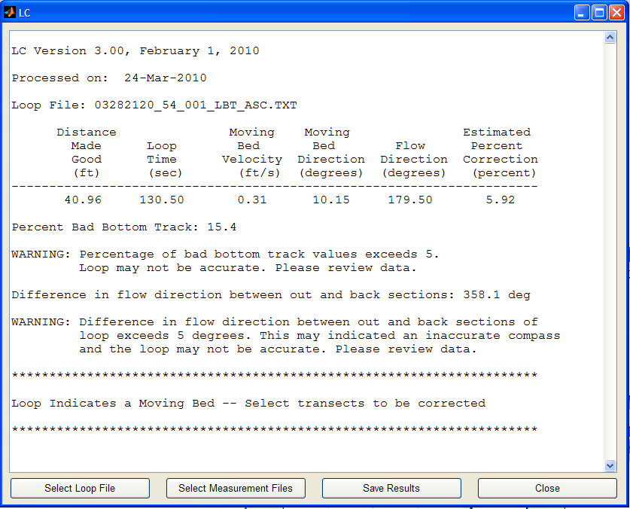
Example 3 – QA/QC
No errors in ADCP test
Good compass calibration
Two loop tests
Notes:
Example 3
There were no errors in the ADCP test and the compass calibration was good.
However, two loop tests show significant moving-bed but are also affected by 15-22 percent invalid bottom track.

Slide 41
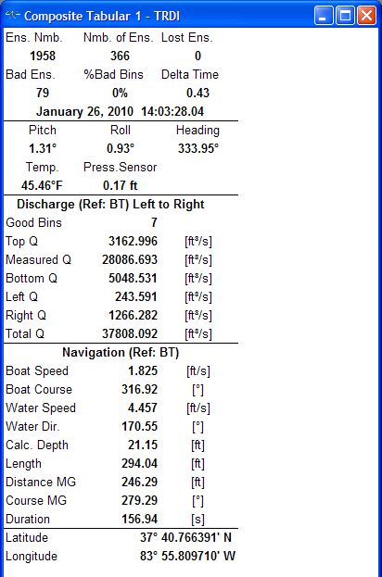
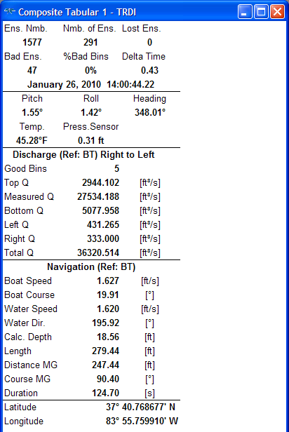
Example 3 – Composite Tabular
High percentage of bad ensembles
Notes:
An initial look at the composite tabular data shows a high percent of bad ensembles, about 15-20 percent, which is consistent with the loop tests. However, we see a clue that may help with the bottom track problems. GPS data has been collected.

Slide 42
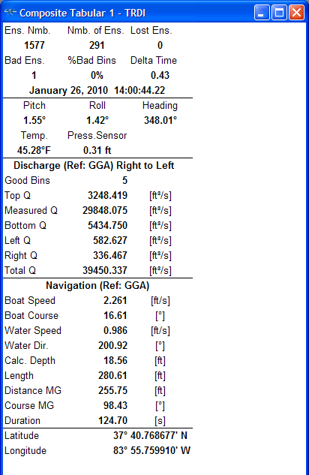
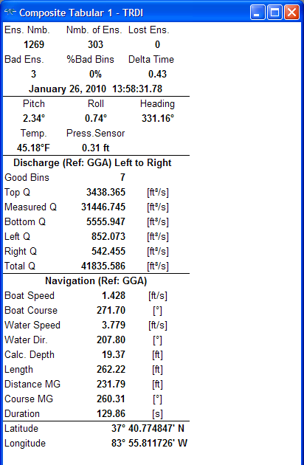
Example 3 – Composite Tabular
Very few bad ensembles with reference set to GGA!!
Notes:
Switching the navigation reference to GPS reduces the number of bad ensembles to about 1%.

Slide 43
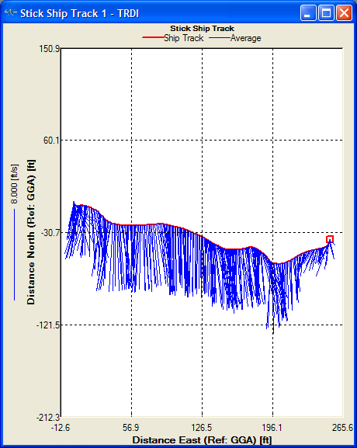
Example 3 – Ship Track / Contour
Everything looks good with reference set to GGA
Notes:
With reference set to GGA the stick ship plot and the contour plot both look good.

Slide 44
Example 3 – Ship Track / Contour
With bottom track we need to qualitatively assess the effect of the invalid data on uncertainty
Notes:
However, if we had to use bottom track we would have to qualitatively assess the uncertainty associated with the invalid data.

Slide 45
Example 3 - Extrapolation
Rough bed
Uncertainty = 1%
Smooth bed
Notes:
As this example will illustrate the user must apply knowledge of the site and consistent logic to select the extrapolation method and assess the uncertainty. The figure on the right shows two power fits. The Gray line is the default 1/6th exponent which clearly does not fit the data. The black line has an exponent of 0.05 and appears to fit the data better. However, its shape a the bottom doesn’t represent the data perfectly and will tend to overestimate the discharge.
The figure on the left shows the constant / no slip fit with two different exponents for the no slip portion. So which do you choose? Since the power curve with the 0.05 exponent appears to overestimate the discharge in the bottom, which is consistent with the discharge sensitivity analysis, I would eliminate it from consideration. So, which of the no slip exponents is correct? Well we really don’t know, but if I know the bed was composed of gravel or coarser material I would probably choose the 1/6th exponent as it has a flatter profile. However, if the bed were smooth clay or silt, I would be inclined to pick the 0.09 exponent as it has a more vertical shape consistent with a smooth bed. The difference in discharge between the two is about 1.25%. So I would estimate the uncertainty at about 1%.

Slide 46
Example 3 – Discharge Summary
Small directional bias
Typical of magvar or compass error with GPS
Correcting magvar 2.5 degrees removed directional bias and changed Q by 1.3 cfs.
Edge discharge are inconsistent but small relative to total Q
Duration = 526 sec
Notes:
Looking at the discharge summary for the GGA reference, we see a directional bias which will inflate our coefficient of variation. Correction the magnetic variation removed the directional bias but changed the discharge by only 1.3 cfs and would not be recommended for this measurement.
The edge discharges are inconsistent but are less than 3% of the total discharge.
The duration is less than 720 seconds. Note: this measurement was collected prior to the new policy.

Slide 47
Example 3 – Discharge Summary
Bottom track referenced discharge are lower indicating a moving bed was present.
Edge discharges are inconsistent but small
Would require correction with LC
Notes:
If we look at the discharge summary for bottom track, we see the discharge is lower than that for the GGA reference, indicating there is a moving-bed at this site. This would require LC to correct the discharge.

Slide 48
Example 3 - Rating
GPS (GGA or VTG) should be used as the reference.
Random uncertainty + bias
3 * 1.6 + 0.5= 5.3%
Value may be inflated due to directional bias
No significant invalid data
Extrapolation error 1 % worst case
Edges would make little difference
Final assessment
Numbers work out to about 6% but could be inflated (5.4% using sqrt sum sqrs) . Rate this measurement “Good” but wouldn’t argue if rated “Fair”
Notes:
Rating the measurement using the GGA reference.
The coefficient of variation was 0.03 so the base uncertainty works out to be 5.3%. But remember we said this number may be inflated due to the directional bias. Using GGA there was no significant invalid data. The extrapolation error was about 1% worst case. The edges were inconsistent but were only about 3% of the total discharge. Therefore, the final uncertianty is about 6%. I would probably rate this measurement good but I would not argue if you wanted to rate it fair.

Slide 49
Example 3 - Rating
If GPS were not available and BT had to be used the rating would change.
Base uncertainty
2 * 1.4 + 0.5= 3.3%
Invalid data
Represent a significant percentage of the flow
Likely estimated well from neighboring data
Add 1% uncertainty
Edges
Inconsistent
Small percentage
Extrapolation
1%
Loops
High percentage of invalid bottom track
5-8% moving-bed bias
Uncertainty estimated at 4% (rounded down)
Final assessment
3.3 + 1 + 4 + 1 = 9.3% (sqrt(3.3^2+1^2+8^2+1^2)=8.8%)
I would probably rate this measurement “Poor” due to loop test.
Notes:
If GPS weren’t available and you had to use BT the rating would be different.
You notice that as predicted the coefficient of variation dropped to 0.02, as the directional bias from the compass is removed, so the base uncertainty is 3.3%. Again the edges are inconsistent but represent less than 3% of the total discharge. The extrapolation estimate is about 1%. Since there was a moving-bed and we are referencing bottom track the loop tests must be used to correct the data. Remember the loop had 15-22% invalid bottom track that could affect the results. The potential moving-bed bias varied from 5-8% between the two loops. I would assume an uncertainty due to the loops of about 4%. Therefore, the final assessment is about 9.3% uncertainty. I would rate this measurement “Poor”, due primarily to the presence of a moving-bed and a poor loop test.

Slide 50
Summary
Consider potential uncertainty or errors as you review the data
Keep review to a minimum unless errors are identified or suspected
Consider the percent of effect of an error or uncertainty will have on the discharge
Use extrap to help determine uncertainty due to top and bottom extrapolations
Use the COV in the discharge summary as the base minimum uncertainty
Assume a 0.5% systematic bias
Contact OSW if you have unusual data or you have questions
Notes:
So In summary:
Consider potential uncertainty or errors as you review the data
Keep review to a minimum unless errors are identified or suspected
Consider the percent of effect of an error or uncertainty will have on the discharge
Use extrap to help determine uncertainty due to top and bottom extrapolations
Use the COV in the discharge summary as the base minimum uncertainty
Assume a 0.5% systematic bias
Contact OSW if you have unusual data or you have questions

