Slide 1
Best Practices for Collecting Mid-section Discharge Measurements with ADCPs
Nick Stasulis
Maine Water Science Center
Webinar Presented:
September 19 and 22, 2011

Slide 2
Overview
What is the mid-section method?
When is the mid-section method preferable?
Overview of TRDI’s SxS Pro
Overview of Sontek’s RS Stationary Live
Some best practices for mid-section Qms
Notes:
This webinar is not intended to be a step-by-step guide on collecting mid-section measurements with ADCPs.

Slide 3
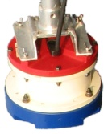
Mid-Section (SxS or Stationary) Discharge Measurement
Velocity
Width
Depth
Notes:
This slide illustrates the mid section method used to make conventional discharge measurements with Price AA, pygmy, FlowTracker and Ott velocity meters. TRDI commonly calls this method section by section, while Sontek refers to mid-section as the stationary method.
With the mid-section method width is computed as half the distance from the current section to the previous section, plus half the distance from the current section to the next section. This width is then multiplied by the depth measured to compute an area. Then we take the resulting area and velocity to compute the discharge at that station.
The current software from TRDI and Sontek, which we will discuss later, is in a much better state than it was even a year ago and manual computations with ADCPs are no longer necessary and are discouraged.
ADCPs give us an advantage over conventional current meters as the depth is measured by the instrument and we are measuring a complete profile, not discrete points at each station

Slide 4
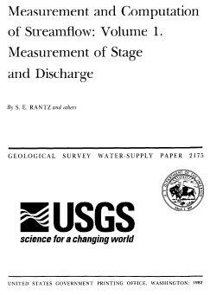
Standard USGS Mid-Section Methods Still Apply
Good cross section
25 - 30 sections attempting to avoid measuring > 5% of discharge in any one section
> 40 second sample time per section
Notes:
When using ADCPs for mid-section measurements we follow the same methods and guidelines as a measurement with conventional velocity meters. We still select a relatively uniform cross-section free of eddies, slack water and excessive turbulence. Ideally, the section should be free of boulders, debris or aquatic growth and have relatively parallel banks.
We still shoot for 25-30 stations. Depending on the software you are using a station may be called a vertical or a profile. We also avoid having any more than 5% of the total flow in any one station and collect data for at least 40 seconds at each.

Slide 5
Why use the mid-section method?
Ice Measurements
Unable to bottom track
Moving bed conditions
Difficulty completing moving boat transects
Check measurements
Confirming edge discharges/bank overflow
Notes:
Next, we will talk about several situations where the mid-section method could be preferable.

Slide 6
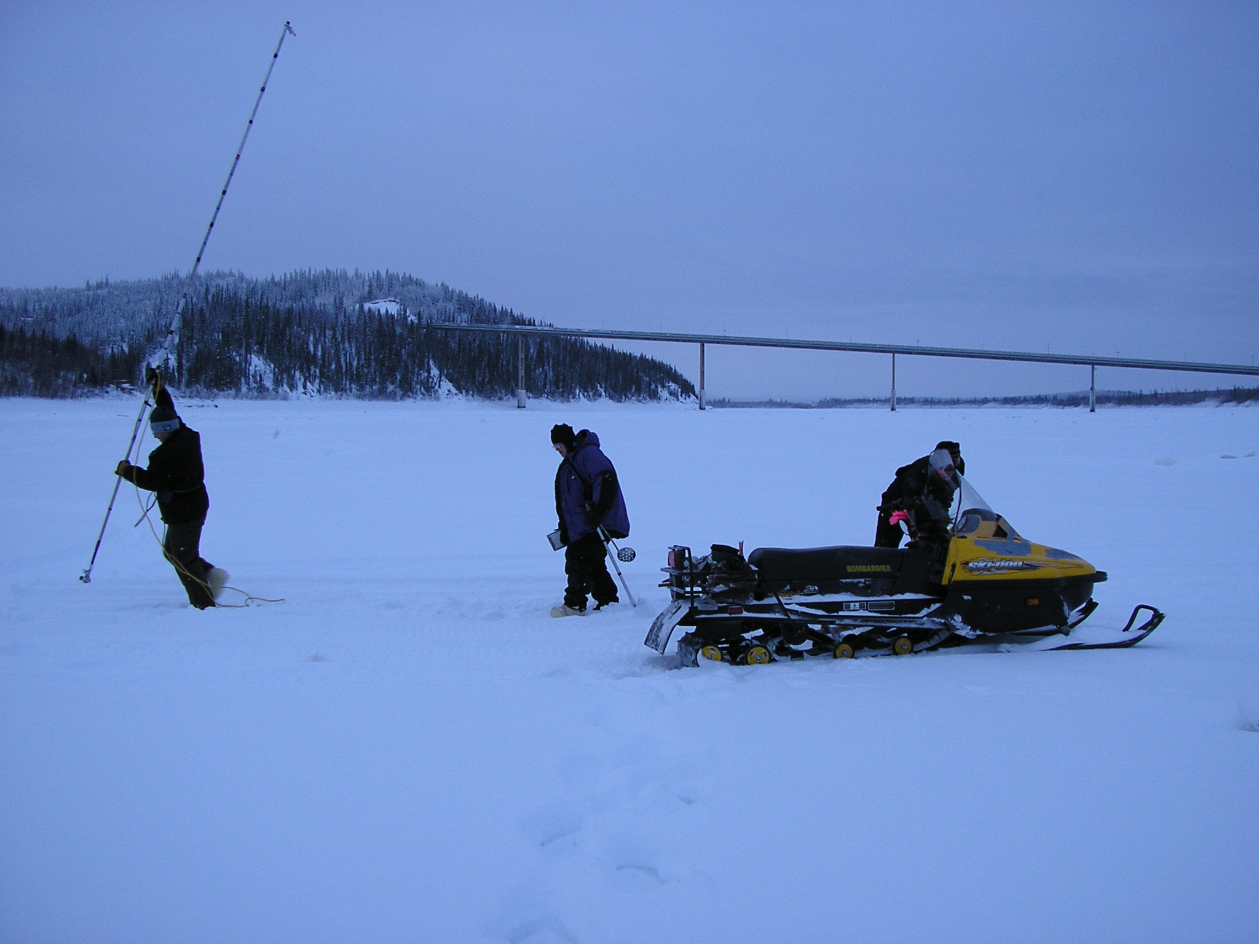
Why use the mid-section method?
Ice Measurements
Using ADCPs with the current software allows for correction of angles
Ideally, only at each station collecting data for ~40 seconds
Potential for smaller diameter auger
No need to sound river depth
Yukon River @ Stevens Village, Alaska
Notes:
Using stationary software with ADCPs might have the greatest potential for improvements in data quality and time savings when measuring in ice conditions. Using the mid-section method with ADCPs with the current software allows for automated correction of angles. This ability to correct for angles under ice is not an option with previous techniques.
With no need to sound the bottom depth and measure velocity at multiple depths, we are only collecting data at each station for 40 seconds in good conditions.
Depending on the instrument you are using, you may be able to use a smaller diameter auger, saving additional time when drilling holes.
Also, the deployment setup becomes simplified without the need to sound the river depth at each station

Slide 7
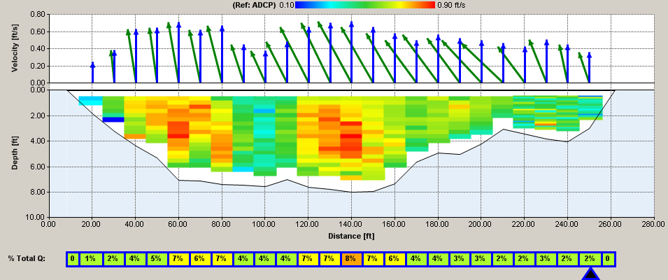
Angles under ice…
With SP:
Q unadjusted = 850 Q adjusted = 760
These angles and the adjusted Q were confirmed by an M9
Notes:
This is a data set from ice comparison measurements made last winter. Significant effort was made to string the tagline perpendicular to the river banks in a straight reach of the river. After making a StreamPro measurement with the SxS Pro software and a comparison polymer AA measurement we noticed some large differences in our final discharges. We noticed the StreamPro discharge when adjusting for angles was much lower than the unadjusted discharge. A Sontek M9 measurement confirmed the adjusted discharge from the StreamPro was correct. Both the StreamPro and the M9 were adjusting for flow angle, and the conventional meter was not, of course.
The angles measured by the StreamPro and the M9, each using a different method, were quite similar. Packed slush is common in Maine rivers during the winter period and is a possible cause, though it’s more likely we were not as perpendicular to the river banks as we thought.
ADCPs allow us to adjust for flow angles and reverse flows under ice, something we haven’t been able to do with conventional meters…

Slide 8
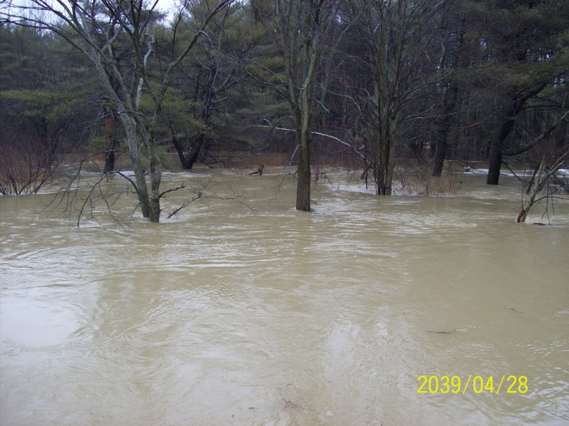
Why use the mid-section method?
Unable to bottom track
High sediment
Near bed vegetation
Uneven channel
Fast/turbulent water
Notes:
There are many conditions where ADCPS are known to have issues bottom tracking. These include high sediment, vegetation or brush near the channel bottom, a cross-section with large depth variations and fast/turbulent water. Since the ADCP is assumed to be stationary, the ability to bottom track is not required for mid-section measurements.
Though the unit doesn’t have to bottom track for mid-section measurements, it still needs to be able to measure depth. In extreme cases where a depth can’t be consistently measured by the ADCP we do have an ability to enter a depth, a feature we will discuss later.

Slide 9
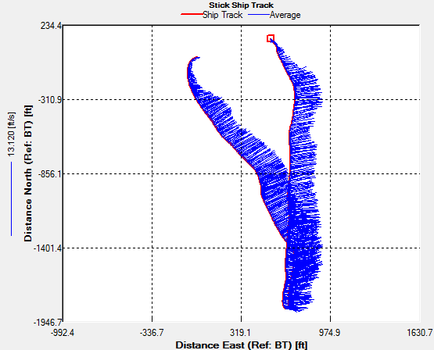
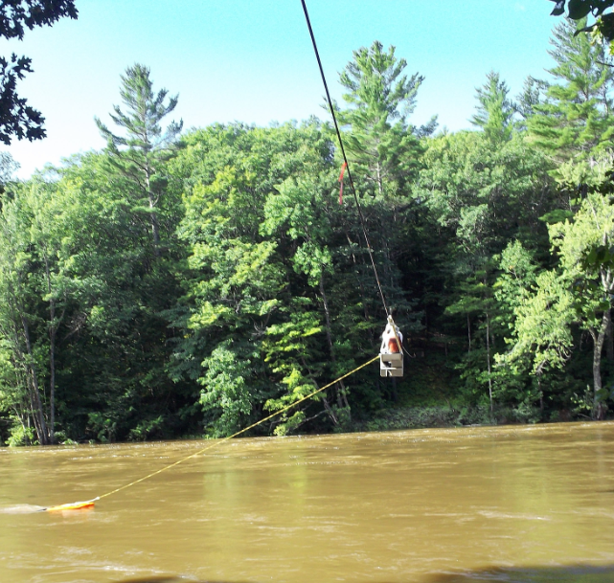
Why use the mid-section method?
Moving Bed Conditions
No need to rely on bottom track, GPS and compass data
Notes:
Since mid-section measurements do not rely on bottom track, there is no potential for a moving bed bias when using this technique.
For both the loop moving bed test and GPS data collection, OSW requires a compass calibration. If a valid compass calibration can’t be obtained, or if a site characteristic causes compass errors, both the loop moving bed test and the GPS navigation references may not be available. Another possibility is that the compass calibration is valid, but GPS data is invalid. If both the loop moving bed test and GPS reference are not available in moving bed conditions, our last option for moving bed correction is multiple stationary moving bed tests. If these tests cannot be collected reliably, or if they show highly variable results, we can collect a mid-section measurement and eliminate the potential for that bias.

Slide 10
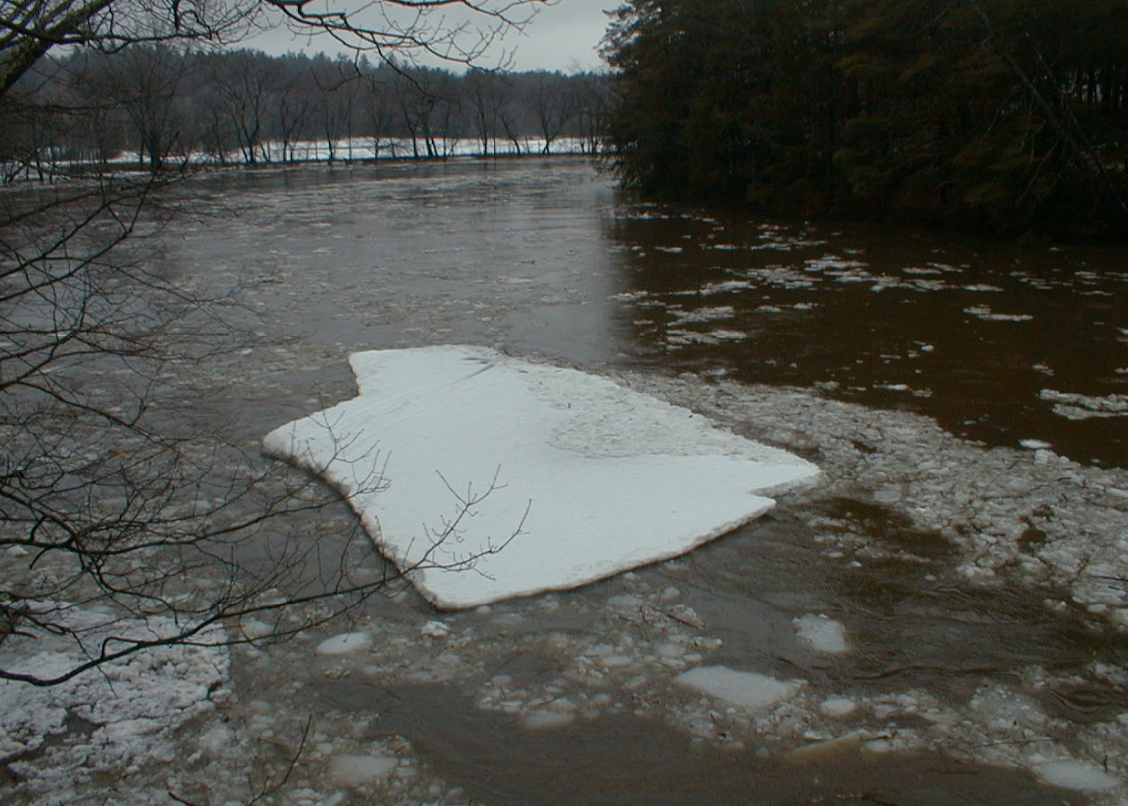
Why use the mid-section method?
Difficulty completing moving boat transects
Flowing Debris
River Traffic
Notes:
We have all attempted to make a moving boat ADCP measurement and had frequent “busted” transects due to heavy debris flows, river traffic or other disturbances.
Moving the boat slightly between stations, or aborting a 40 second data collection period at one station, could be much easier than constantly busting transects trying to avoid ice and debris or traffic in the river

Slide 11
Why use the mid-section method?
Check measurements
Uses an entirely different method than a moving boat ADCP measurement
A great option if an ADCP is the only measurement option and/or only one unit is available
Confirming estimated edge discharges/bank overflow
Notes:
Using the mid-section method with an ADCP is a great option for a check measurement when only one ADCP is available as it uses a different computation method than the moving boat technique. It also eliminates some sources of potential error that exist with the moving boat technique (bottom track biases, like moving bed, for example).
The mid-section method is also useful to confirm estimated edge discharges that are large and/or uncertain. Another potential use is to help measure overbank flows in flood conditions.

Slide 12
TRDI’s SxS Pro Software
Released June 2010
Software can be downloaded for free and used to playback data collected in the WinRiver II SxS software or the PDA SxS software
A license is required to collect data with SxS Pro
For units with SxS for the PDA or WinRiver II the upgrade cost is $500
For a unit without SxS the cost is $1,450
A key specific to the activated ADCP is entered into the SxS Pro software
Notes:
{AFTER COVERING INFO ON SLIDE} Do not be confused. This SxS Pro software is NOT the same as the WinRiver II SxS software and is considerably more stable for data collection and processing.

Slide 13
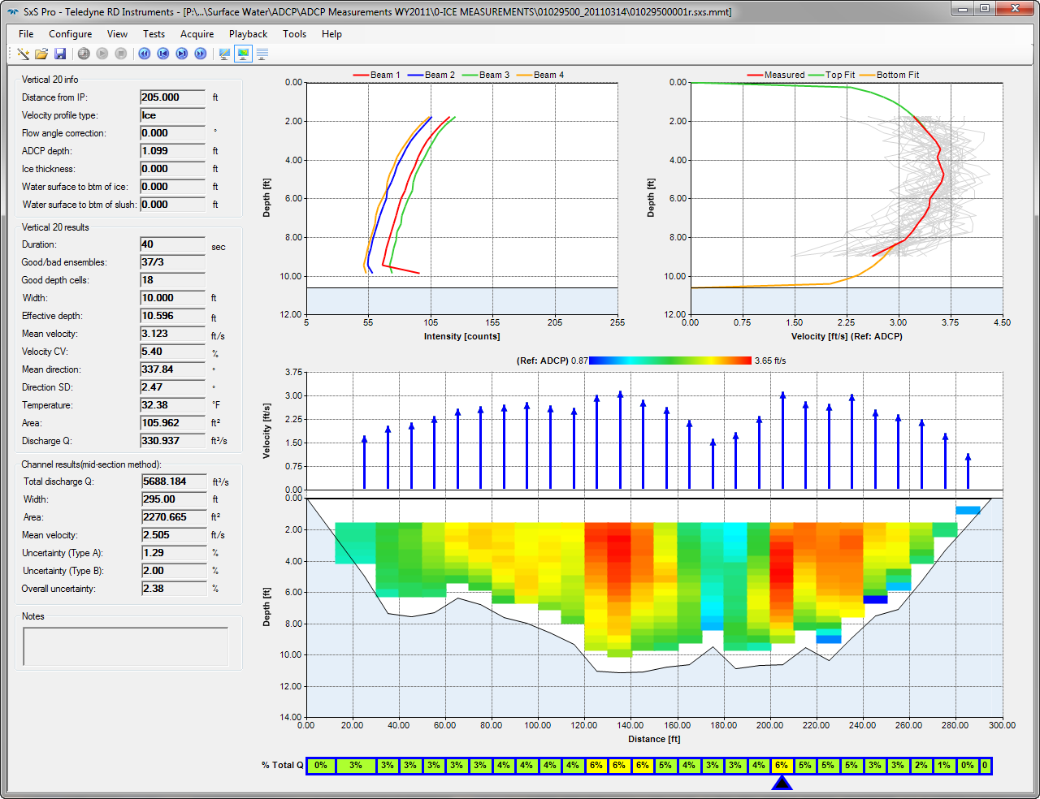
Notes:
The look and feel of the SxS Pro software is quite a bit different than WinRiver II, though the process of going through the wizard and starting a new measurement is similar. The menu options and terminology are similar as well. The software does have some limitations when it comes to viewing data, especially when trying to view tabular displays.

Slide 14
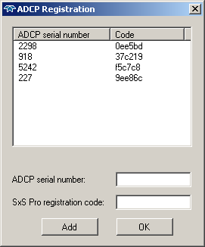
Activation
PDA software and SxS for WinRiver II moved key into unit
SxS Pro requires key entered into software
Notes:
In the current PDA and WinRiver II software the SxS option is activated in the firmware of the instrument, so anyone with the software installed could connect and collect data.
SxS Pro requires that the key is entered into the software for every computer that will be used for data collection. Any computer with the software installed can process data without a key.
This screen capture shows that this particular computer has 4 ADCPs activated for SxS data collection, with the serial number and specific code entered for each. The key was purchased for each ADCP, individually.

Slide 15
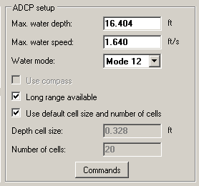
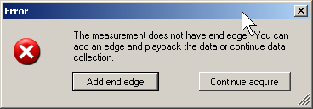
SxS Pro Highlights
Open existing measurement (if not ended) and continue data collection
Edit configuration and change instruments mid-measurement using wizard
Notes:
When opening a measurement that is missing an ending edge you are prompted to either add that edge, or continue data collection. Opening an existing measurement could be useful if your laptop battery died and the laptop shut down or if the software had an issue for some reason (though I haven’t experienced any fatal errors)
Another great feature is the ability to stop pinging mid-measurement and edit the configuration in the wizard, including changes to depth conditions, which allow you to optimize your bin size, and water mode. This ability to change your bin size and water mode introduces some questions with screening thresholds and configuration settings, however. This is further complicated by the fact that you can actually switch instruments mid-measurement and screening thresholds for WM12 with the StreamPro would be the same as those applied to WM5 with a 600 kHz Rio Grande.

Slide 16
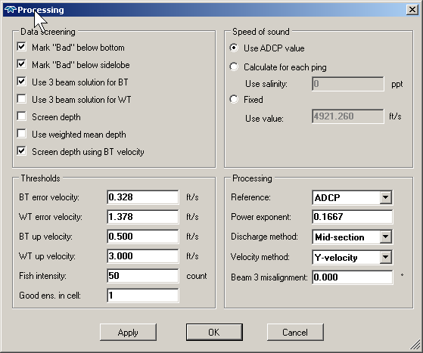
Ability to correct for angles if beam 3 is oriented DS and transducer can be held stationary (likely not for float deployment)
Notes:
If beam 3 can be oriented downstream at each station and held steady we have an ability to use the Y-velocity method for discharge computation, which will account for angles. This method is similar to a FlowTracker. We orient the unit in a known way to the tagline and the unit applies corrections for flow angles automatically.
This method is likely not appropriate for most trimaran/float deployments as the float will cause the ADCP to turn into the flow and not remain perpendicular to the tagline.
If beam 3 was held in an orientation other than downstream, a misalignment correction can be applied.

Slide 17
Sontek’s RS Stationary Live (RSSL)
Released October 2010
Software can be downloaded for free and used to playback data already collected
A license is required to collect data with RSSL
A license for one ADCP is $1,950 and is entered into the firmware of that unit using the Utility software.
Notes:
{AFTER COVERING INFO ON THE SLIDE} This activation method means that any computer with the software installed can connect to a unit with the firmware switch and collect stationary data.

Slide 18
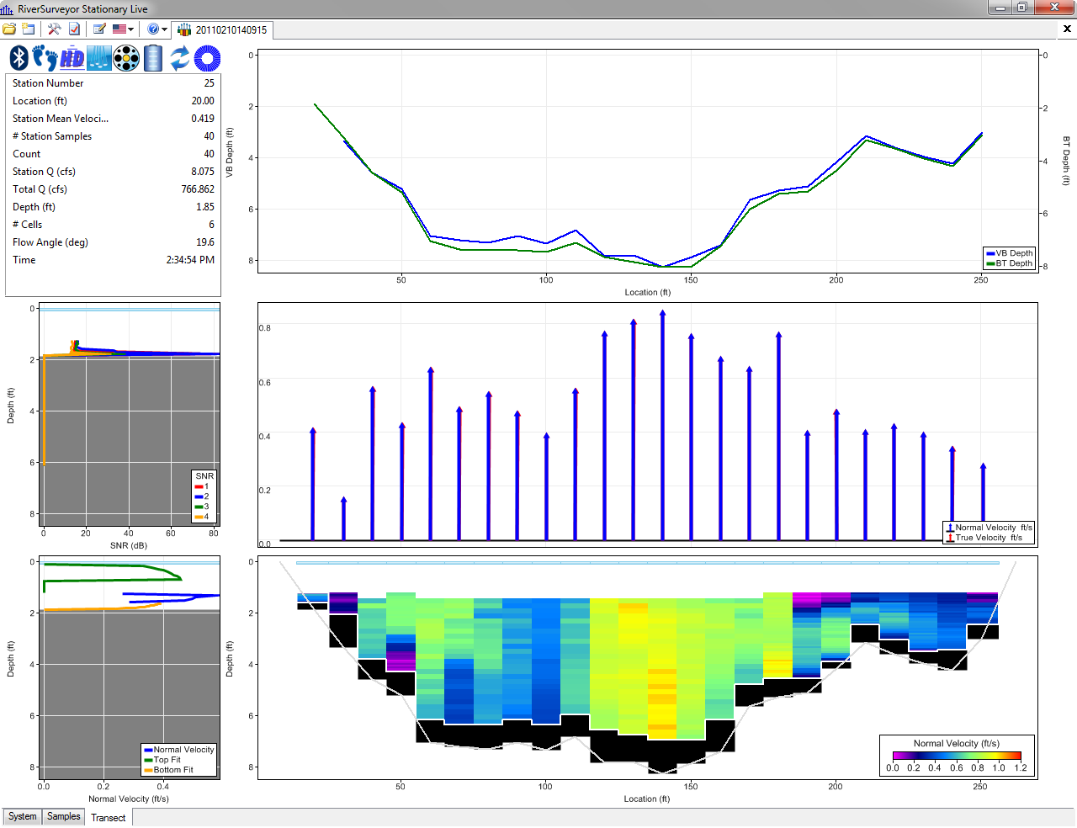
Notes:
RSSL is very similar to RSLive, including the process of setting up, collecting and viewing data in the software. Though the display options are limited, the graphs, controls, icons, tables, etc will be familiar to those using RSLive.
RSSL corrects for flow angles using the compass, so it is critical you get the correct azimuth of your tagline or cross section, something we will discuss later.

Slide 19
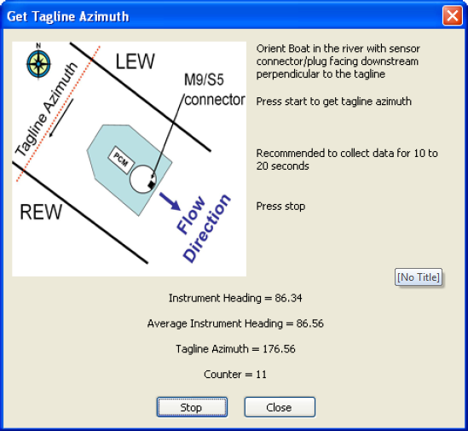
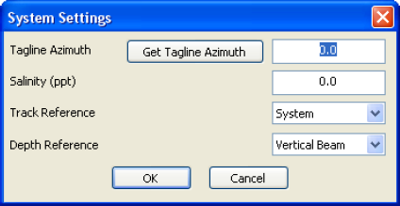
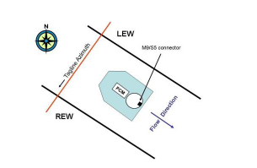
RSSL Highlights
Notes:
With RSSL we have the ability to correct for flow angles using the compass in the ADCP. To do this we use the ADCP (with a calibrated compass) to tell the software the azimuth of our tagline/cross-section. This requires the connector on the ADCP to be facing straight back on the float.
Once the ADCP is oriented correctly (with the connector facing downstream and perpendicular to the tagline) we collect 10-20 seconds of data to document this azimuth. {CLICK}
The software can then take the actual velocity direction and adjust it to be perpendicular to the cross section.

Slide 20
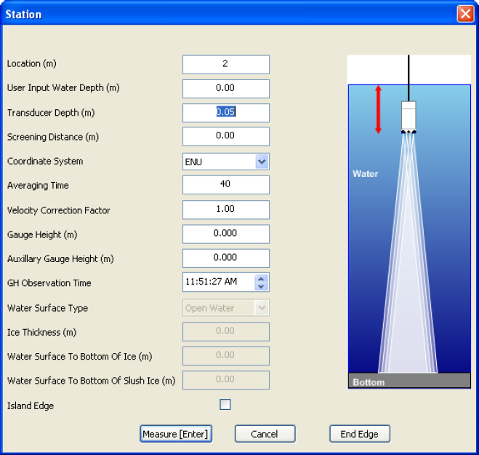
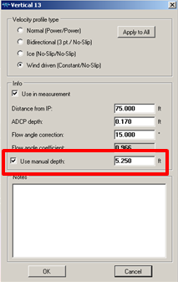
Features in both software packages
RSSL
SxS Pro
Notes:
Now, let’s talk about a couple features available in both software packages
A manual depth can be entered in conditions where the ADCP cannot consistently measure depth, but can measure velocity data. This can be common in sections with brush/aquatic growth on the channel bottom and in very high sediment conditions.
Intermittent data while pinging can provide great estimate of depth. If possible, depths could be measured manually with another method.
When there is considerable brush/aquatic growth on the channel bottom or very high sediment, be sure to consider the possible influences of these interferences on your velocity data and the intermittent depth measured by the ADCP.

Slide 21
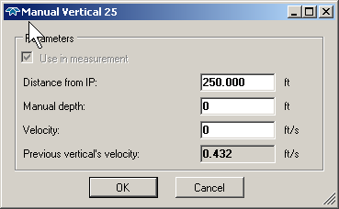
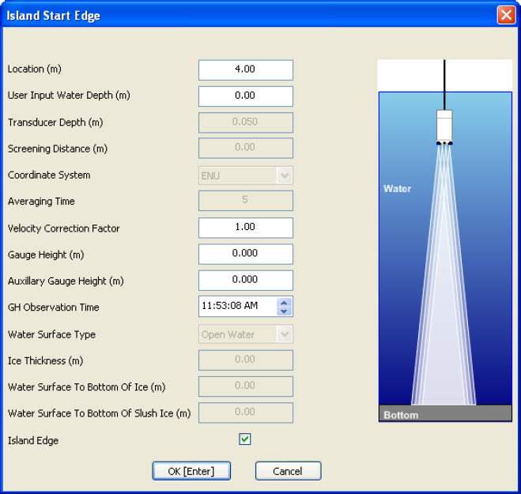
Manual Vertical or Island Edge
Slush-to-bottom, too shallow to profile or to account for island/pier
Notes:
It also possible to enter a manual depth and do a “manual vertical” or “island edge” to account for water that is too shallow for the ADCP to measure, to account for a hole that is packed with slush (typically called slush to bottom) when making ice measurements, to account for an island or pier in the section, or for vertical banks.
For a vertical wall, this is no different than accounting for a vertical wall with a conventional measurement. We enter the depth at the location and a velocity correction based on our last measured velocity. SxS Pro shows you the last velocity and asks you to input the actual estimated velocity for that location, rather than ask for the correction factor.

Slide 22
Best Practices
Like with any new equipment or method, comparisons measurements are essential to ensure this new software measures a discharge similar to accepted equipment and software combinations
Conduct comparisons over the range of conditions you intend to use the stationary software
Comparisons are not required for every measurement
Submit comparisons to the OSW Sharepoint Site!
Notes:
{FIRST} Now, let’s talk about some best practices for all mid-section measurements, regardless of manufacturer.

Slide 23
Best Practices
With mid-section measurements we still make many of the same key assumptions as moving boat ADCP measurements:
All beams are “seeing” the same flow
Use in turbulence, eddies or highly variable depths may result in erroneous velocities
We should still keep the ADCP a river depth away from vertical walls
Discharges on the top/bottom are estimated through extrapolation

Slide 24
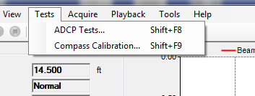
Best Practices
RSSL
SxS Pro
Notes:
Compass calibration procedures in both software packages allow us to calibrate for site conditions. Compass data is used to adjust for angles automatically and to account for rotation of the ADCP in RSSL and to account for rotation of the ADCP in SxS Pro.
In the event that compass data is completely invalid for some reason, discussions have been recently started with the manufacturers on how to ignore compass data completely. The StreamPro does have a feature built into SxS Pro currently as the compass is located in the head, not the transducer, and the two are typically not oriented correctly during ice measurements as the transducer and head are not mounted on the boat.
RSSL provides the ability to switch to an XYZ coordinate system for an individual vertical, which does not use compass data, but would have to be done for each vertical.
If the compass is experiencing small, consistent interference it’s likely the relative differences in heading can still be used for determination of boat rotation.

Slide 25
Best Practices
Angles in open-water
Though both software packages provide automated methods for angle correction it is important to observe the angle measured by the unit and confirm through surface observations at each station
With RSSL a poor calibration of the compass or interference could cause the azimuth for the tagline or individual station angles to be incorrect

Slide 26
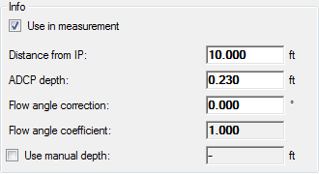
Best Practices
Angles in open-water
SxS Pro does not have an automated procedure for open water angle correction, unless the boat can be oriented perpendicular to the tagline (usually on possible during ice measurements)
You MUST manually enter an angle from perpendicular for each station to account for flow angles
Notes:
{AFTER COVERING THE SLIDE} While the entry field is actually an angle in degrees, the box below shows the coefficient corresponding to that angle

Slide 27
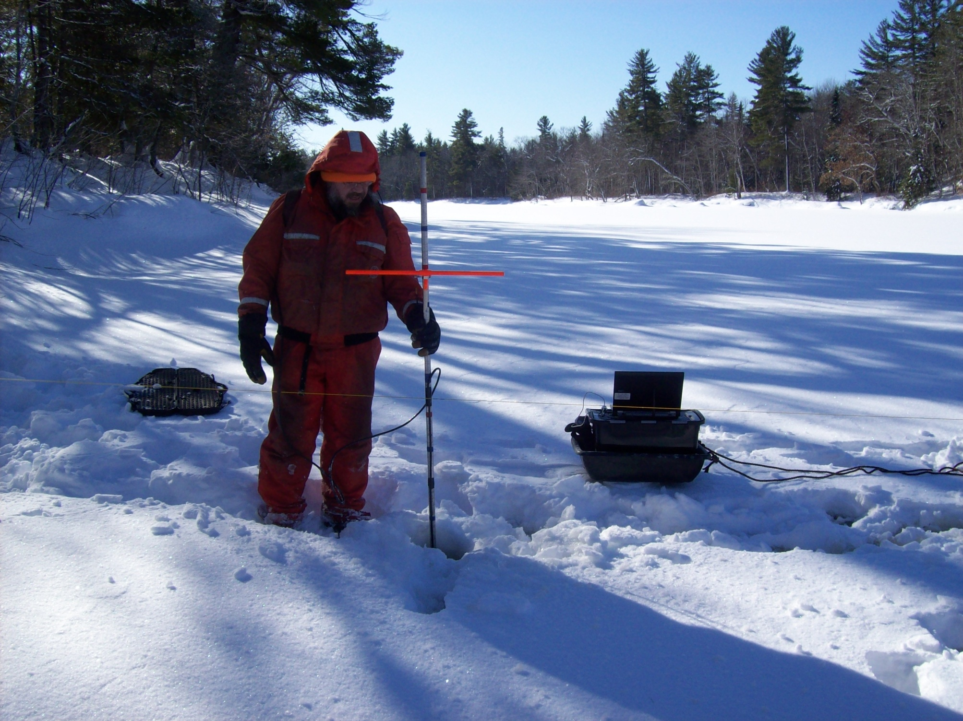
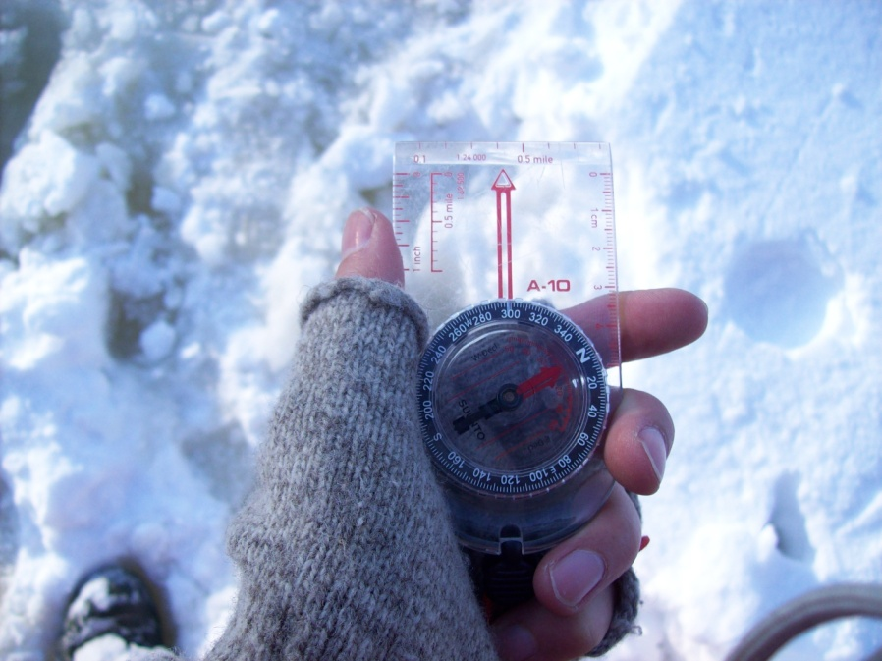
Best Practices
Angles under ice
With RSSL, consider using a hand-compass to measure the azimuth of the tagline to check against the ADCP value
With SxS Pro holding beam 3 downstream throughout the entire data collection period is essential. This can be difficult.
Notes:
Hopefully standardized deployment methods and hardware will help improve data collection for ice measurements when attempting to correct for angles. With RSSL, you can still measure the azimuth of the tagline to account for angles in ice conditions, and it is worth using a hand compass to note the azimuth of the tagline to check against the ADCP value. Be aware of compass interference with Sontek instruments. Steel toe boots right near the ADCP are a concern.
When using SxS Pro holding beam 3 downstream throughout the entire period of data collection can be difficult. Any rotation of the ADCP will lead to apparent velocity angles. Be very aware of this movement.
Also, incorporation of compass data into SxS Pro is highly desirable for Rio and RiverRay ice measurements and open water measurements. Deployment of the StreamPro for ice measurements when using compass data could be difficult as the compass is not in the transducer. I am told TRDI is considering an ice rod that would eliminate this problem.

Slide 28
Best Practices
Check the velocity directions in open water and under ice to ensure the directions are similar
This is important with manual angle corrections and with automated angle corrections
This can be done in the “contour” views and the tabular summaries
An 8 degree angle = a 0.99 coefficient
An 11.5 degree angle = 0.98 coefficient
A 14 degree angle = 0.97 coefficient

Slide 29
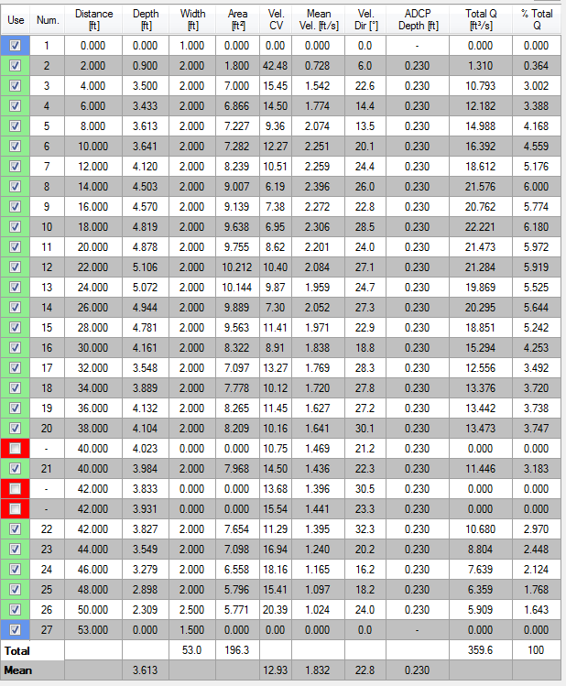
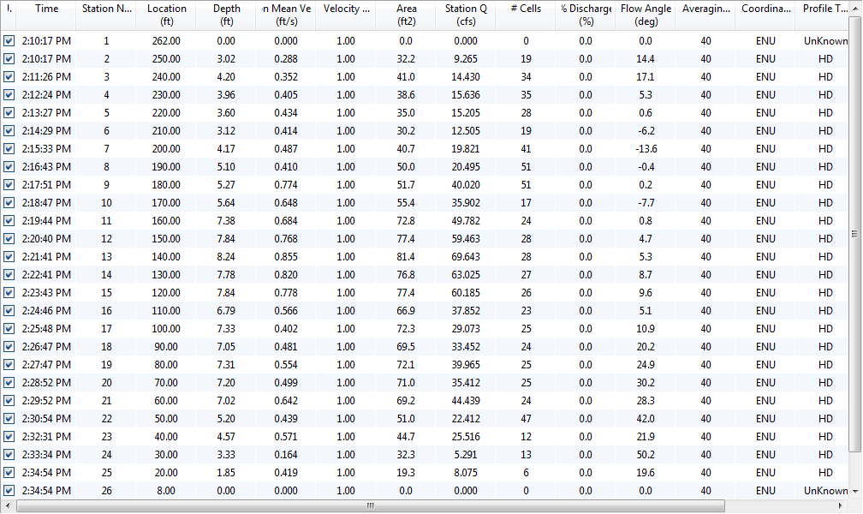
Velocity Direction
Notes:
When looking at the SxS Pro tabular display we can see the direction of the velocity. Check through these directions and look for relative consistency. While these numbers are not used for flow computation, they do provide some indication of variation in flow direction throughout the cross section. When evaluating these directions, it could be helpful to remember how much of an angle it takes to cause a change in velocity. For instance, a difference of 8 degrees equates to a 0.99 correction factor. If you are seeing large variations in velocity direction you would hope to see a manual flow angle entered by the user. {CLICK}
RSSL displays the angle of the flow through the cross section through their tabular display. Again, scan this column and look for outliers/consistency from station to station and for the mean, overall flow angle/direction.

Slide 30
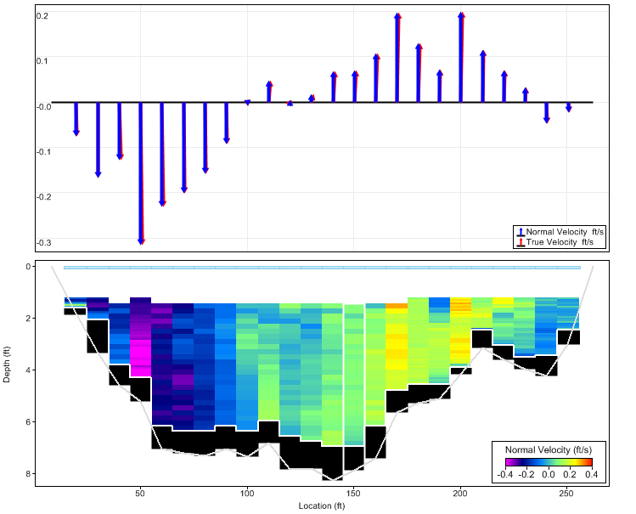
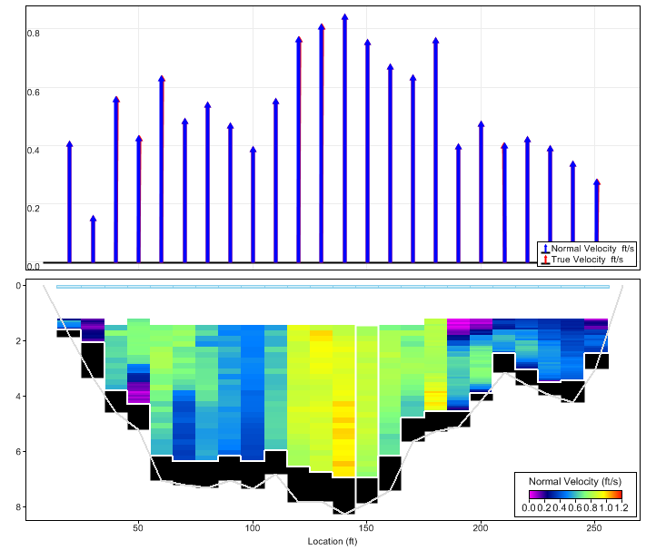
Velocity Direction
Incorrect azimuth, compass experiencing interference during collection of azimuth
With correct azimuth, measured with hand compass before measurement
Notes:
When using a tagline azimuth with the Sontek software, or the Y-velocity option in SxS Pro, angle correction is “automated” by the software. Despite this automated procecss, it is important to confirm that the angles measured are consistent with river observations. If angles are indicated that are likely not real due to compass errors it may be necessary to manually edit the tagline azimuth to remove the false angles. This brings up the fact that river observations are important. If real angles were observed in open water, you wouldn’t want to change the azimuth and remove them. In ice conditions, look for large, erroneous velocities that are likely incorrect.
This screen capture is from an ice measurement where the compass was experiencing interference during collection of the azimuth with an M9 as the ADCP was sitting between the hydrographer’s feet, who was wearing steel toe’d footwear. {CLICK}
After entering the tagline azimuth from a hand compass the data looks much more reasonable. While we couldn’t confirm the flow angles based on river observations, we did observe large differences from our azimuth to that measured by the ADCP, which raised some questions.
Selection of a good cross section can eliminate potential angle isssues, but in the event angles cannot be avoided, field observations and thorough notes are essential.

Slide 31
Effect of Boat Movement on Water Velocity Measurements No Compass
Rotation results in averaging velocity components which appear to the instrument to be in different directions will bias the velocities low
Rotation + lateral movement in direction of rotation creates positive velocity that results in movement of the boat being added to the water velocity
May also result in varying depths
Notes:
With mid-section measurements we need to be aware of the effects of boat movement on our data. When no compass is available the coordinate system is relative to the beams. Rotation of the ADCP will result in velocity data being averaged that appears to the ADCP to be in different directions. This will result in velocities that are biased low.
Rotation and lateral movement in the direction of rotation creates a positive velocity that results in the movement of the boat being added into the water velocity.
Boat movement can also result in varying water depths.
These errors make it important to stabilize the ADCP as much as practical and watch data quality indicators.

Slide 32
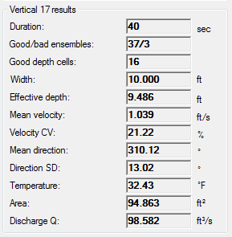
Standard Deviation of Flow Direction
If > 20 degrees, a good indication of uncompensated rotation that may result in a low bias
Efforts should be made to stabilize the ADCP
Notes:
One data quality indicator available in the SxS Pro software is the standard deviation of the water direction. If deviation is greater than 20 degrees there is high potential for rotation that is not compensated for and this could result in a low bias.
This standard deviation for flow direction is not available in RSSL, but these units include a compass, and should not be susceptible to uncompensated rotation

Slide 33
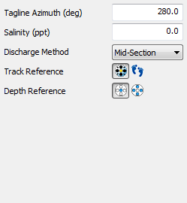
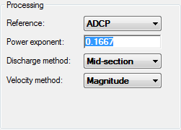
Changes to Reference
ADCP (or System)
Assumes the ADCP is stationary
This is the standard setting and will typically not be changed
Bottom Track
Accounts for movement of the ADCP and removes the bottom track velocity from the water velocity
DO NOT use if there is potential for moving bed!
Notes:
If ADCP movement is unavoidable there are some options to look for the possible effects on your data in addition to the velocity direction standard deviation.
Both software packages have an ability to change the reference from the ADCP, or system, to bottom track. This will allow the program to remove the bottom track velocity (from instrument movement) from the water velocity. Ideally, the ADCP will be mostly stationary during data collection, but this ability to change the reference to bottom track can be used as a quality check to identify large potential errors from boat movement. DO NOT use bottom track as a reference if moving bed conditions are possible.

Slide 34
Effect of Boat Movement on Water Velocity Measurements With Compass
Rotation Compass allows velocities to be averaged in same coordinate system
Lateral movement should average out
Relies on accurate heading applied to each ensemble
May also result in varying depths
Notes:
With a compass, the coordinate system is relative to earth as we have a compass that allows us orient the velocity data in the same coordinate system. Rotation of the ADCP is accounted for by the compass, so our velocities remain in the same coordinate system. Lateral movement should average out if the ADCP is actually swimming “randomly” at the end of the line. This relies on an accurate heading for each ensemble.
There is potential for depth variations, however, even with a compass.
When using a compass, acceleration/deceleration of the ADCP on the end of the line can cause compass errors and it is still important to minimize boat movement.

Slide 35
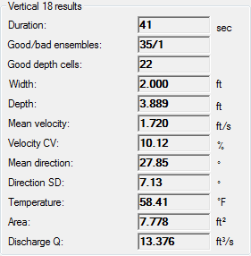
COV for Velocity
Q = 14.7 cfs
Q = 12.0 cfs
+10% = 1.89 ft/s
-10% = 1.55 ft/s
Out of 360 cfs total
Notes:
SxS Pro provides a coefficient of variation for velocity. This is expressed as a percentage. In this vertical the velocity values from ping to ping varied 10.12% throughout the 35 ensembles. Ideally, the CV should decrease during the data collection and stabilize.
Consider the variation in each vertical and the effect that variation will have on that station’s discharge and the significance of that station to your total discharge. Using this COV of 10.12% we can get a rough idea of the range of velocity conditions at this station and the effect this range of velocities could have on that station’s discharge. By adjusting the mean velocity +10% and -10% and using the station’s area to compute a discharge for each velocity we observe a 2.7 cfs potential error, which is still <1% of the total Q.

Slide 36
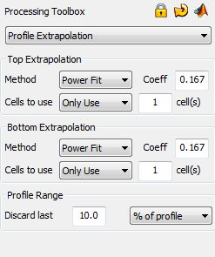
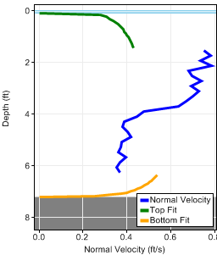
Extrapolation
Notes:
Be sure to evaluate extrapolation methods and ensure they are being applied appropriately, especially in ice conditions.
This example from RSSL shows an extrapolation selection using one cell on the top and bottom and is clearly not using the upper/bottom most cells. This is not just a display problem, but an issue computationally as well. Sontek is aware of the problem and intends to reevaluate the extrapolation computations in the next release.

Slide 37
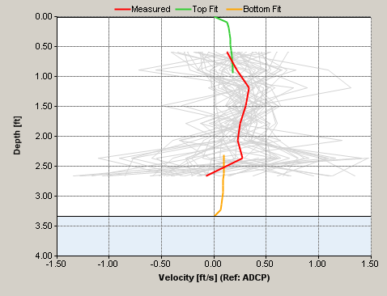
Extrapolation
Notes:
SxS Pro has potential errors in bi-directional flow on the top/bottom of a profile. Here we can clearly see that the extrapolation is not using the data closest to the bottom, and is actually estimating a positive flow, not negative as our data suggests.
This example might have a negative average on the bottom due to noise in the velocity data, but regardless, our measured profile average is showing negative values that are not being used.

Slide 38
Slush in ice conditions
When slush is present near-surface the ADCP will likely not collect valid data
To determine the slush/water interface:
While pinging, slowly drop the transducer deeper into the hole until valid is obtained and adjust the transducer depth accordingly
Observe SNR/intensity profile plots and look for inconsistencies to be sure the transducer is clear of the slush
Using an ice fishing basket for clearing holes on a graduated rod can also be used to determine if/where slush is located

Slide 39
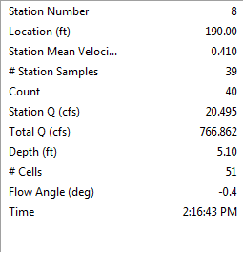
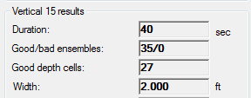
Duration of data collection
Ensure the sample time and number of samples is reasonable
Increase observation time if data is intermittent
Ensure the actual number of ensembles is reasonable (you may collect for 40 seconds but only get one ensemble)
Notes:
Typically, you would like to have collected at least 75% of the intended number of ensembles.

Slide 40
Equipment Summary
RiverSurveyor Stationary Live (RSSL)
Uses ADCP’s compass to determine the tagline azimuth and corrects velocity angle to perpendicular automatically in both ice and open water conditions
Compass also used to account for ADCP rotation
SxS Pro
Open water - Uses observed, manual angle corrections
Compass used to account for boat rotations
Ice - Uses Y-velocity method
Requires beam 3 is held downstream, perpendicular to tagline, for entire 40 second period
Rotations of the transducer will cause flow angle

Slide 41
Summary
There are many situations where mid-section ADCP measurements are preferable
Be sure the licenses/software are setup appropriately BEFORE field use
Make comparison measurements
Don’t assume the data from the ADCP is always correct – confirm with river conditions!
Use software data quality indicators

Slide 42
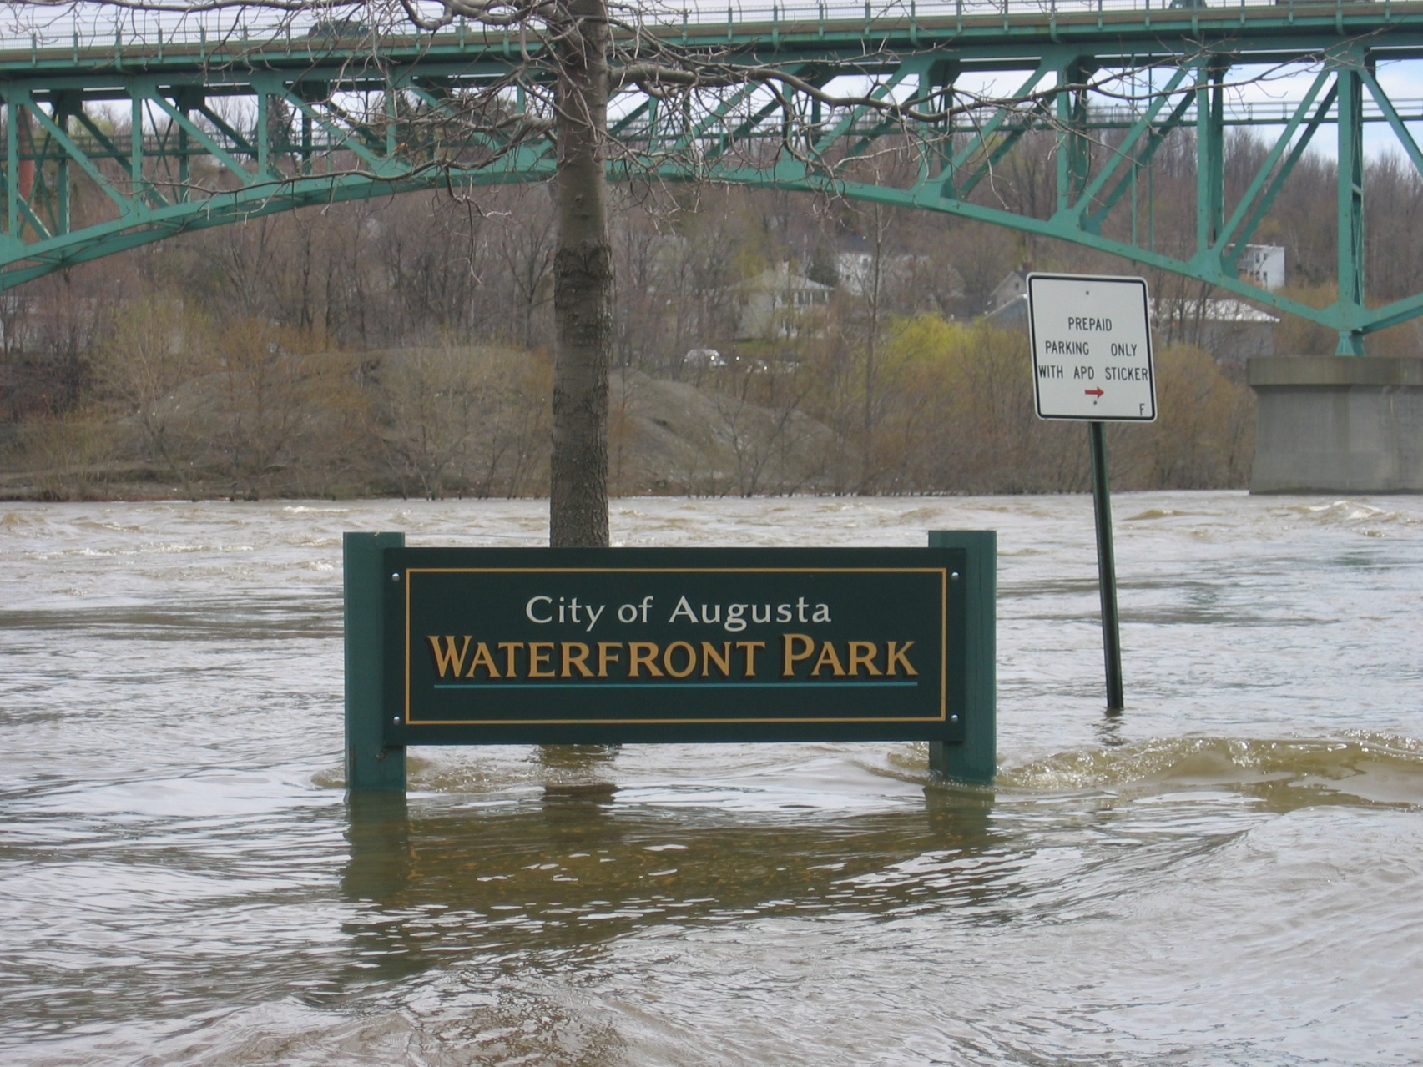
Questions?

