Slide 1
2013 Update To:
Measuring Discharge with Acoustic Doppler Current Profilers from a Moving Boat
Techniques and Methods 3-A22

Slide 2
Goals of Report Update
Achieve consistency between memos and T&M
Clarify policy that has been confusing
Establish policy on some items that we teach in training but have never been documented in policy
Consolidate all policy to date in T&M so there is only one place to look for policy
Provide guidance on SonTek M9/S5 and TRDI RiverRay ADCPs
Provide better guidance on measurement in unsteady and difficult conditions.
Provide better guidance and efficiency in data review

Slide 3
Object of this Webinar
Highlight changes
Explain some of the topics covered
Answer questions

Slide 4
Prior Policy Memos
The following memoranda are considered superseded or duplicated by the policy and procedures in this report and need not be referenced in the future:
2012.01 – Processing ADCP Discharge Measurements On-site and Performing ADCP Check Measurements
2011.08 – Exposure time for ADCP moving-boat discharge measurements made during steady flow conditions
2009.05 – Publication of the Techniques and Methods Report Book 3-Section A22 “Measuring Discharge with Acoustic Doppler Current Profilers from a Moving Boat” and associated policy and guidance for moving boat discharge measurements
2009.02 – Release of WinRiver II Software (version 2.04) for Computing Streamflow from Acoustic Doppler Current Profiler Data
2006.04 – Availability of the report “Application of the Loop Method for Correcting Acoustic Doppler Current Profiler Discharge Measurements Biased by Sediment Transport”
by David S. Mueller and Chad R. Wagner (USGS Scientific Investigations Report 2006–5079) and guidance on the application of the Loop Method
2005.05 – Guidance on the use of RD Instruments StreamPro Acoustic Doppler Profiler
2005.04 – Release of WinRiver Software version 10.06 for Computing Streamflow from Acoustic Profiler Data
2003.04 – Release of WinRiver Software version 10.05 for Computing Streamflow from Acoustic Profiler Data
2002.03 – Release of WinRiver Software (version 10.03) for Computing Streamflow from Acoustic Profiler Data
2002.01 – Configuration of Acoustic Profilers (RD Instruments) for Measurement of Streamflow
2002.02 – Policy and Technical Guidance on Discharge Measurements using Acoustic Doppler Current Profilers

Slide 5
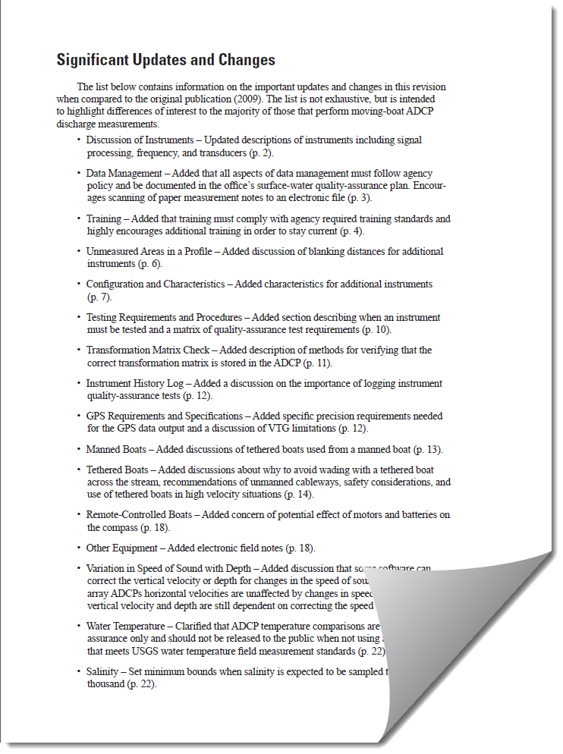
Significant Update and Changes

Slide 6
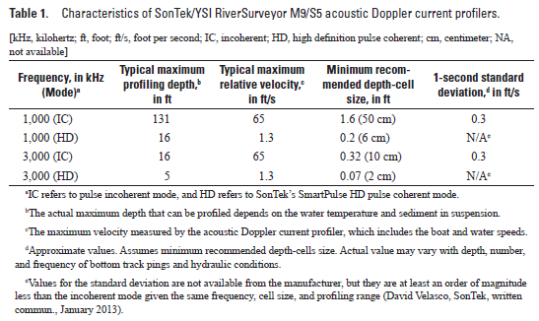
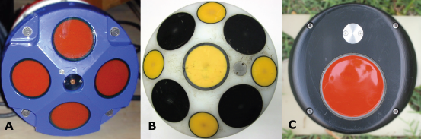
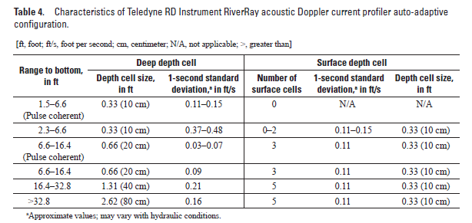
New ADCPs

Slide 7
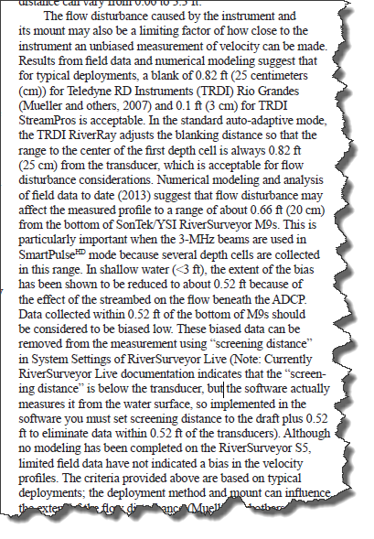
Blanking Distance with Flow Disturbance
Rio Grande: 25 cm
StreamPro: 3 cm
RiverRay: variable (acceptable)
RiverSurveyor M9: 16 cm (0.52 ft) this can be done by setting the “Screening distance” to the draft + 0.52 ft (16 cm)
RiverSurveyor S5: No indication of problems at the default setting.

Slide 8
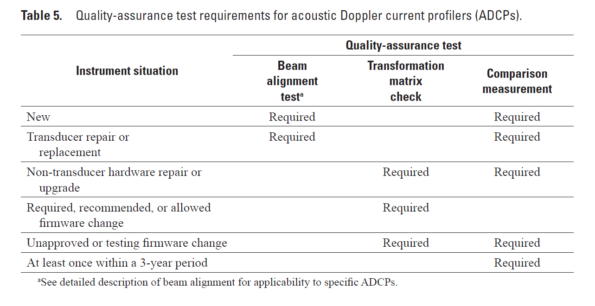
Quality-Assurance Test Requirements
OSW 2014.04 States: In addition to AQA checks on existing ADCPs, all new ADCPs purchased directly from the manufacturer and/or meters sent to the HIF or the manufacturer for repair, must be AQA checked in the HIF-HL before being placed into service for the first time or back in service. Meters purchased through the HIF will be AQA checked as part of the HIF’s standard QA/QC process.
HIF
HIF
WSC
WSC
NOTE: The policy presented in OSW Technical Memorandum 2014.04, Quality Assurance Checks of Acoustic Doppler Current Profilers, is consistent with and satisfies the beam-alignment test requirements described in TM 3-A22.

Slide 9
Transformation Matrix
TRDI ADCPs
  In the ADCP test
  Can also be obtained using BB-Talk and sending the PS3 command
SonTek ADCPs
  Not directly accessible
  Stored in the Matlab output of a transect
  The matrix can be read from the Matlab file using the USGS utility RSMatrix
  BREAKING NEWS!!: SonTek recalibrates the matrix every time the instrument is sent for repair or upgrade resulting in small changes in the matrix. We are looking into this.

Slide 10
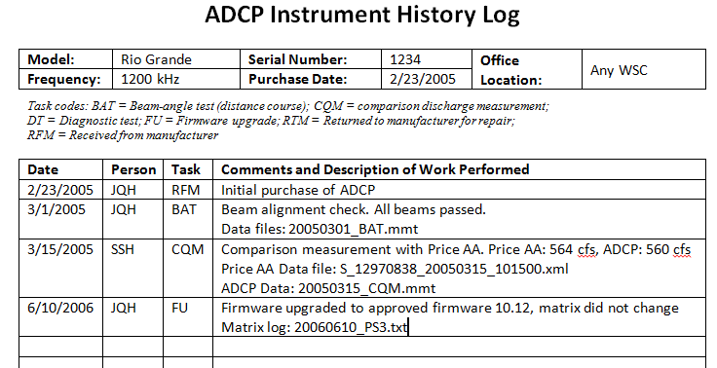
Instrument History Log
Create a paper or electronic log of all updates, repairs, comparison measurements, non-measurement related quality assurance tests, etc. for each ADCP.
This is how SonTek’s changing of the transformation matrix was found.

Slide 11
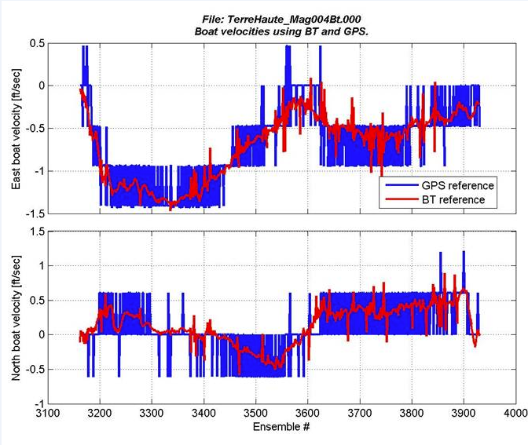
Minimum GPS Receiver Requirements
GGA
  Differential correction
  Submeter accuracy
  5 decimal place resolution for decimal minutes of latitude and longitude (Note: most handheld and fishing type GPS receivers do not meet this criteria.)
  2 Hz data output rate
VTG
  2 decimal accuracy
  2 Hz data output rate
Recommend disabling all filters and smoothing functions.

Slide 12
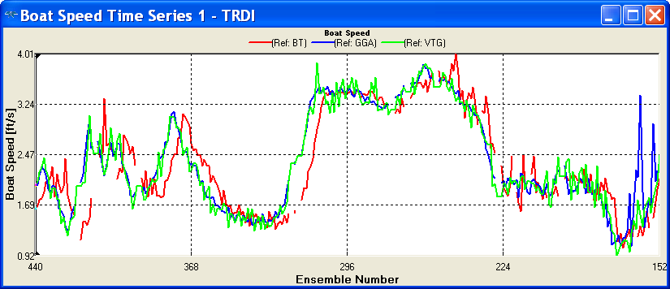
Check for GPS Data Lag
Some GPS receiver and computer serial port combinations will result in buffering of the GPS data causing a lag.
Try changing baud rate and reducing data output rate.
Increasing Ensemble Number

Slide 13
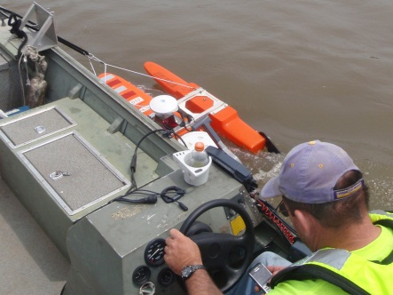
Guidance on Use of Tethered Boat from Manned Boats
allow the ADCP transducers to be positioned free and clear of the boat hull,
be in a position free from velocity and water-surface distortions caused by the manned boat,
and be tethered such that rotation of the tethered boat relative to the manned boat is minimized, so that the tethered boat rotates with, not separate from, the manned boat.

Slide 14
Wading with a Tethered Boat
Wading - BAD!!
Rope and pulley - GOOD!!!
“One method that has been employed but should be avoided is wading with the tethered boat. Several issues have been observed when attempting to wade the boat across the stream:”
the boat does not move smoothly across the stream but rather moves sporadically with more pitch-and-roll than is typical of bank-operated cableways;
the hydrographer in the stream may interfere with the acoustic beams if they are too close to the boat; and
the hydrographer may change the flow pattern measured by the ADCP if they are too close to the boat or moving upstream.
“Therefore, a temporary bank-operated cableway should be used instead of wading.”

Slide 15
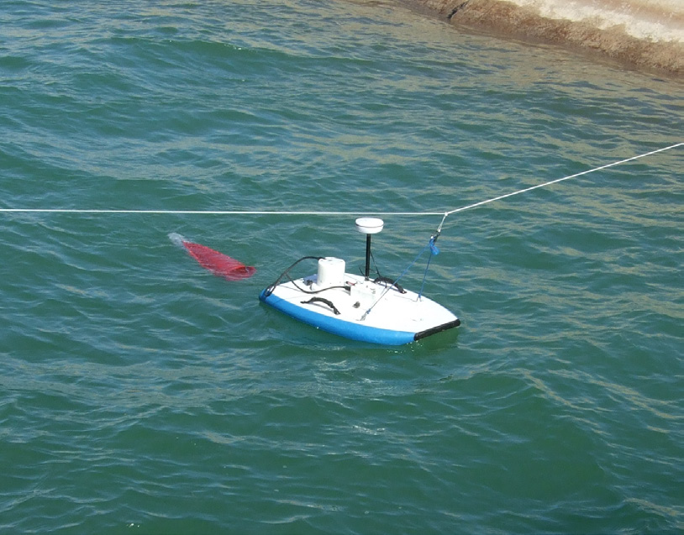
Tethered Boat in Slow Velocity
In velocities less than 0.5 ft/s the smooth movement of the boat may be difficult.
Wind can become a big issue.
Using a sea anchor or something to increase drag can help.
Maintain a smooth boat speed that is fast enough to keep the boat moving consistently in one direction and prevent it from wandering back and forth. This may be higher than the water velocity.

Slide 16
Tethered Boat Safety
Tether line should be visible from the water surface to minimize risk of collision with boat traffic. Use flagging if necessary.
The operator should be capable of releasing the tether quickly in case the boat becomes entangled in debris or collides with boat traffic.
DO NOT wrap the tether around your hand to hold the boat.
DO NOT have excess rope around your feet or behind your body.
DO wear high quality gloves.
Follow all other applicable safety guidelines for your site conditions.
This public service announcement and inclusion in the report was at the request of regional safety officers after reports of accidents with tethered boat deployments became a bit too common.

Slide 17
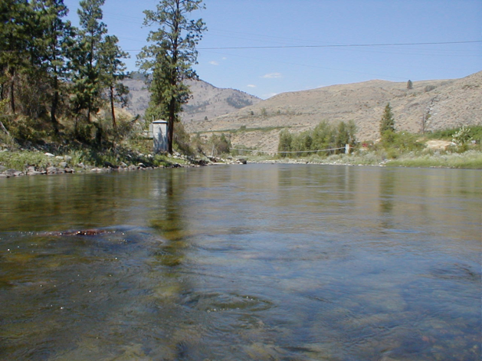
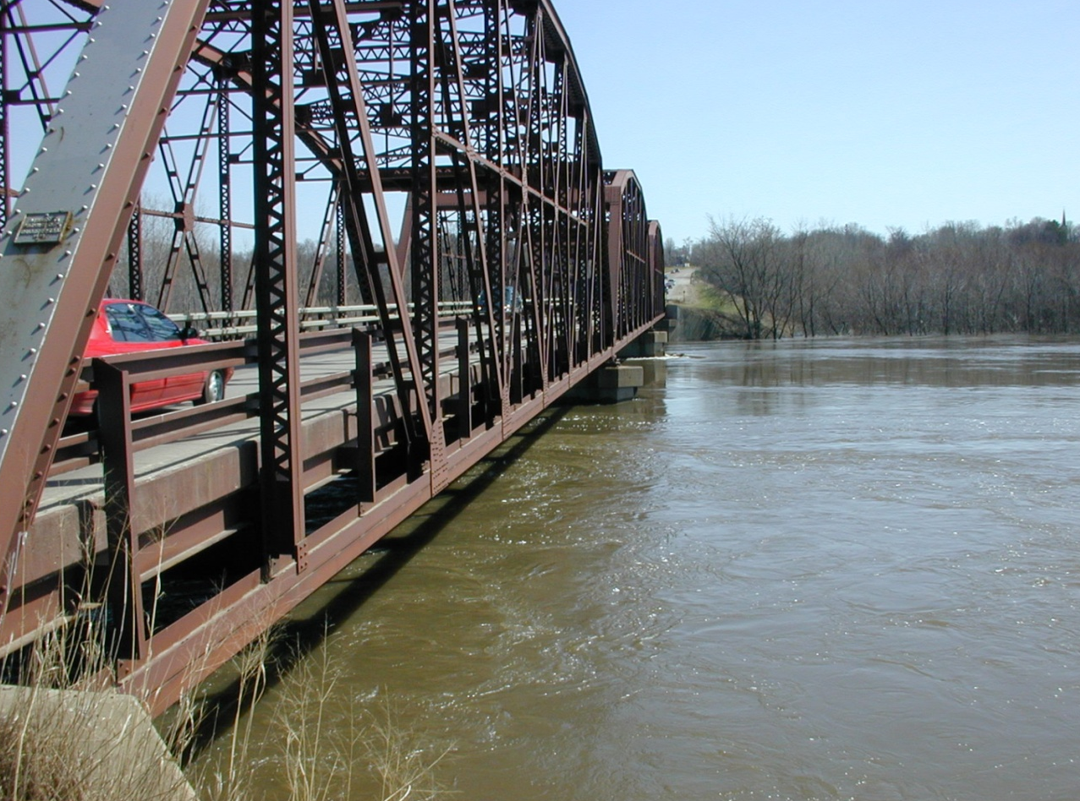
Site Selection
Location, Location, Location !!!!
Just because you can measure there and it is convenient doesn’t mean you SHOULD measure there.
Location
  Straight reach, uniform flow
Shape
  Regular shape, no sharp changes
  Avoid long shallow edges or bars
Flow
  Greater than 0.3 ft/s if possible
  Uniform distribution
  Avoid large eddies, standing waves, etc.
Other
  Magnetic interference
  Overhead obstructions that may interfere with GPS

Slide 18
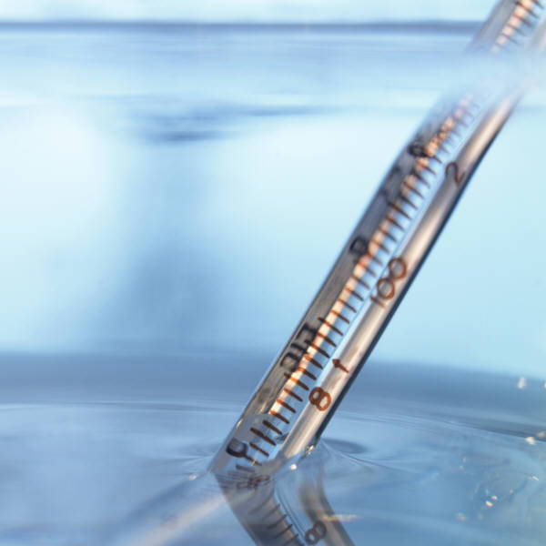
Speed of Sound
Temperature
  Must be measured independently and
  compared to the ADCP prior to every
  discharge measurement.
  Difference should be less than 2 deg C.
  Give the ADCP sufficient time to equilibrate
  to water temperature.
  If difference is consistently greater than 2 deg C the ADCP should be repaired. You may manually set the temperature in software as a temporary fix to collect data during trip.
  5 deg C change in water temperature at 20 deg C will cause a 3% error in the measured discharge for piston transducers.

Slide 19
Speed of Sound – cont.
Salinity
  A change in salinity from 0 to 5 ppt at a water temperature of 20 °C will result in about a 1 percent change in discharge.
  Where the salinity is expected to be greater than 5 ppt, the salinity should be measured near the transducer face and recorded in the field notes.
  The salinity value may then be entered into the ADCP data-collection software prior to data collection and adjusted as necessary during measurement playback and processing.
  The salinity value used for a transect should reflect an average salinity for the section to be measured at the approximate depth of the ADCP transducers.

Slide 20
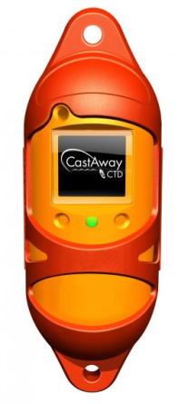
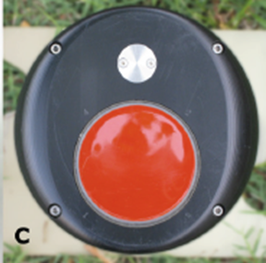
Speed of Sound – cont.
Variable with depth
  For the horizontal velocity measurement the speed of sound is only needed at the transducer face.
  For depth measurement the average speed of sound for the full depth is needed.
  Using the SonTek CastAway CTD sensor with
  RiverSurveyor Live allows for correction of the
  change in speed of sound with depth. This typically
  minor except in highly stratified situations.
RiverRay – Phase array transducers
  Changes in the speed of sound change the
  angle of the beams in such a manner that
  the horizontal velocity measurements are
  independent of the speed of sound.

Slide 21
Compass Calibration
Required for:
  Loop test
  GPS reference
Guidance
  Minimize ferrous material and electromagnetic fields in the vicinity of the ADCP
  Goal is a calibration with an error of less than 1 degree
  Rotate smoothly at about 5 degrees per second or less
  If using a pitch and roll calibration, pitch and roll smoothly through the range expected during data collection.
  Calibrate as close to measurement section as possible
    Avoid field truck, bridge, guard rails, etc.
  Rotate entire deployment together: ADCP, tethered boat, manned boat, etc.

Slide 22
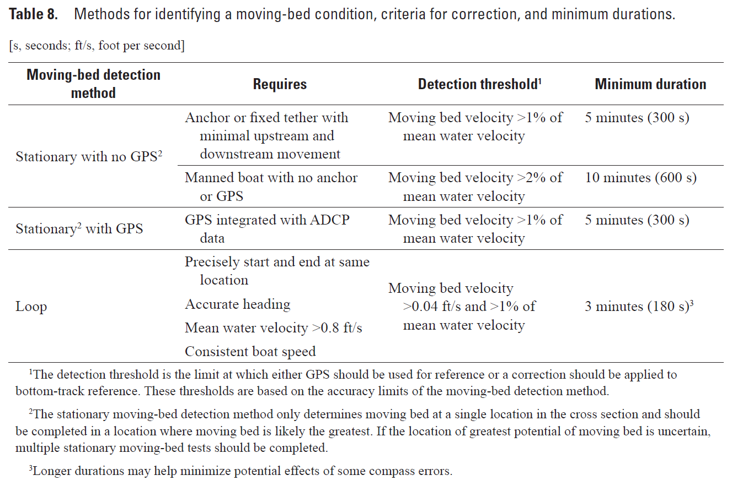
Moving-Bed Test
A moving-bed test is REQUIRED prior to every ADCP discharge measurement.

Slide 23
Moving-Bed Test in Tidal Situations
When the flow conditions change during a measurement or series of measurements, the moving-bed conditions are also likely to change.
If using GPS:
  A moving-bed test should be made immediately prior to the start of the discharge transects. The loop test is recommended as it will capture the moving-bed conditions throughout the cross section. The result of the moving-bed test should be consistent with the difference in discharges computed with GPS and bottom track as the navigation references for transects immediately following the moving-bed test. This procedure will verify that the GPS, compass calibration, and magnetic variation are accurate.
  As flow conditions change, the GPS referenced ship track and discharge can continue to be compared to the bottom-track referenced ship track and discharge. The final discharges should be referenced to bottom track unless (a) the bottom-track referenced ship track plots upstream from the GPS referenced ship track and (b) the bottom-track discharge is consistently less than the GPS referenced discharge by 1 percent or more.

Slide 24
Moving-Bed Test in Tidal Situations
If Using Bottom Track only:
  At least two moving-bed tests should be made: one at the beginning of the measurement series and one in the condition expected to have the greatest potential for a moving bed.
  If both tests indicate no moving bed, it could reasonably be assumed that a moving bed does not exist for the full range of conditions, although additional tests would provide better support for this assumption.
  If either moving-bed test indicates a moving bed, then additional moving-bed tests need to be made to fully characterize the change in moving-bed conditions until no moving-bed condition exists. Corrections to measured discharges between moving-bed tests need to be interpolated from the moving-bed tests that bracket the measurement. These interpolations and corrections may be made manually if available software does not support such computations.

Slide 25
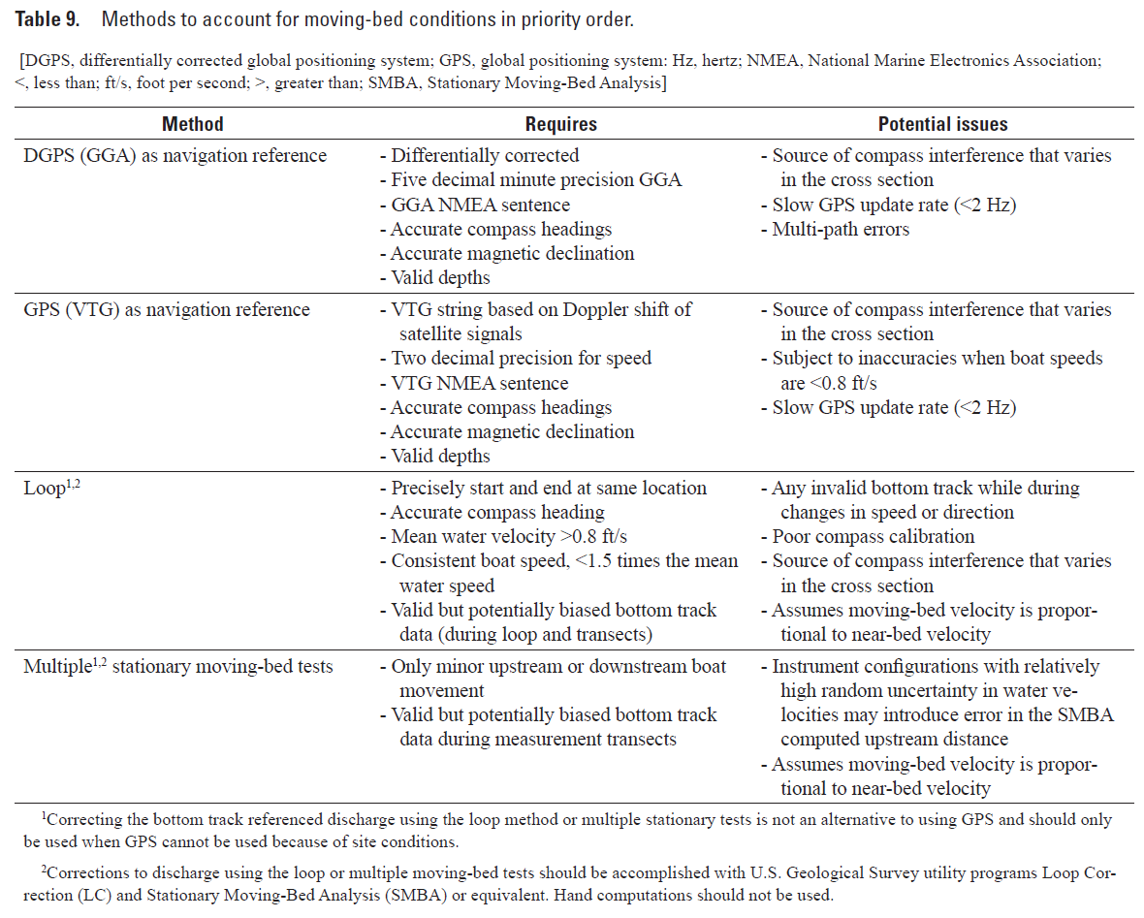
Measuring in Moving-Bed Conditions

Slide 26
Unsteady-Flow Conditions
At times, flow changes rapidly enough that discharge measurements with a duration of 720 seconds may not properly characterize the streamflow being measured.
If possible, reciprocal transects should be averaged together as one measurement of discharge to reduce the potential of directional bias.
Justification for using less than 720 seconds should be documented.

Slide 27
Measuring in Difficult Conditions
Discussion and guidance on collecting data in the following difficult conditions is provided:
  Slow Flow
  Fast and (or) Turbulent Flow
  Vertically Stratified Bi-Directional Flow
  Shallow Flow
  Deep Flow
  Vertical Walls
  Rough and Irregular Streambeds or Vegetation on the Streambed
  Wind
  High Sediment Load

Slide 28
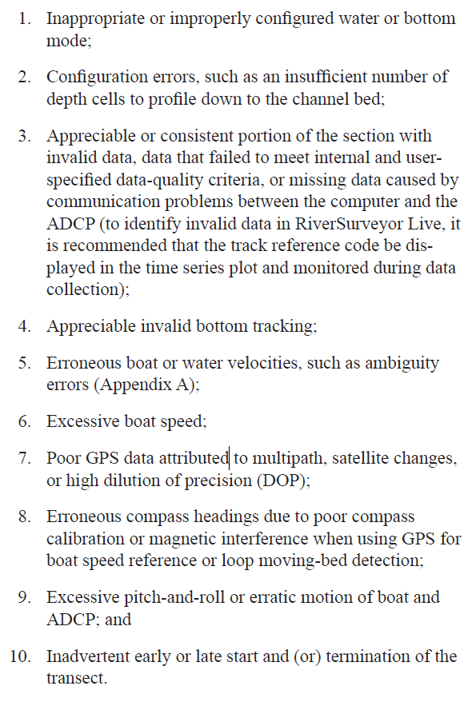
Critical Data-Quality Problems
If a critical data-quality problem is observed during measurement in a transect, the use of that transect may be terminated. If a transect is not used, the reason should be documented in the ADCP discharge-measurement field notes, and that transect should not be used in the computation of measurement discharge.
Potential critical data-quality problems can include, but are not limited to the following:

Slide 29
Estimating Edge Discharge
If an individual edge discharge is more than 5 percent of the total discharge, an alternate method of measuring/estimating the discharge should be used to check the edge discharge. An alternate method could include measuring and (or) estimating multiple point velocities and depths in the edge and computing a discharge for the edge using the midsection method. If the edge discharge measured with the alternate method agrees with the ADCP software edge discharge, the ADCP software edge discharge should be used. If the discharge from the alternative method does not agree with the ADCP software edge discharge, the more accurate of the two discharges, based on the hydrographer’s judgment, should be used. The alternate method must be documented with the measurement.

Slide 30
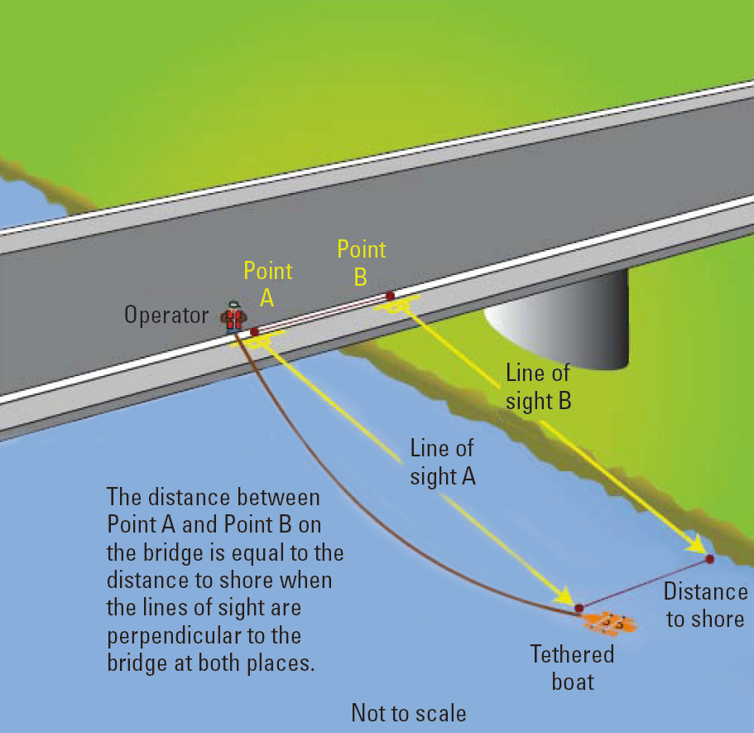
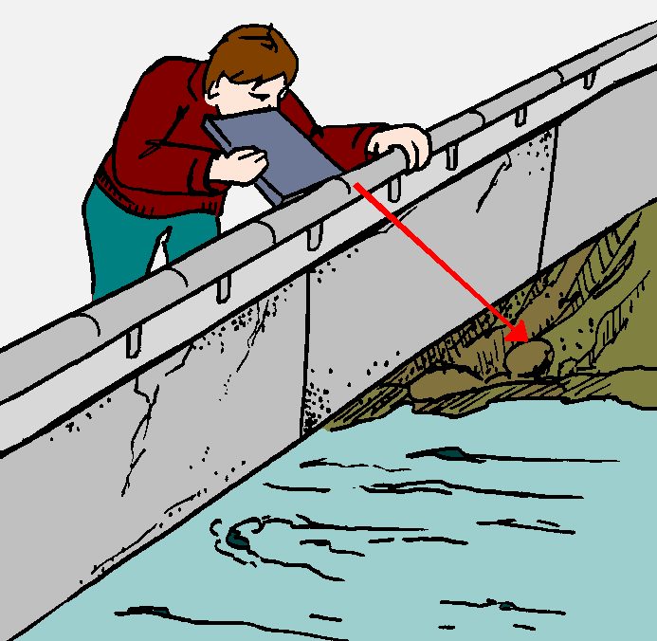
Edge Distance
The distances from the edge of water to the starting and stopping points of each transect must be measured using a distance- measurement device (such as a laser or optical rangefinder), tagline, or some other accurate measurement device.

Slide 31
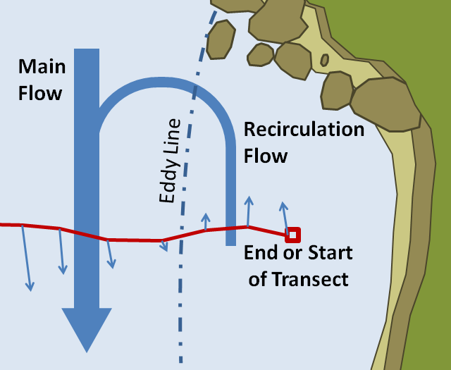
Eddies at Edge
The velocity used to compute the edge estimate must be representative of the flow in the edge.

Slide 32
Before Leaving the Site
Evaluate QA/QC Data – ADCP test, compass cal., moving-bed
Verify User Input – draft, magvar, etc.
Evaluate Tabular Data
Evaluate Ship Track and Velocity Vector Plot
Evaluate Velocity Contour Plot
Evaluate Echo Intensity – Particularly important for SonTek
Select Proper Extrapolation Methods
Evaluate Discharge Summary – consistency
Check Measurement? – Change as much as practical
Backup Data
Store ADCP
Appendix F has detailed data
review steps and examples

Slide 33
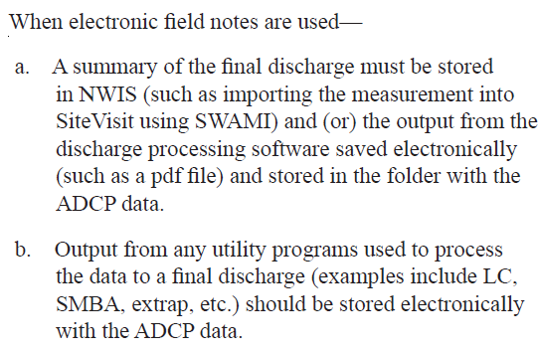
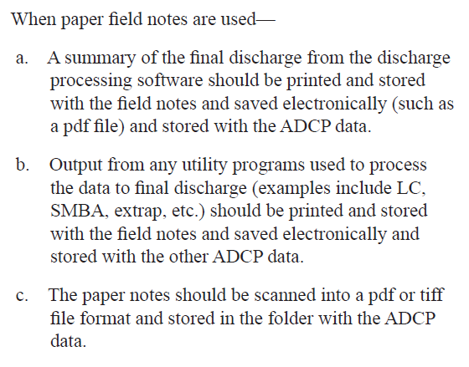
In The Office
All measurement data should be moved from the field computer or field backup media to an office server within 48 hours of returning from the field.
Once the measurement has been finalized, it should be permanently stored in a manner that would prevent accidental modification and (or) deletion.
All ADCP data, including compass calibration and ADCP test results associated with an individual measurement, should be stored together in a unique folder.

Slide 34
Misc.
Glossary - added
Appendix A – Updated for newer instruments, including discussion of phased array transducers.
Appendix B – Collecting Data in Moving-Bed Conditions
  Updated with information on using Stationary Moving Bed Analysis (SMBA) software for stationary moving-bed tests.
  Added additional details on the importance of compass accuracy when using loop moving-bed tests.
  Added new quality-assurance checks and guidelines for using the loop moving-bed method.
  Added potential inaccuracies in VTG-based discharges, particularly for boat speeds less than about 0.8 foot per second.
Appendix C – Description of Water-Tracking Modes – Revised to include auto-adaptive capabilities of newer instruments.
Appendix D – Beam-Alignment Test – Revised to include RiverSurveyor M9/S5 and RiverRay beam matrix descriptions.
Appendix E – Forms and Quick-Reference Guides – All forms revised to include newer equipment and improved with additional information.
Appendix F – Measurement Processing Procedure – Completely revised with expanded discussions for each step.

Slide 35
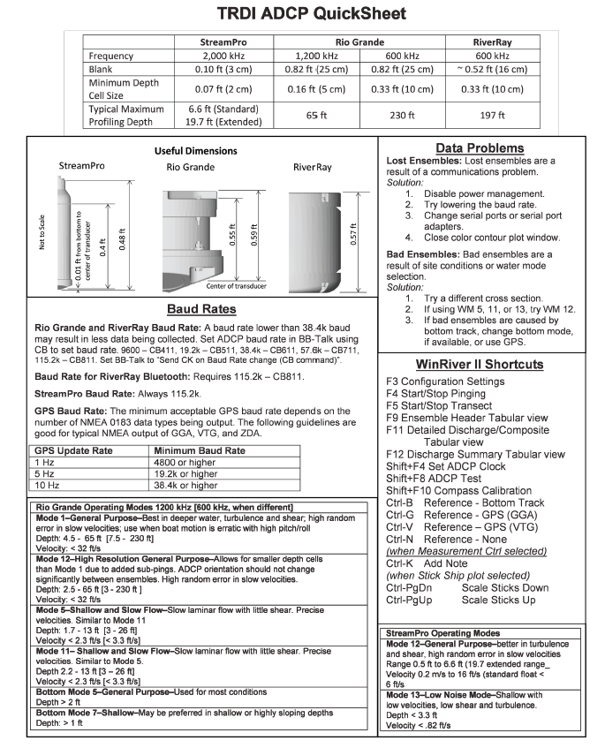
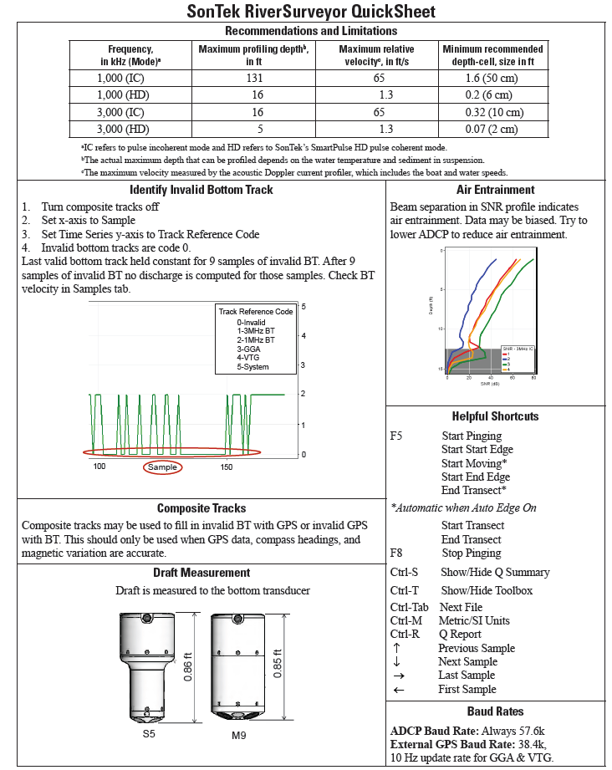
Revised Quick Sheets

Slide 36
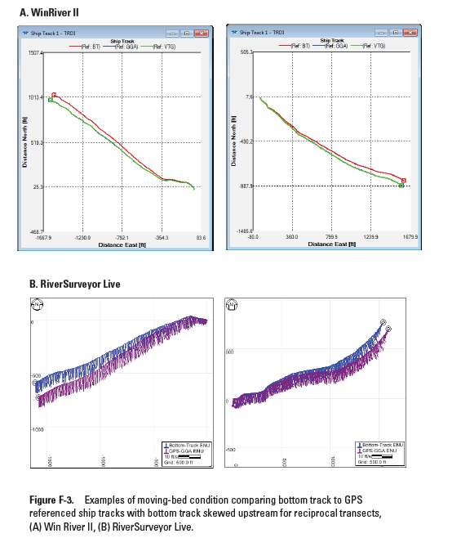
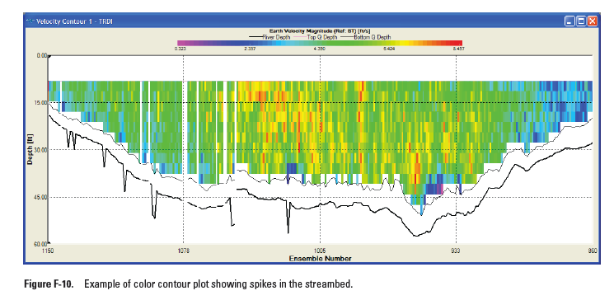
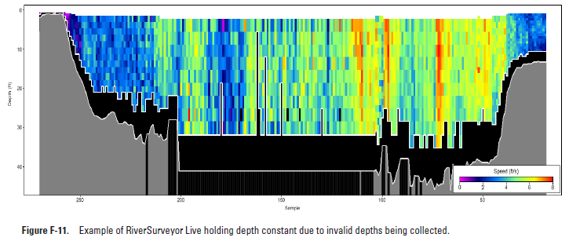
Examples for WinRiver and RiverSurveyor

Slide 37
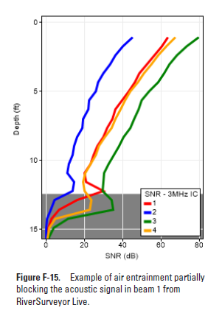
Air Entrainment - SonTek

Slide 38
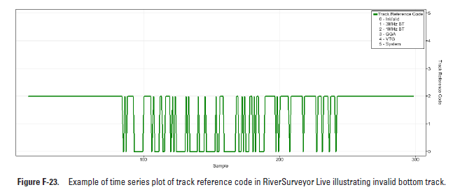
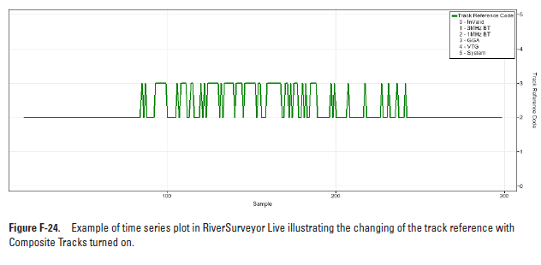
Invalid Bottom Track / Composite Tracks

Slide 39
Read the Report and Use It!!

Slide 40
Questions

