Slide 1
Hydroacoustics And Field Computing
Tablet Usage for Hydroacoustics: Experiences and Lessons Learned

Slide 2
Overview
Water Science Center Experiences
Arin Peters – Hydrographer, KS WSC
Kevin Housel – Hydrographer and field technical support, WI WSC
Clinton Hittle – Pittsburg Field Office Chief, PA WSC
Summary of Options
Jason McVay – HaWG regional representative - IA WSC
Open Discussion
All presenters
Burl Goree - Field Computing Integration and Support (FCIS)

Slide 3
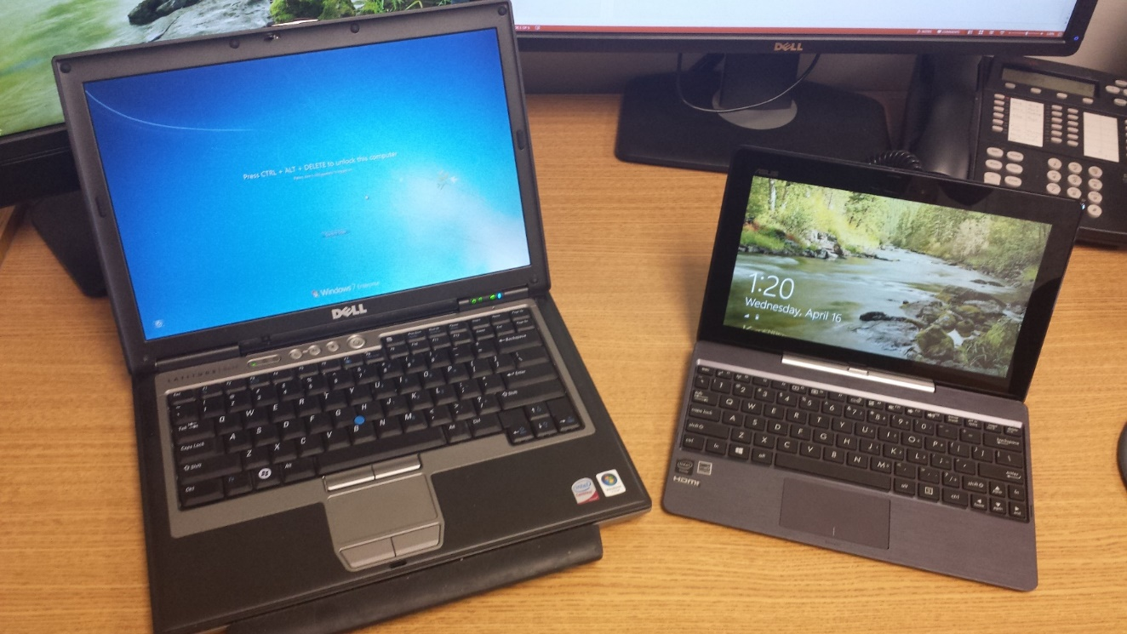
Convertible tablet PCs for field computing
Advantages over laptops:
Smaller
Lighter
Cheaper
More versatile
Battery life

Slide 4
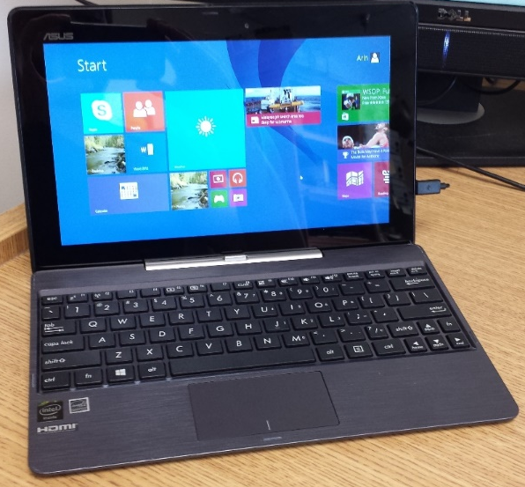
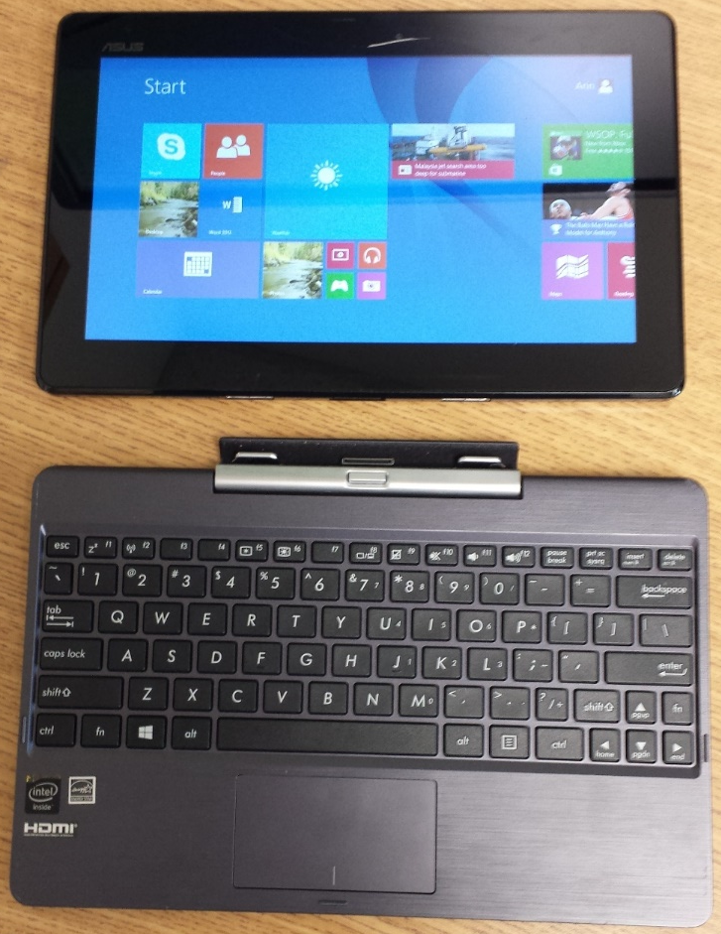
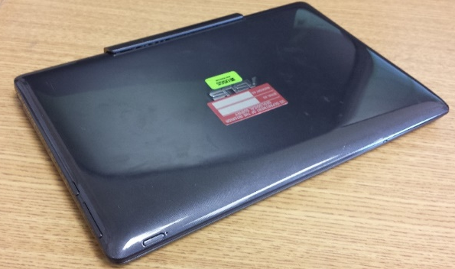
ASUS T100 Transformer

Slide 5
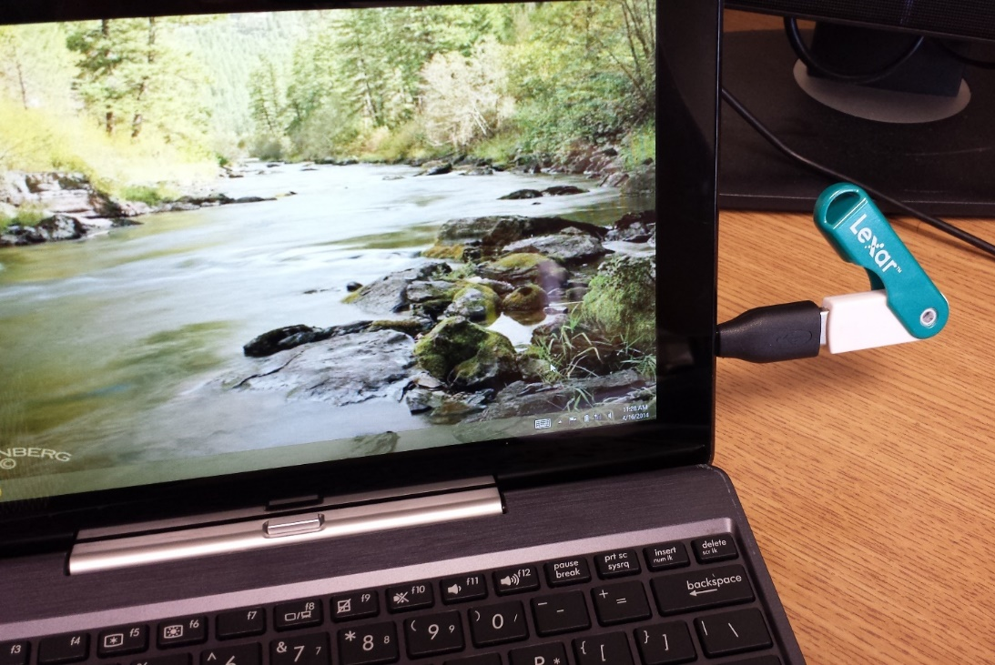
ASUS T100 Transformer
Specs:
Windows 8.1
1.33 GHz atom Processor
2.00 GB RAM
32 GB Hard Drive
Micro SD slot for added storage
One USB 3.0 port in keyboard
One Micro USB port (charging point) in tablet
$350
Micro USB to USB adapter can be used if the keyboard is not connected or if you need to connect two devices

Slide 6
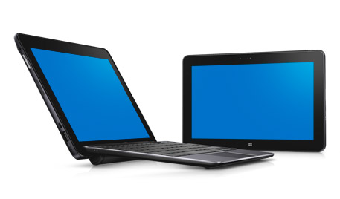
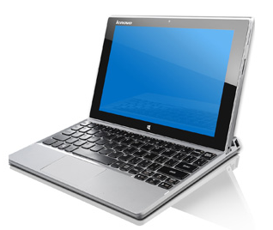
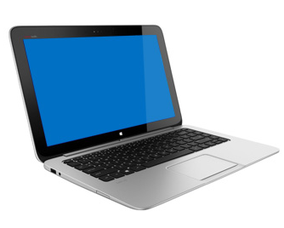
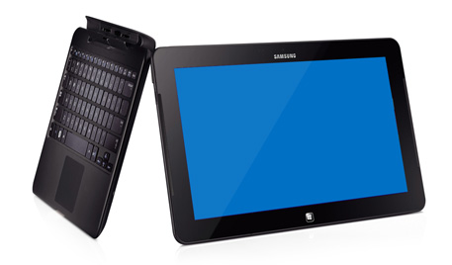
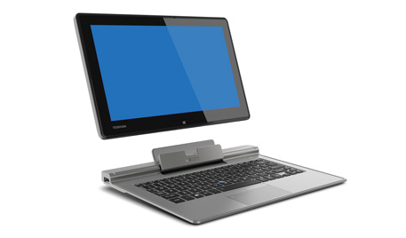
Other Options:
Dell Venue 11 Pro
$499
Lenovo Miix 2
$499
HP Split x2
$799
Samsung ATIV Tab 7
$1199
Toshiba Portege Z10t
$1449

Slide 7
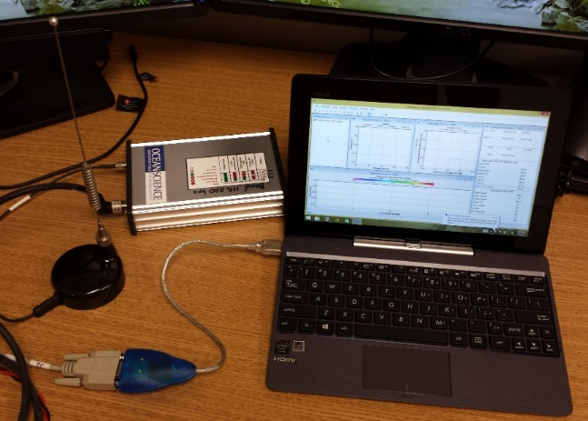
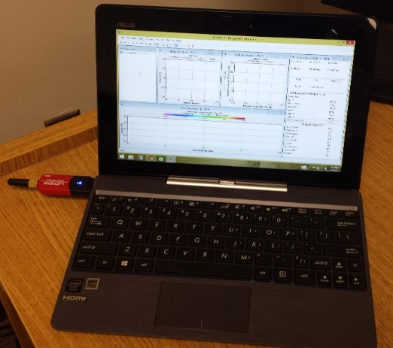
Communicating with Acoustic Instrumentation/Gage house equipment
Spread Spectrum (SS) Radios using USB to Serial Adapter
Bluetooth

Slide 8
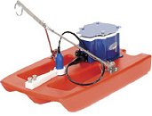
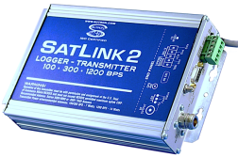
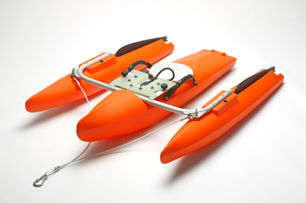
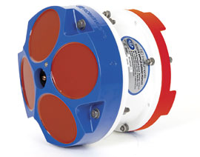
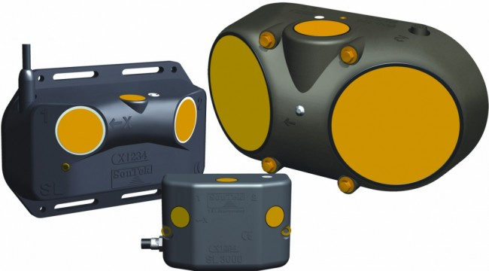
Equipment used/communicated with
Sutron SatLink2 V2
USB to serial adapter
RDI StreamPro
Bluetooth
RDI RiverRay
Bluetooth and SS Radios
RDI Rio Grand 600kHz (and 1200kHz)
SS Radios
Son Tek Argonaut-SL (Side Looker) ADVM
USB to serial adapter

Slide 9
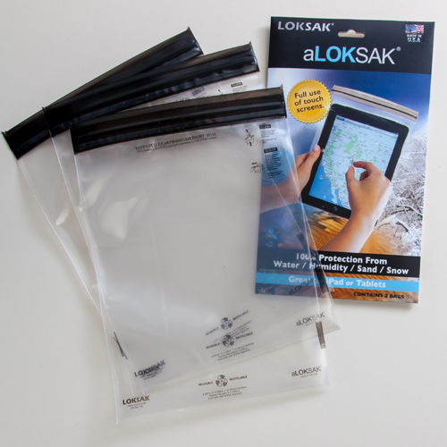
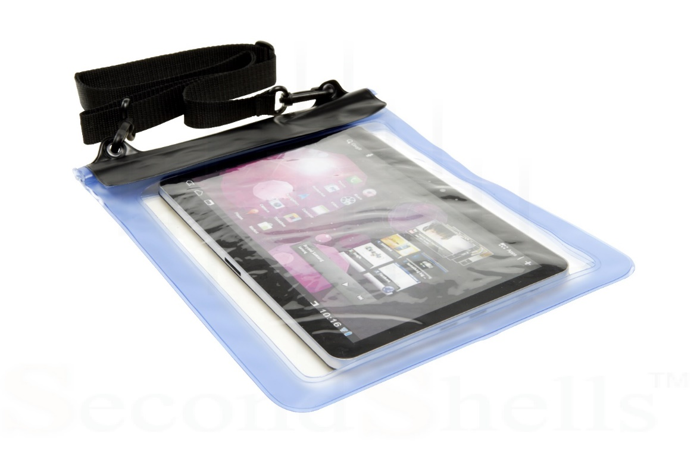
Keeping your tablet dry

Slide 10
WI-WSC Tablets
1st Generation Tablets
HP Slate 500 8-inch
ACER W500 10-inch
Fujitsu 10-inch
2nd Generation Tablets
Asus ME400C 8-inch
Acer W3-810 8-inch
Dell Latitude 10 – ST2 10-inch
Things you need to watch out for…
Pros
Standard USB port
SD Card Slot
Processor Speed
Cons
Non-dedicated power
Real-estate

Slide 11
WI-WSC Tablets
3rd Generation Tablets
Panasonic ToughPad FZ-G1 10.1-inch
2.40 GHz Intel Core i5
128 GB Hard drive
Win 8.1 64-bit OS
8 GB Ram
10.6’ HD screen (1920x1200)
Microsoft Surface Pro2 10.6-inch
1.70 GHz Intel Core i5
128 GB Hard drive
Win 8 64-bit OS
4 GB Ram
10.6’ HD screen (1920x1080)
Dell Nevue 11 Pro 10.8-inch
1.5 GHz Intel Core i5
128 GB Hard drive
Win 8.1 64-bit OS
4 GB Ram
10.8’ HD screen (1920x1080)
Pros
Win 8/8.1
Full Microsoft OS (must) USGS Field Software will not run on Microsoft RT
Faster processor (min 1.5 GHz - Intel Core i5)
Possible Desktop replacement w/ dual monitors requires docking station
Full software field image allows on-site data processing (SiteVisit and GRSAT), using a MiFi or Smartphone HotSpot and eRAS.
Can run all software, PCFF7.1, Sonutils, etc.
Higher screen resolution allows software to “fit” better
Cons
$$$
Battery life
Next Gen…
Microsoft Surface Pro3?

Slide 12
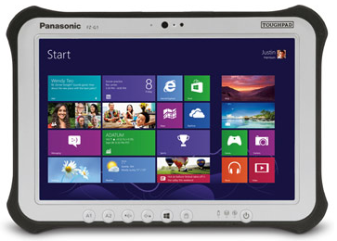
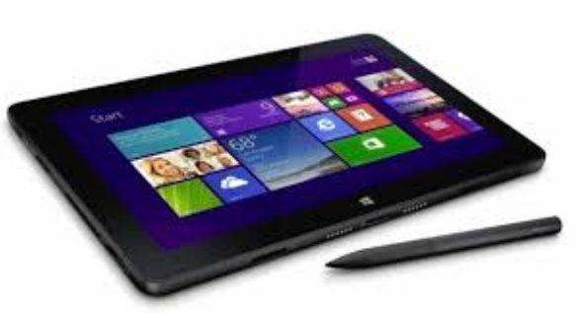
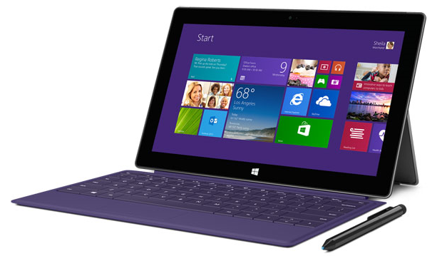
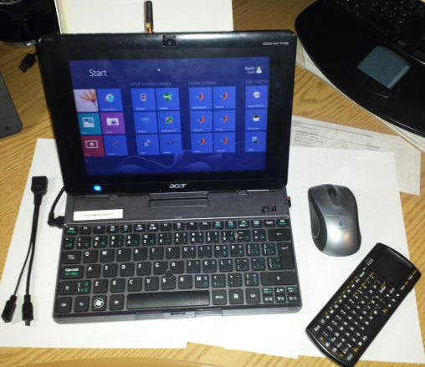
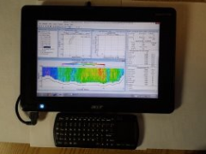
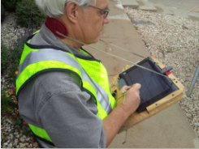
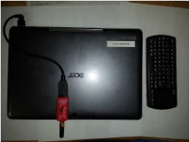
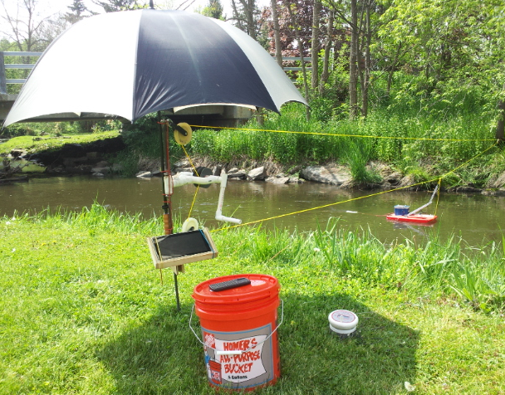
WI-WSC tablets

Slide 13
Overall Pros and Cons from testing
Outdoor – viewable in sunlight
USB ports – std/micro adaptor cables for Parani’s
Internal BT support for other BT Devices, keyboard, etc.
Platform dependent, may cause interference when using BT nubs, like AZIOs.
Portability, flexibility and versatility in mounts
Multi-function single USB port
Charging uses same USB port
Processor speeds
Higher speed with later models
OS limitations
Hard Drive, min 120 GBs
Stylus
Keyboard functionality
Memory
Battery life

Slide 14
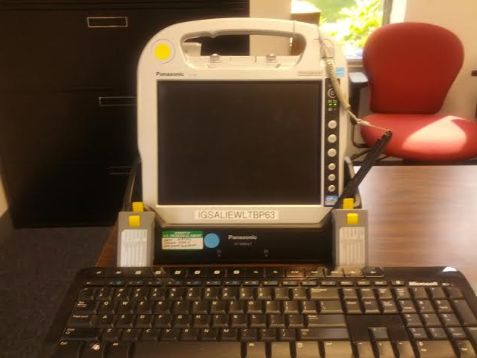
Panasonic
CF-H2

Slide 15
Panasonic CF-H2 Specs:
- Intel Core I5 1.7 gHz proc.
- 120 GB SSD drive
- 4-8 GB of RAM
- 64 Bit OS
- Class 1 bluetooth

Slide 16
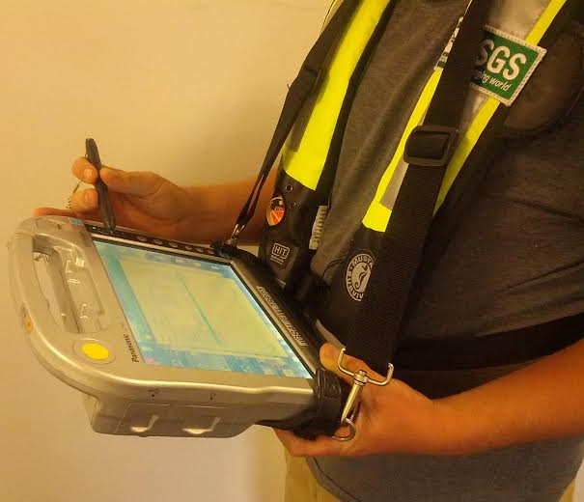

Slide 17
Digitizer Pens:
Pen sent with tablet is not good. Rugged digitizer pen
from Motion computing works well but does not fit
into the tablet. Buy spares because they are easy to
lose .

Slide 18
The CF-H2 holds two batteries. Battery life is
average. Recommend purchasing spares.

Slide 19
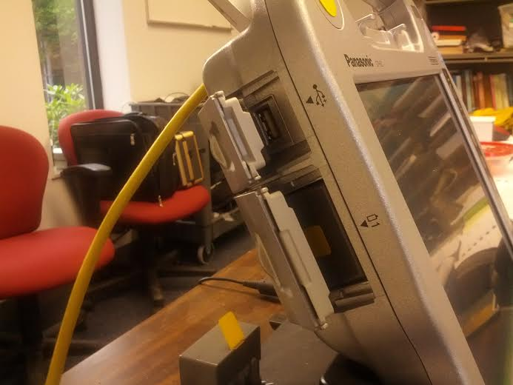

Slide 20
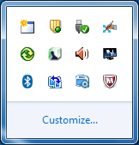
Internal Bluetooth option:
- Very good range.
- Connect to the instrument before
entering the software package.

Slide 21
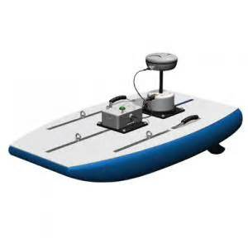
Sontek M9 has internal bluetooth

Slide 22
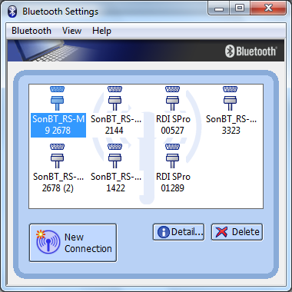

Slide 23
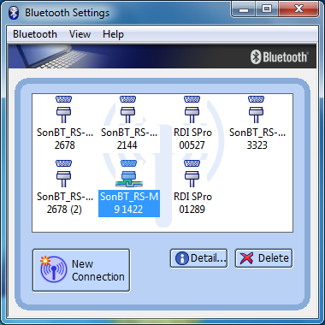

Slide 24
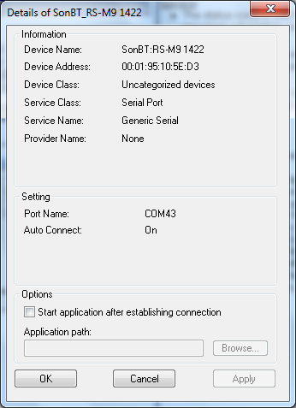
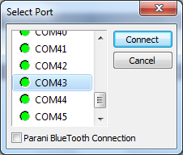
RSL software:

Slide 25
Panasonic CF-H2 Tips:
Disable bluetooth when not needed as it can
Interfere with other communications such as
communicating with an ADVM via serial.
Turn power save off while collecting discharge
measurement data.

Slide 26
Hydroacoustics and Field Computing Webinar Summary
-We heard from three different users within the USGS using tablets while collecting Hydroacoustic data.
-All three are using different tablet platforms.
-Some of the reasons for making the change to a tablet are.
-Solo ADCP measurements
-Mobility
-Functionality – (ie. rugged, robust processing, replaceable)
-With the many options available for tablets there are trade-offs of cost, performance and durability. Each WSC will need to determine the option that works best for their situation.

Slide 27
Summary of Tablet Options
Inexpensive and Portable – Processors and memory are less superior and tend to be used mostly for data collection and not used as a substitute for a full laptop or tablet. The processors for these tablets are usually Intel Atom (Bay Trail) processors.
Desired minimum specs:
1280 x 800 resolution
2 gigs of RAM
32 gig hard drive (64 gigs preferred)
ability to use USB port and charge the tablet at the same time. (preferred)
Cost range: $300 to $700

Slide 28
Summary of Tablet Options
Powerful and Non ruggedized– Processors and memory are more robust and could be used as a full laptop or desktop. Although this option would need to be protected in adverse weather.
Desired min. Specs for this option are:
I3 or I5 processor
4 to 8 gig RAM
128 gig hard drive
USB 3.0
$700+

Slide 29
Summary of Tablet Options
Powerful and Ruggedized– These tend to be fully ruggedized or mostly so, and have robust processors. The processor are typically I-3 or higher.
Desired min. Specs for this option are:
I3 or I5 processor
4 to 8 gig RAM
128 gig hard drive
USB 3.0
Cost range : $2000 to $3500+

Slide 30
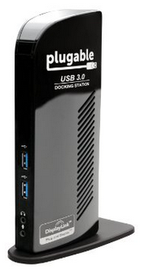
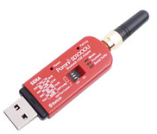
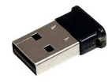
Connectivity Options
Office:
Docking station: tablet specific or universal USB 3.0 (approx $130)
Gigabit Ethernet – for connecting to the network
Additional USB ports
Dual monitors
Field:
Instrument commutations
USB Serial port (FTDI chipset, available from HIF)
Parani SD1000U - can be used as serial port and does not conflict with built-in bluetooth
Long range (Class 1) Bluetooth USB
may conflict with internal bluetooth. Which may mean that the internal bluetooth would have to be disabled.

Slide 31
Sources of Information
Electronic Field Forms and Mobile Computing
https//hydroacoustics.usgs.gov/forum
This room is located on the OSW forum and is meant to be a location for users to share their experiences with mobile computing, ask questions, and archive previous discussions.
FCIS - Field Computing Integration and Support (FCIS)
http://wwwrustla.er.usgs.gov/fcis/
Covers all of the information regarding SWAMI, SWAMI PC, Station Levels, MONKES, and CHIMP
BWTST (NT_TAC) - Bureau Windows Technical Support
http://bwtst.usgs.gov/
Covers all of the current support related to the Windows operating system
OSW Hydroacoustics
hydroacoustics.usgs.gov
Covers all of the latest information regarding the use of Hydroacoustic equipment within the USGS. Including were to find the latest software and firmware versions of our most commonly used equipment.

Slide 32
Questions?
There has been time set aside during this webinar for questions so please feel free to ask.
Thank you for attending.

Slide 34
Open Discussion

